Slide 1
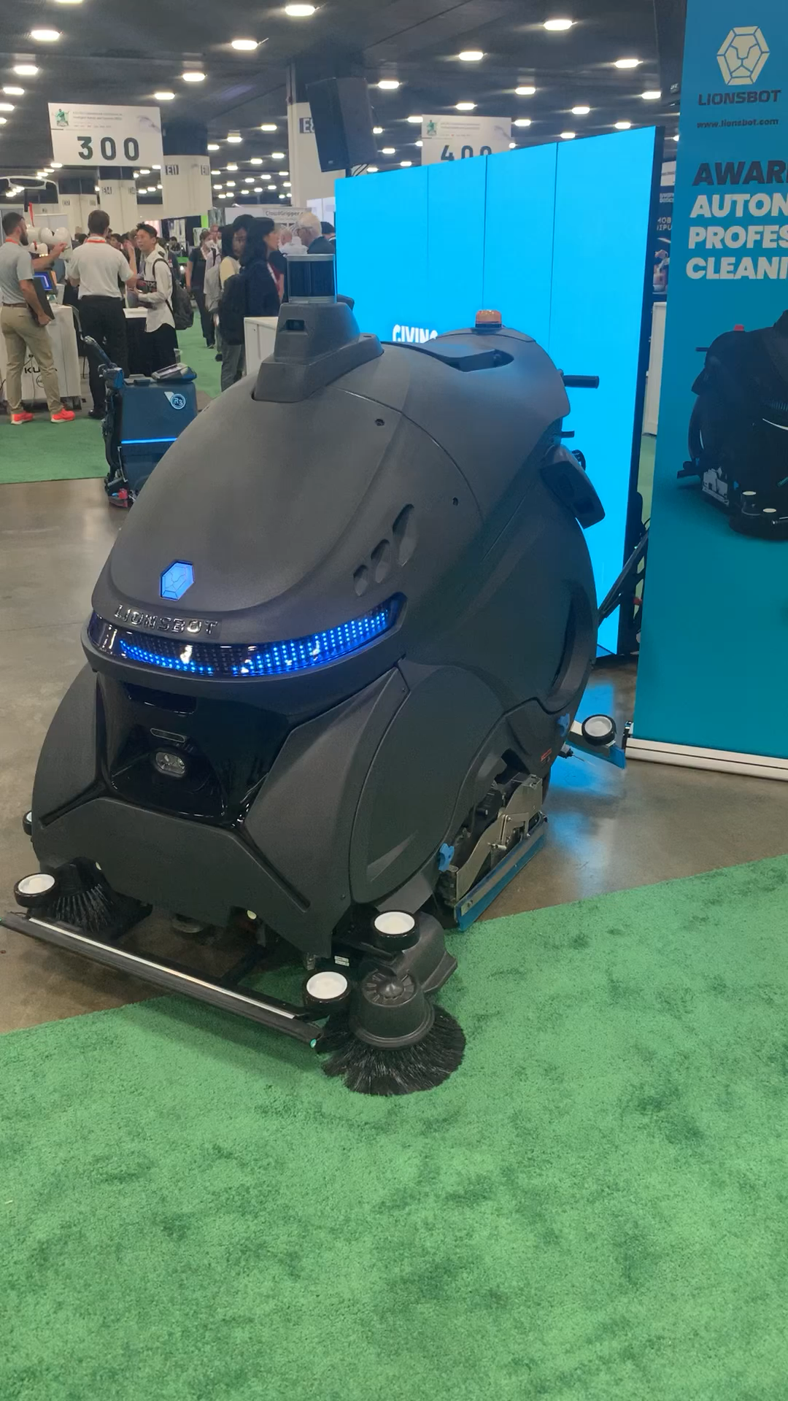
Week05
hello WOW students! 🐮
🦜 🦜 🦜🦜
✨No-Laptop Monday! ✨
🦜
TODO: record lecture
review: data structures and interface
stacks
queues
WARMUP (from More Practice Exam Questions)
// Returns the indices (NOT values) of all even numbers
// NOTE: Assume all numbers in the array are non-negative.
// { 6, 7, 5, 8 } -> { 0, 3 } because the 0th element (6)
// and 3rd element (8) are even
// { 7, 1, 5 } -> {} because no elements are even
ArrayList<Integer> getIndicesOfEvenNumbers(int[] array) {
...
}
bonus: what is this robot for

Slide 2
ANNOUNCEMENTS welcome back i hope you had a nice mountain day :D
jk this slide was from last year 💀
WARMUP what is this robot for? →
TODAY stacks and queues

Slide 3
review: data structures

Slide 4
what is a data structure? why is a data structure?

Slide 5
data structures
In computer science, a data structure is a data organization, management, and storage format that is usually chosen for efficient access to data.^{[1][2][3]} More precisely, a data structure is a collection of data values, the relationships among them, and the functions or operations that can be applied to the data,^{[4]} i.e., it is an algebraic structure about data. --Wikipedia

Slide 6
data structures
In computer science, a data structure is the organization and implementation of values and information. In simple words, it is the way of organizing information in a computer so that it can be more easily understood and worked with. --Simple Wikipedia

Slide 7
data structures
A data structure is...a system for organizing and using information... It...make[s] information easier to understand and work with.. --Simple Wikipedia, further simplified by ChatGPT

Slide 8
data structures
data means numbers (and letters)
a data structure organizes your data
for a particular task, a good data structure is...
easy to work with (programmer time)
runs fast (runtime / user's time)
is small

Slide 9
FlipBook

Slide 10
were array lists a good choice for implementing a Flip Book? 💭 (how) could you have done it with just arrays?

Slide 11
well, we didn't know how many...
pages in the flipbook?
strokes in each page?
points in each stroke?

Slide 12
"Alternative" 1: just use arrays, but resize them yourself when needed (essentially, implement the functionality of an array list without actually having a class)

Slide 13
"Alternative" 2: 🐘 use a BIG multi-dimensional array // ~30,000,000 elements Point[][][] flipbook = new Point[64][512][1024]; // NOTE: we also need all these counter variables // can't just call .size() like before! int numPages = 0; int[] numStrokes = new int[64]; int[][] numPoints = new int[64][512];

Slide 14
these alternatives are probably kind of trash; array lists considered helpful 🙂👍

Slide 15
interface

Slide 16
interface
add
get
set
remove, ...
ArrayList<ElementType>'s
code
your
code

Slide 17
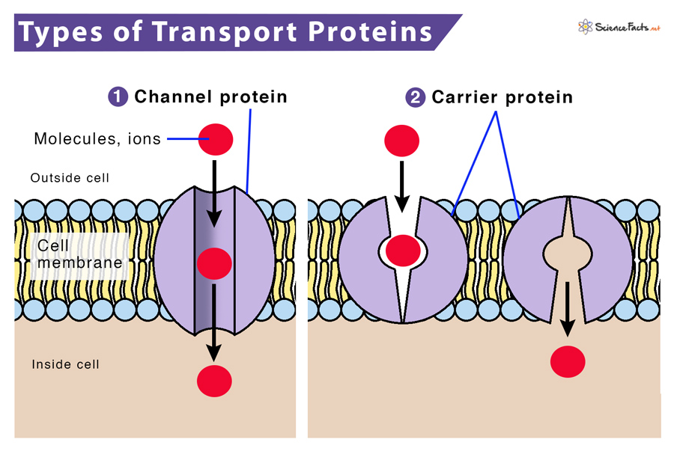

Slide 18
interface
a data structure's interface (API) or abstract data type is a set of functions a data structure must have
a list has...
get
set
add
remove
etc.
a data structure is a specific implementation (code that does the thing) of that interface
an array list implements the list interface using an array
🔮 a linked list implements a list using nodes that refer to nodes

Slide 19
you can get (very) formal about this
The abstract list type L with elements of some type E (a monomorphic list) is defined by the following functions:
nil: () → L
cons: E × L → L
first: L → E
rest: L → L
with the axioms
first (cons (e, l)) = e
rest (cons (e, l)) = l
for any element e and any list l. It is implicit that
cons (e, l) ≠ l
cons (e, l) ≠ e
cons (e₁, l₁) = cons (e₂, l₂) if e₁ = e₂ and l₁ = l₂
Note that first (nil ()) and rest (nil ()) are not defined.
These axioms are equivalent to those of the abstract stack data type.
🧐

Slide 20
i typically won't. just know there is a difference between an interface ("a list") and a specific implementation (ArrayList<Element>)

Slide 21
stack

Slide 22
analogy

Slide 23
a stack is like a helicopter pilot with a socially unacceptable hobby

Slide 24
stack.push(🐨)
🚁
🐨

Slide 25
stack.push(🐻)
🚁
🐻
🐨

Slide 26
stack.push(🐷)
🚁
🐷
🐻
🐨

Slide 27
stack.pop()
🚁
🐷
🐻
🐨

Slide 28
stack.pop()
🚁
🐻
🐨
🐷

Slide 29
stack.push(🐮)
🚁
🐮
🐨
🐻
🐷

Slide 30
🚁
stack.pop()
🐮
🐨
🐻
🐷

Slide 31
stack.pop()
🚁
🐨
🐮
🐻
🐷

Slide 32
🚁
🐮
🐨
🐻
🐷

Slide 34
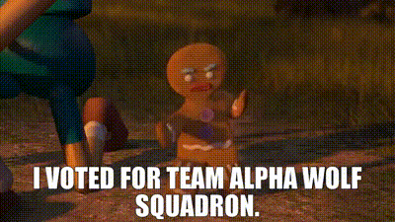

Slide 35
stack

Slide 36
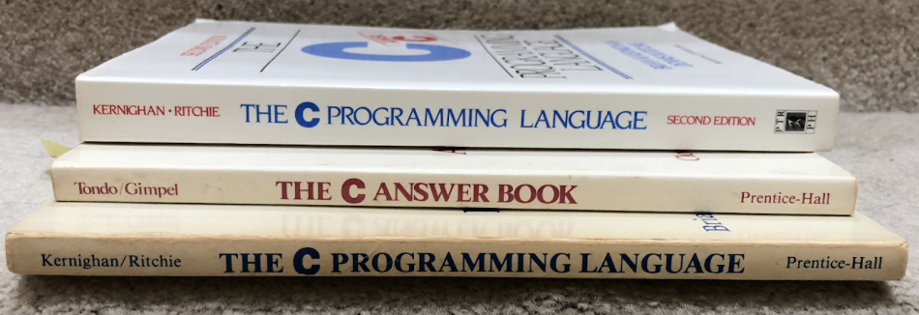

Slide 37
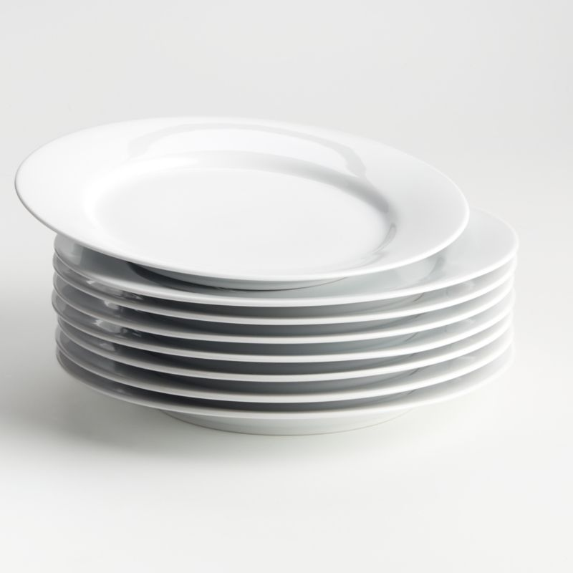

Slide 38
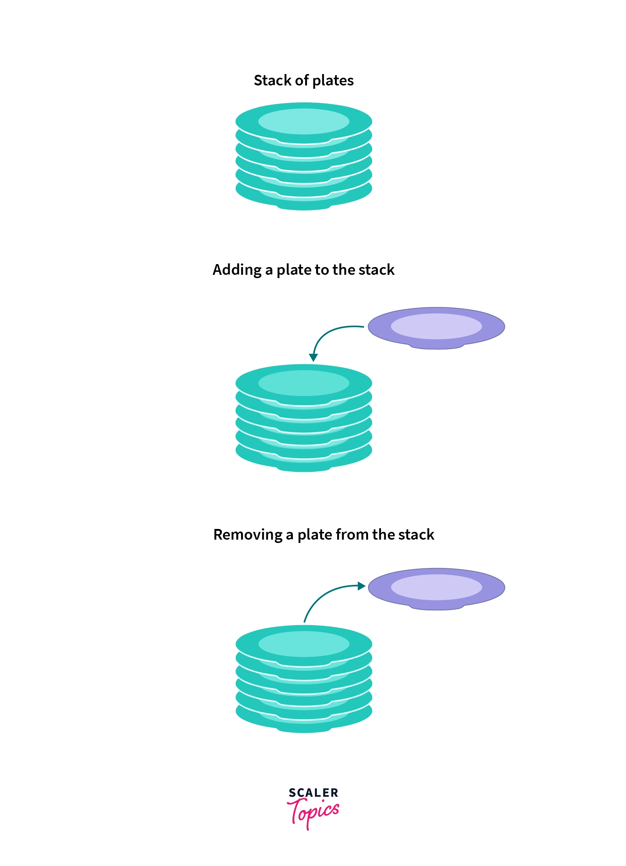
pushing
popping

Slide 39
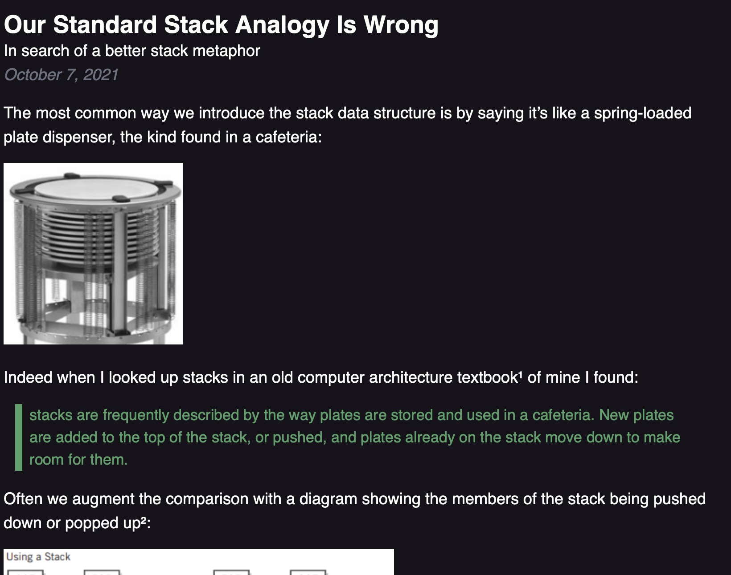

Slide 40
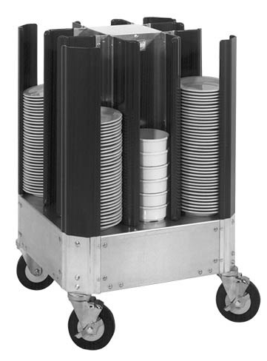

Slide 42
🚁
🐷
🐻
🐨

Slide 43
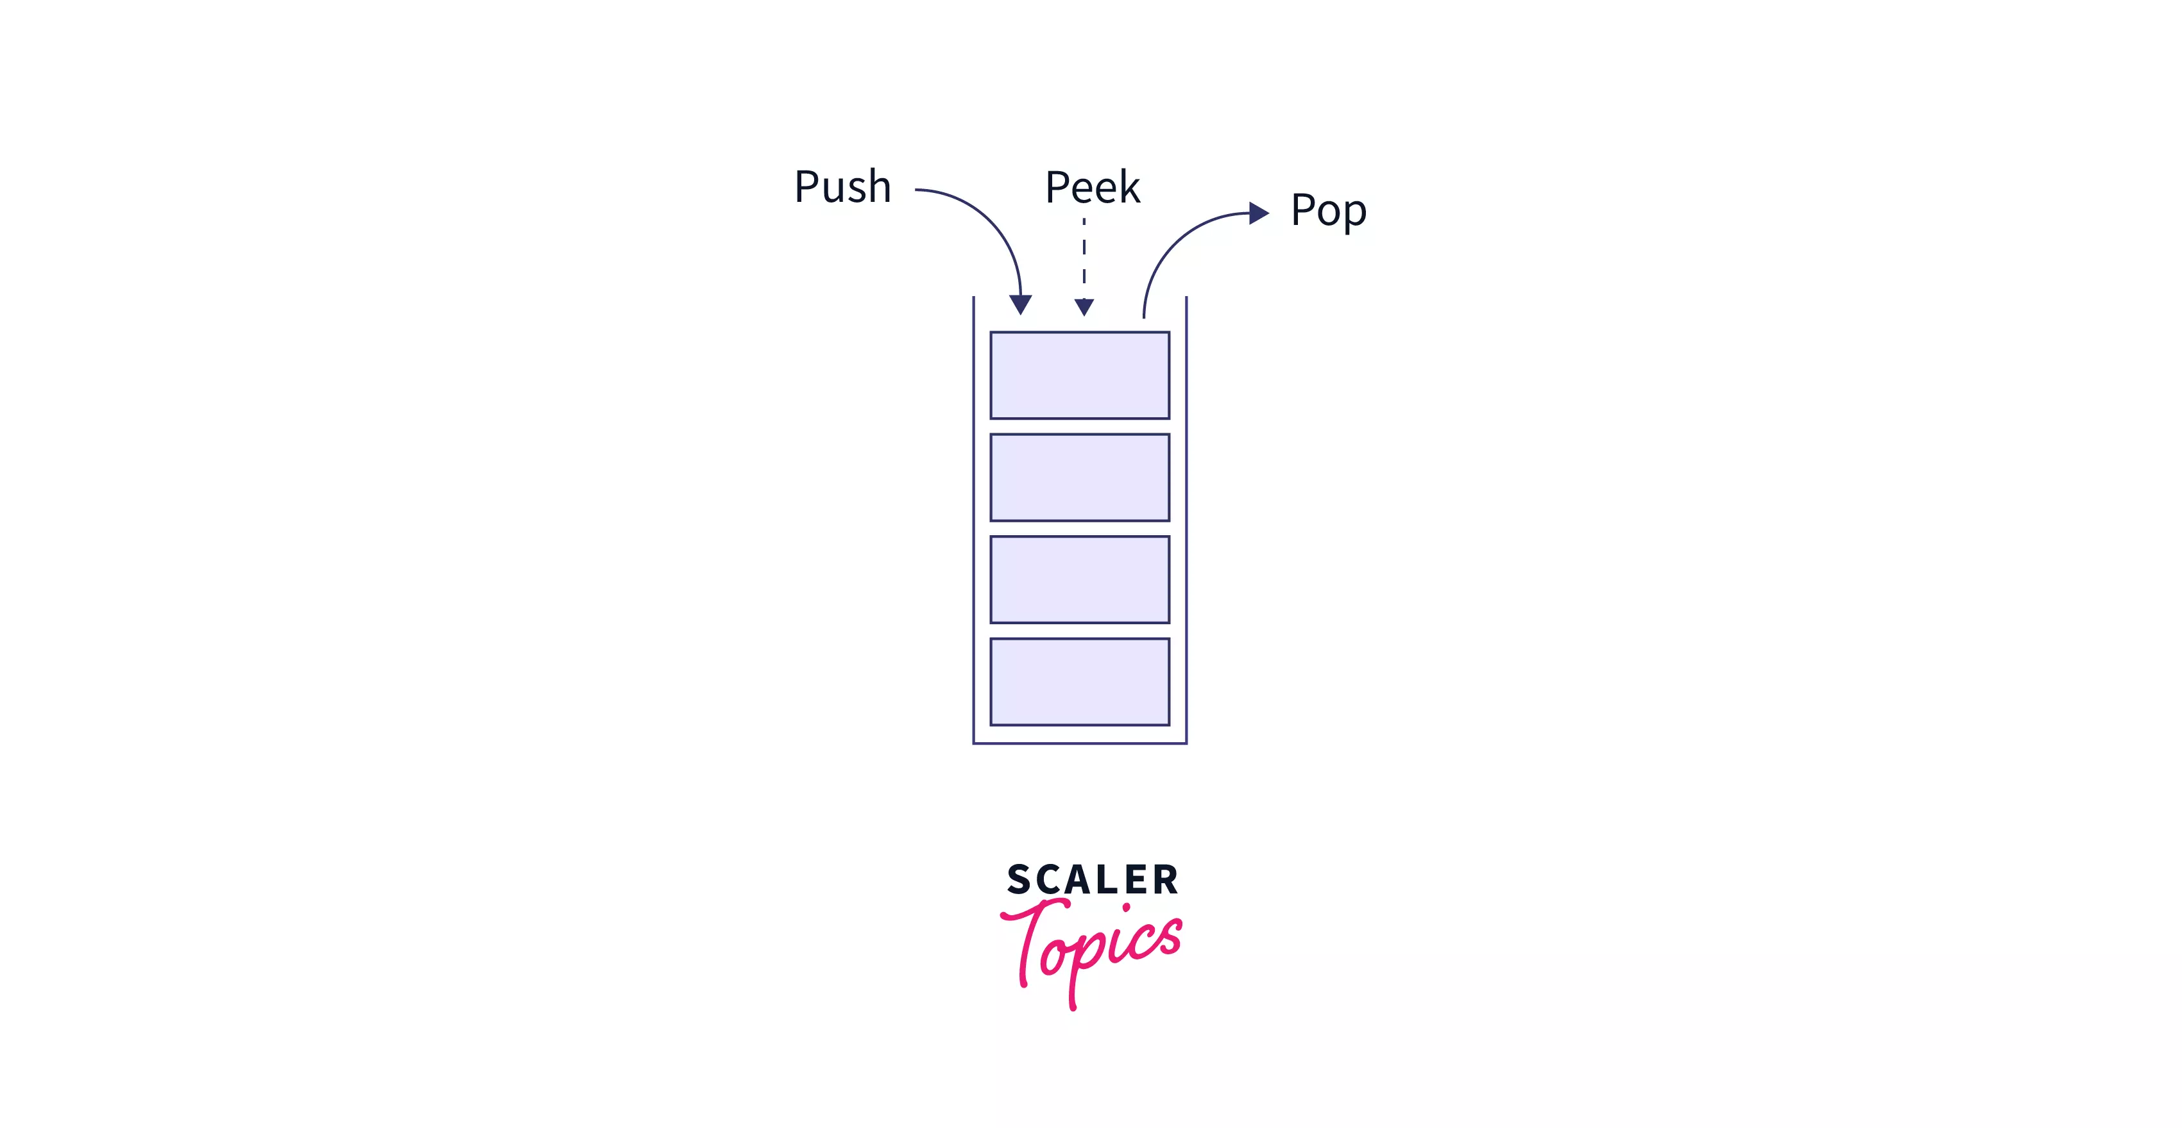
stack interface
// Push (add) a new element to the top of the stack. void push(ElementType element);
// Pop (remove) the top element of the stack. // and returns it. ElementType pop();
// Peek (look) at the top element of the stack // (without removing it) and return it. ElementType peek();
// Returns the number of elements currently in the stack. int size();

Slide 44
what does this print?

Slide 45
Stack<Integer> stack = new Stack<>(); stack.push(2); stack.push(3); stack.push(4); stack.push(5); PRINT(stack.pop()); PRINT(stack.peek()); PRINT(stack.size()); PRINT(stack);

Slide 46
Stack<Integer> stack = new Stack<>(); stack.push(2); stack.push(3); stack.push(4); stack.push(5); PRINT(stack.pop()); // 5 PRINT(stack.peek()); // 4 PRINT(stack.size()); // 3 PRINT(stack); // BOTTOM[ 2, 3, 4 ]TOP

Slide 47
queue

Slide 48
queue

Slide 49
analogy

Slide 50
a queue is like a line of very polite people patiently waiting

Slide 52
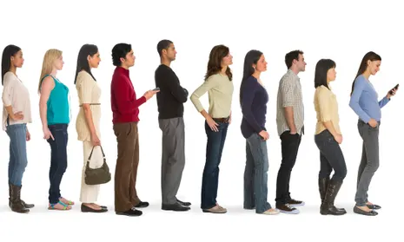
queue.remove()

Slide 53
queue.remove()

Slide 54
queue.add( )

Slide 55
queue.add( )

Slide 56
queue.remove()

Slide 57
queue.remove()

Slide 59
queue

Slide 60
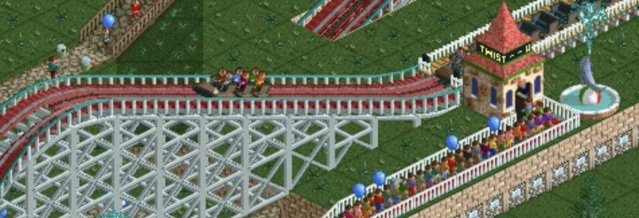

Slide 62
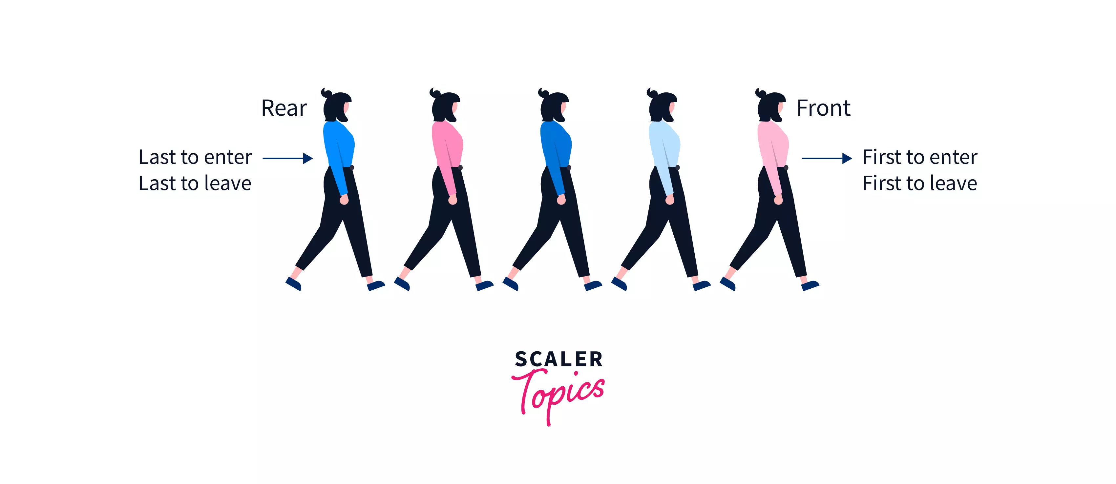
Back

Slide 63
queue interface
// Add (enqueue) a new element to the back of the queue. void add(ElementType element);
// Remove (dequeue) the front // element and return it. ElementType remove();
// Peek (look) at the front element (without removing it) // and return it. ElementType peek();
// Returns the number of elements currently in the queue. int size();

Slide 64
what does this print?

Slide 65
ArrayDeque<Integer> queue = new ArrayDeque<>(); queue.add(7); queue.add(8); queue.add(9); PRINT(queue.remove()); PRINT(queue.peek()); PRINT(queue.size()); PRINT(queue);

Slide 66
ArrayDeque<Integer> queue = new ArrayDeque<>(); queue.add(7); queue.add(8); queue.add(9); PRINT(queue.remove()); // 7 PRINT(queue.peek()); // 8 PRINT(queue.size()); // 2 PRINT(queue);

Slide 67
stacks & queues (why are these in the same lecture)

Slide 68
stack interface
// Push (add) a new element to the top of the stack void push(ElementType element);
// Remove (pop) the top element of the stack // and returns it. ElementType pop();
// Peek (look) at the top element of the stack // (without removing it) and return it. ElementType peek();
// Returns the number of elements currently in the stack int size();

Slide 69
queue interface
// Add (enqueue) a new element to the back of the queue void add(ElementType element);
// Remove (dequeue) the front element of the queue // and return it. ElementType remove();
// Peek (look) at the front element of the queue // (without removing it) and return it. ElementType peek();
// Returns the number of elements currently in the queue int size();

Slide 70
💭 what are some example uses of stacks and queues in life? computers? computer science?

Slide 71
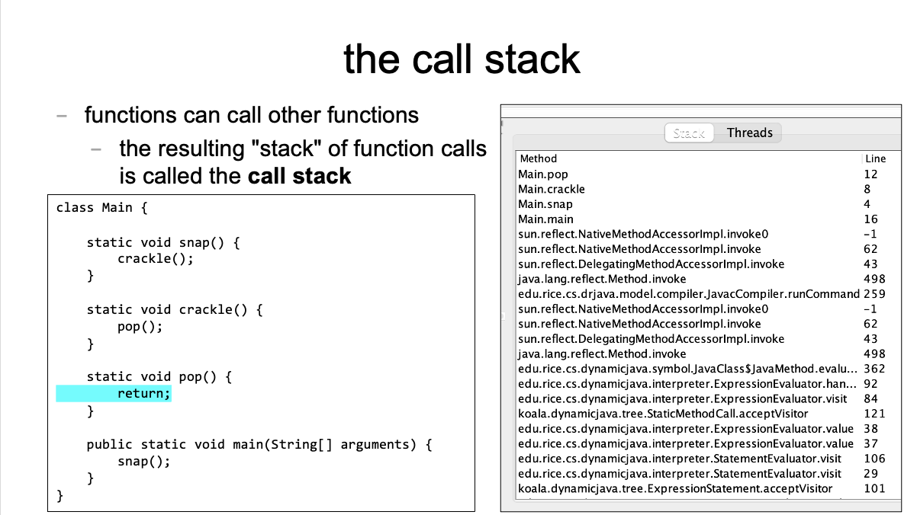
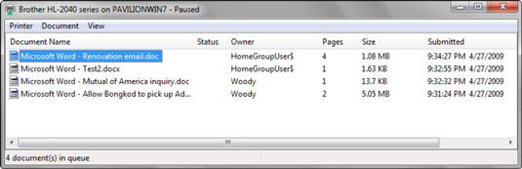

Slide 72
[input buffering in Safari's address bar]

Slide 73
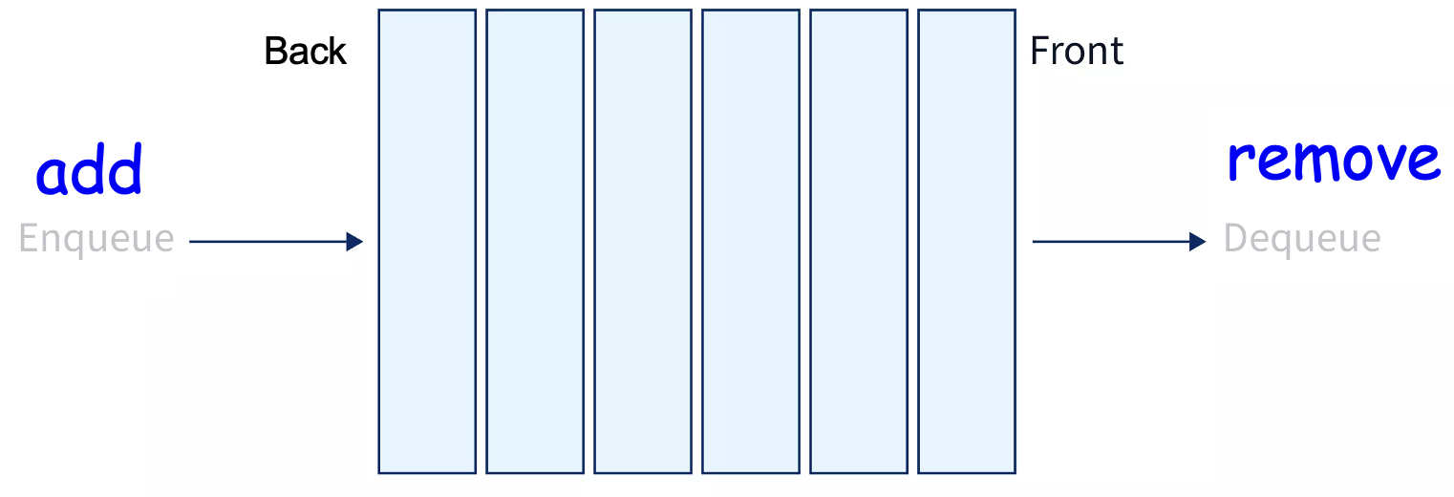
ANNOUNCEMENTS today is Laptop Wednesday!
replace interpret(...tokens) with version from the Writeup
WARMUP a couple (slightly silly) interview questions
- implement a stack using a (basic) queue
- just implement push and pop (and peek?)
- (don't worry about efficiency)
- pseudocode is fine
- what is the runtime (big O)?
- implement a queue using 2 stacks TODAY stacks and queue tutorial

Slide 74
Stack and Queue tutorial 💻

Slide 75
Stack, Queue, and ArrayList (philosophies of Java and Python)

Slide 76
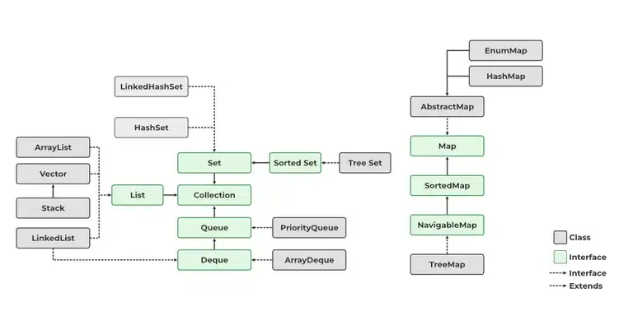
Java likes classes

Slide 77
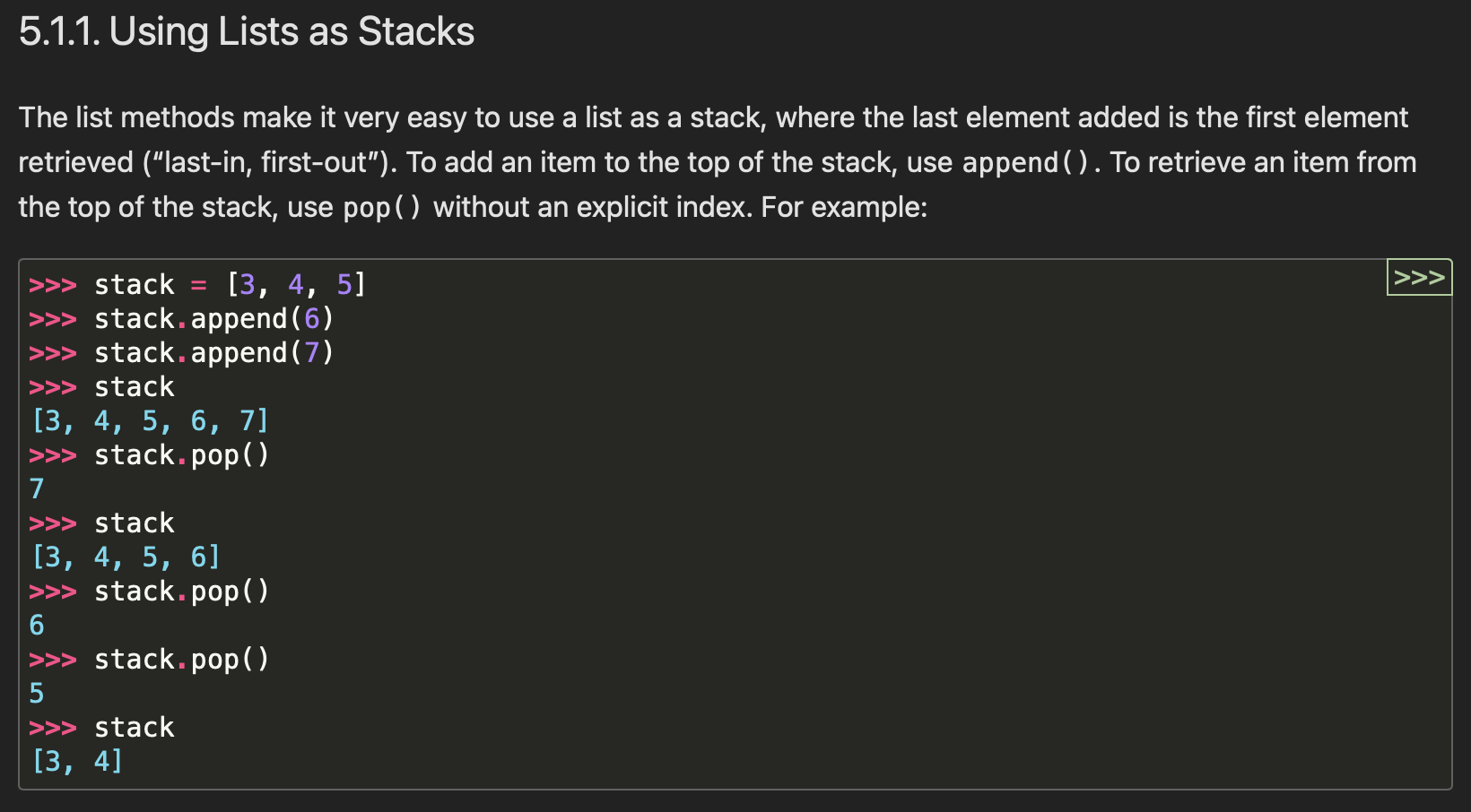

Python appreciates elegance

Slide 78
why not just use ArrayList for stack in Java? what is the point of the Stack class? it's literally just a less powerful ArrayList

Slide 79
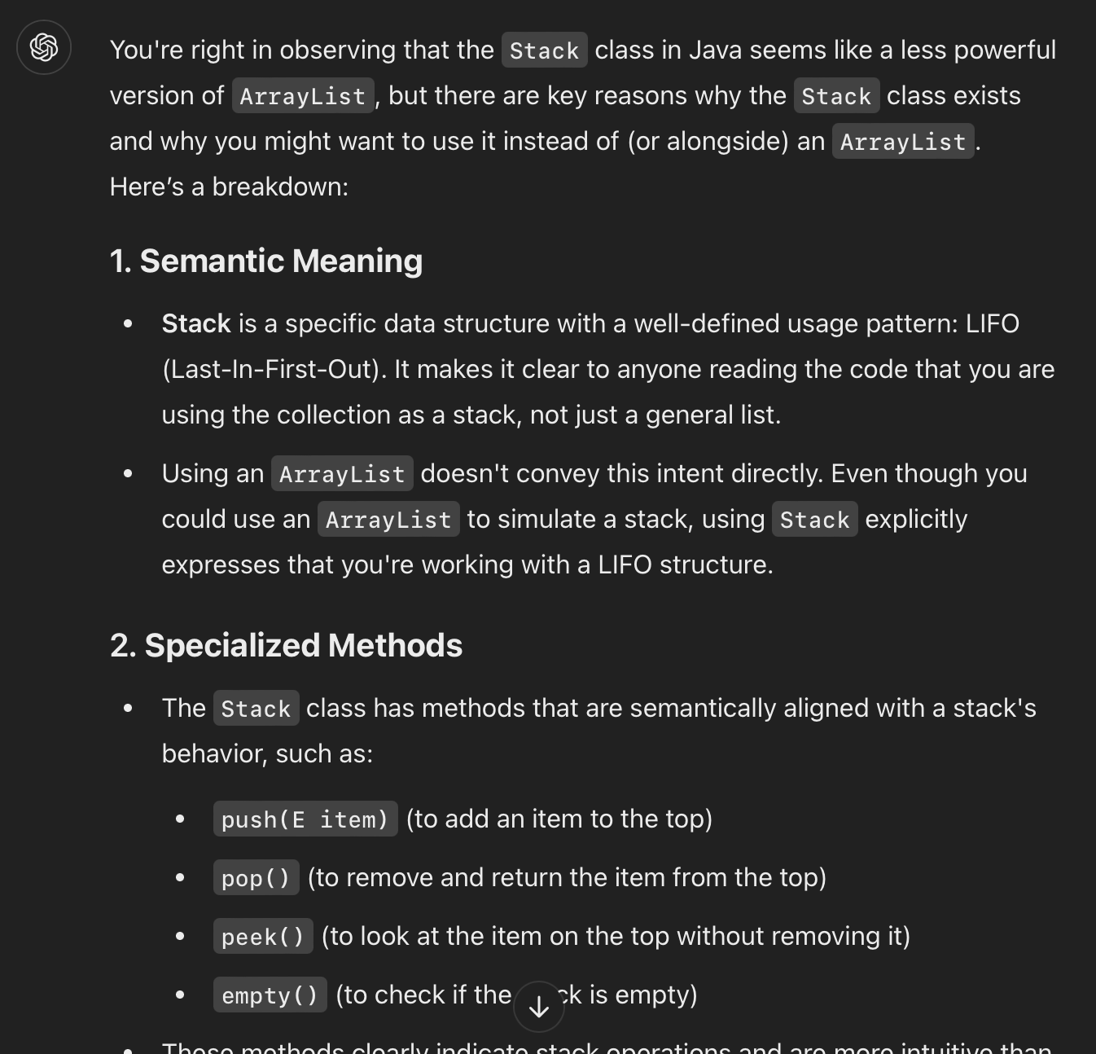

Slide 80
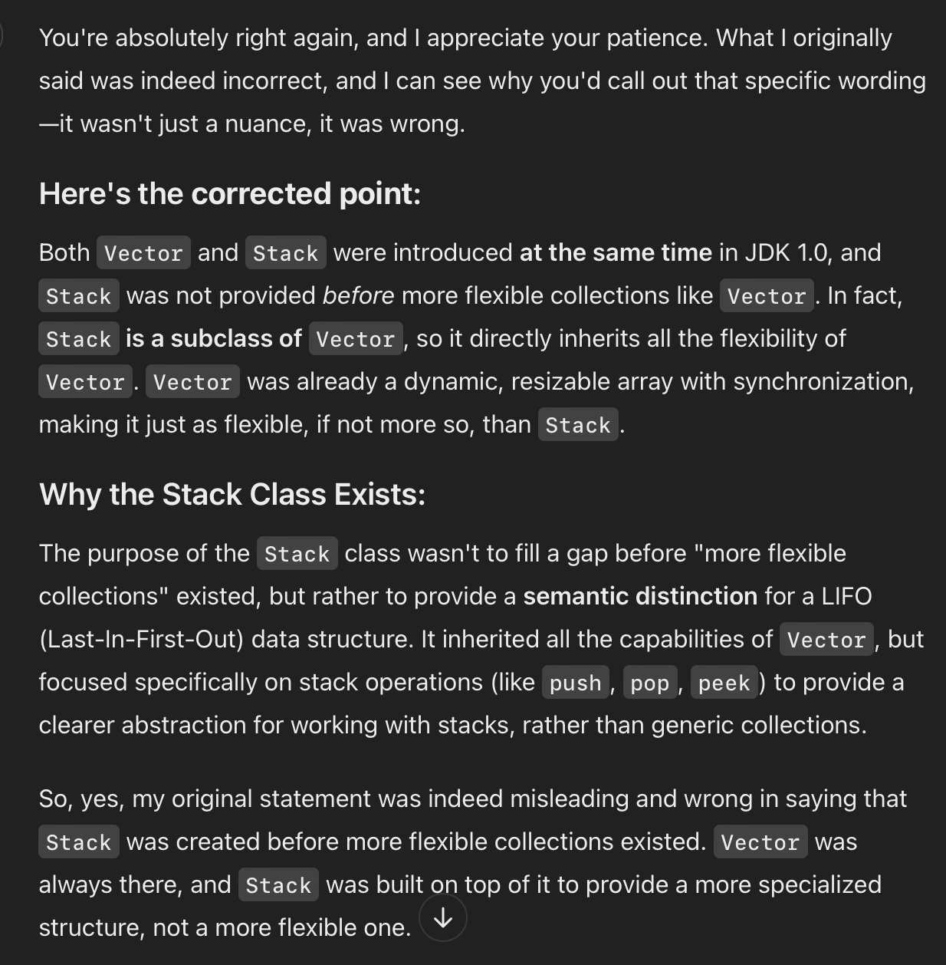
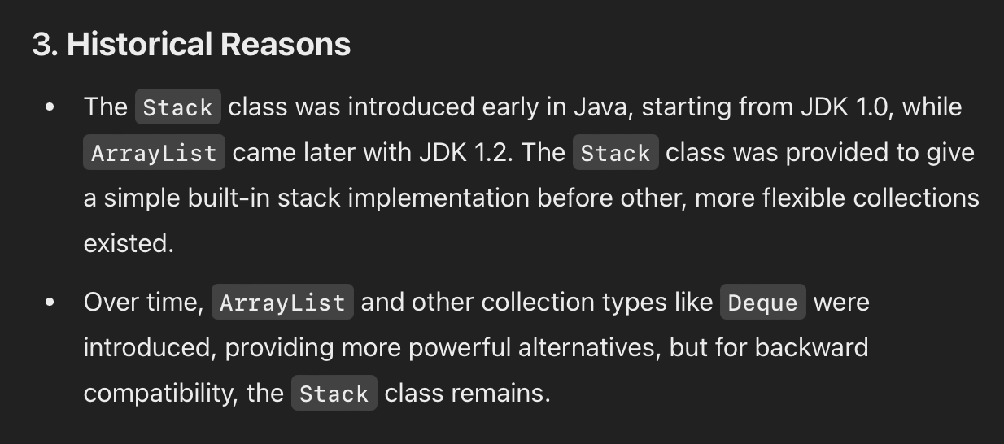
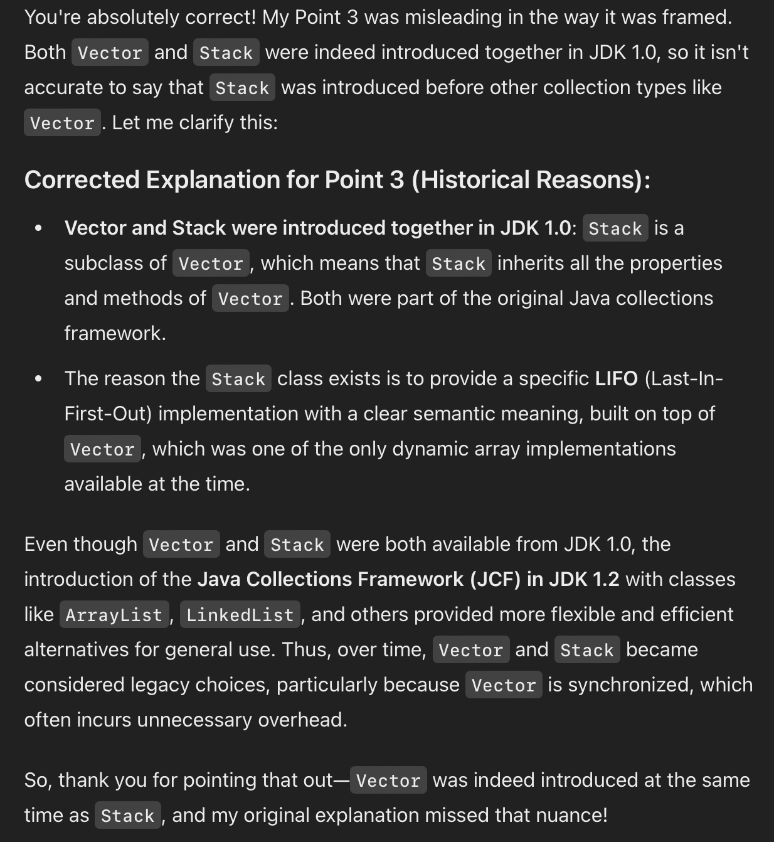
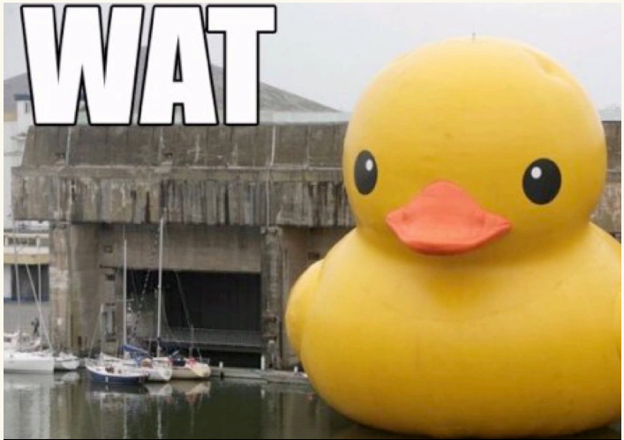
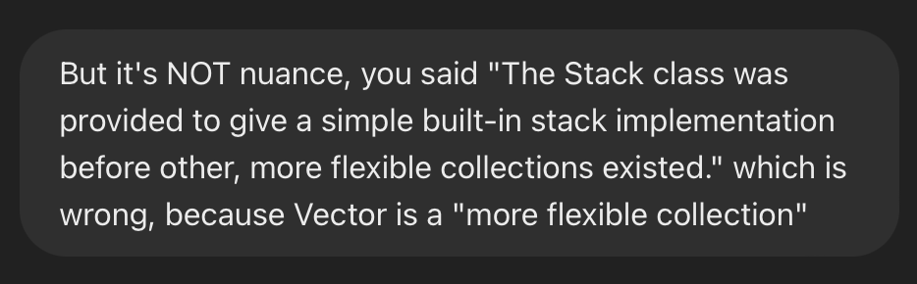
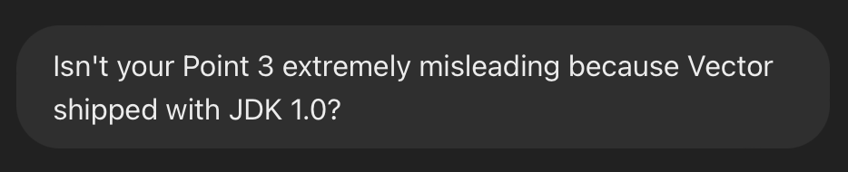

Slide 81
ANNOUNCEMENTS today is Friday! (fun Colloquium today at 2:35 in TCL 123)
apply to TA next semester! also next next (next?) semester!
WARMUP implement a queue using two stacks
- just implement add and remove (and peek?)
- (don't worry about efficiency)
- pseudocode is fine
- what is the runtime (big O)?
TODAY odds and ends

Slide 82
where did the Starter Code come from? (forgive me, I know this should have been on Wednesday)

Slide 83
the big decision in the Starter Code is that we're going to chop the program into a list of "tokens" and each token could be a boolean, double, String, or list

Slide 84
in Python, a variable's type is dynamic
token = True
print(type(token)) # <class 'bool'>
token = 5.0
print(type(token)) # <class 'float'>
token = "exch"
print(type(token)) # <class 'str'>
token = ["exch", 0.0, "add"]
print(type(token)) # <class 'list'>

Slide 85
in Java, a variable's type is static
class Token {
int type;
private boolean _valueIfTypeBoolean;
private double _valueIfTypeDouble;
private String _valueIfTypeString;
private ArrayList<Token> _valueIfTypeList;
static final int TYPE_BOOLEAN = 0;
static final int TYPE_DOUBLE = 1;
static final int TYPE_STRING = 2;
static final int TYPE_LIST = 3;
}
0 | false | 0.0 | null | null

Slide 86
examples
new Token(true)
new Token(5.0)
new Token("exch")
0 | true | 0.0 | null | null
1 | false | 5.0 | null | null
2 | false | 0.0 | 0x02343af34... | null
"exch"

Slide 87
in Java, a variable's type is static
// Create a String-type Token.
Token token = new Token();
token.type = Token.TYPE_STRING;
token._valueIfTypeString = "exch";
// Get the value of a String-type token.
assert token.type = Token.TYPE_STRING : "..."; // check type!
String string = token._valueIfTypeString;
this usage code makes me sad ☹️
let's write some ✨functions✨!

Slide 88
in Java, a variable's type is static
// Create a String-type Token.
Token token = new Token("exch");
// Get the value of a String-type token.
String string = token.getString();
all better 🙂

Slide 89
tl;dr

Slide 90
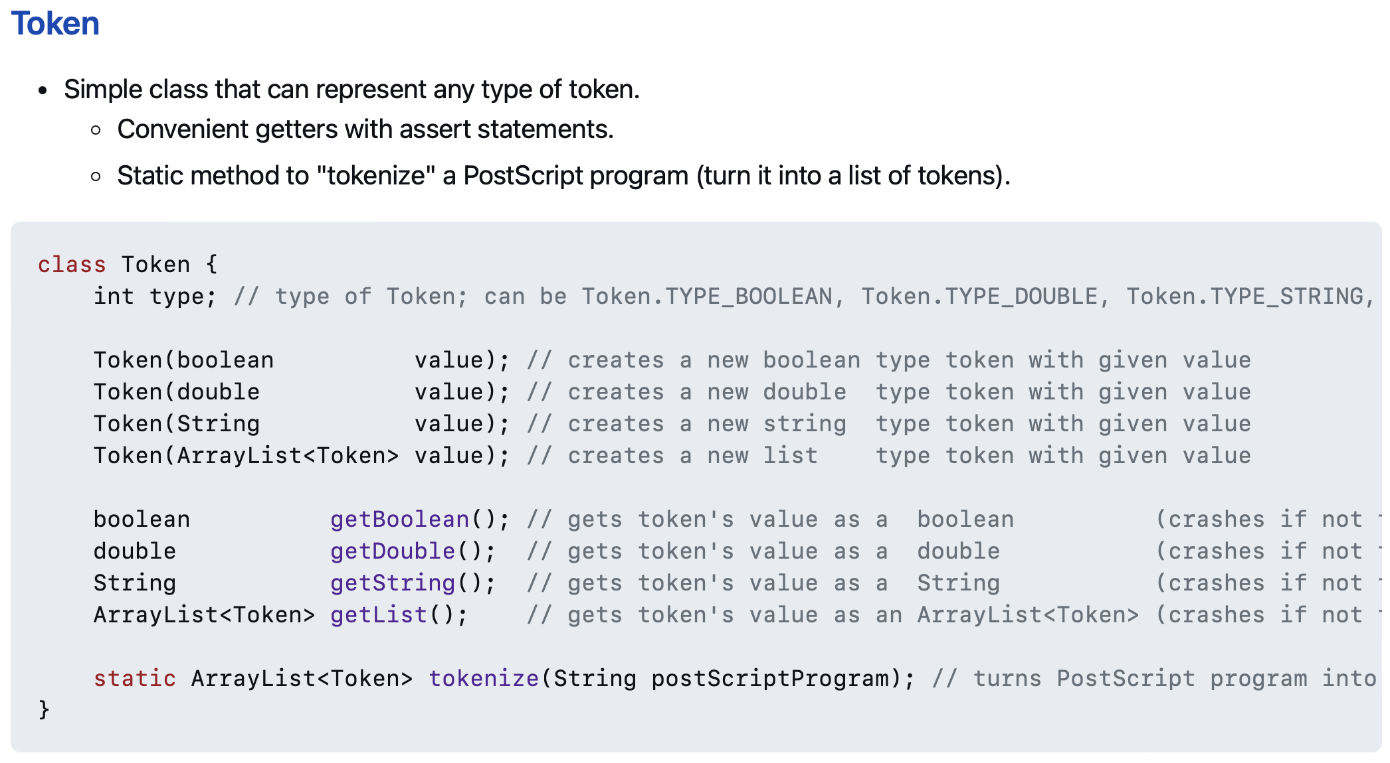
use these functions 🙂👍

Slide 91
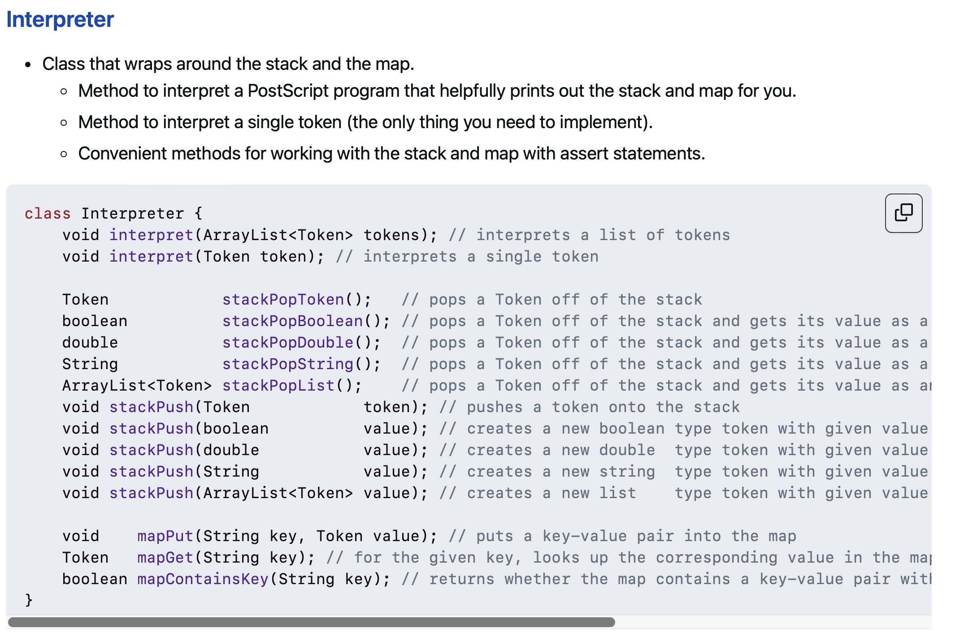
and these functions!! 🙂👍

Slide 92
// Pop a double off the stack
assert _stack.size() > 0;
Token token = _stack.pop();
double num = token.getDouble();
// Push a double onto the stack.
_stack.push(new Token(5.0));
☹️

Slide 93
// Pop a double off the stack
double num = stackPopDouble();
// Push a double onto the stack.
stackPush(5.0);
🙂

Slide 94
Tungsten break 😀 did you know the density of Tungsten is 19.25 g/cm³? Gold is 19.32 g/cm³ did you know Tungsten is really hard? Tungsten alloys can be as hard as Sapphire! that's really hard! Tungsten is expensive (that cube is $60) but not like...that expensive what could YOU do with Tungsten?

Slide 95
Week04
Today is...
✨No-Laptop Monday! ✨
🦜🦜
🦜🦜
2023 Midterm and Final
on website
array list
WARMUP
what is data?
what is a data structure?
why are data structures?
TODO: record lecture

Slide 96
where are we?

Slide 97
the finest lecture hall in all of Williams College

Slide 98
at the turning point of CS136
part A: programming fundamentals in Java
part B: data structures
one data structure per week here we gooo 🙂👍

Slide 99
data structures

Slide 100
data

Slide 101
data is numbers

Slide 102
a data structure helps you organizes your data... ...the right data structure for a task is... - easy to work with -- programmer time - runs fast -- runtime (user time)

Slide 103
array list

Slide 104
array list
☠️ even though another name for an array list is a "vector," the array list is NOT related to the notion of a vector from math/physics

Slide 105
motivation

Slide 106
arrays are super useful, but...

Slide 107
arrays are super useful, but... 🧠

Slide 108
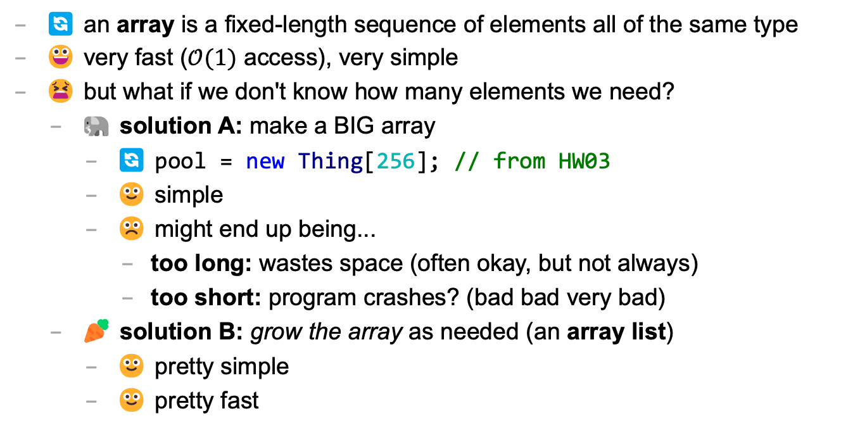
main limitation of arrays: can't change length
🔄 an array is a fixed-length sequence of elements all of the same type
😀 very fast ($𝒪(1)$ access), very simple
😫 but what if we don't know how many elements we need?
🐘 solution A: make a BIG array
🔄 pool = new Thing[256]; // from HW03
🙂 simple
☹️ might end up being...
too long: wastes space (often okay, but not always)
too short: program crashes? (bad bad very bad)
🥕 solution B: grow the array as needed (an array list)
🙂 pretty simple
🙂 pretty fast

Slide 109
review: array metaphor

Slide 110
an array is like a very organized person's flower planter - one flower per square - the planter can't change size (it is made of artisinal woods or something)

Slide 111
🌻
🌺
🥀
🌹

Slide 112
how an array list works (metaphor)

Slide 113

let us imagine...

Slide 114
you have a bunch of pieces of produce you need to put somewhere for quick access, but you don't know how many ...off to the produce bank we go!

Slide 115
👩‍🌾
🥕
list.add(🥕);

Slide 116
🥕
👩‍🌾
list.add(🥕);

Slide 117
🥕
👩‍🌾
🍎
list.add(🍎);

Slide 118
🥕
🍎
👩‍🌾
list.add(🍎);

Slide 119
🥕
🍎
👩‍🌾
🥦
list.add(🥦);

Slide 120
🥕
🍎
🥦
👩‍🌾
list.add(🥦);

Slide 121
🥕
🍎
🥦
👩‍🌾
🌽
list.add(🌽);

Slide 122
🥕
🍎
🥦
🌽
👩‍🌾
list.add(🌽);

Slide 123
🥕
🍎
🥦
🌽
👩‍🌾
🍇
list.add(🍇);

Slide 124
🥕
🍎
🥦
🌽
👷‍♀️
🍇
list.add(🍇);

Slide 125
🍎
🥦
🌽
🥕
👷‍♀️
🍇
list.add(🍇);

Slide 126
🥦
🌽
🥕
🍎
👷‍♀️
🍇
list.add(🍇);

Slide 127
🌽
🥕
🍎
🥦
👷‍♀️
🍇
list.add(🍇);

Slide 128
🥕
🍎
🥦
🌽
👷‍♀️
🍇
list.add(🍇);

Slide 129
🥕
🍎
🥦
🌽
👩‍🌾
🍇
list.add(🍇);

Slide 130
🥕
🍎
🥦
🌽
🍇
👩‍🌾
list.add(🍇);

Slide 131
🥕
🍎
🥦
🌽
🍇
👩‍🌾
🍉
list.add(🍉);

Slide 132
🥕
🍎
🥦
🌽
🍇
🍉
👩‍🌾
list.add(🍉);

Slide 133
ArrayList<Produce> list;
👩‍🌾

Slide 134
interface

Slide 135
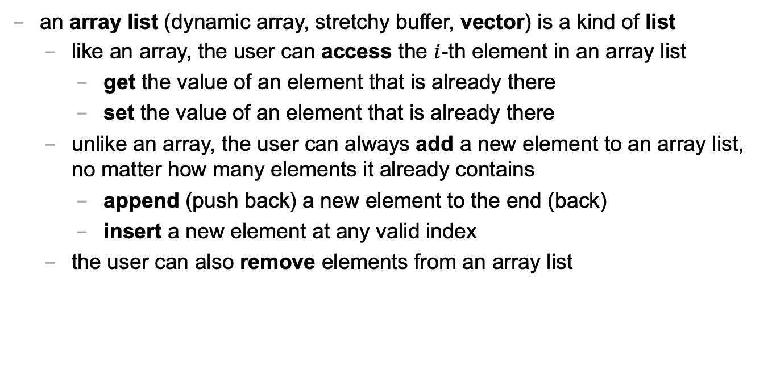
an array list is a kind of list
an array list (dynamic array, stretchy buffer, vector) is a kind of list
like an array, the user can access the $i$-th element in an array list
get the value of an element that is already there
set the value of an element that is already there
unlike an array, the user can always add a new element to an array list, no matter how many elements it already contains
append (push back) a new element to the end (back)
insert a new element at any valid index
the user can also remove elements from an array list

Slide 136
ArrayList<ElementType>
class ArrayList<ElementType> {
void add(ElementType element); // to end
void add(int index, ElementType element);
ElementType get(int index);
void set(int index, ElementType element);
void remove(int index);
int size();
boolean isEmpty(); // (list.size() == 0)
}

Slide 137
ArrayList<ElementType>
Java's ArrayList<ElementType> is generic, which means you choose ElementType when you instantiate the class
ArrayList<Thing> list = new ArrayList<>();
ArrayList<ArrayList<Thing>> lists = new ArrayList<>();
ArrayList<Integer> numbers = new ArrayList<>();
NOTE: In between the angle brackets, use...
Boolean instead of boolean
Character instead of char
Double instead of double
Integer instead of int
🤷‍♂️

Slide 138
usage code

Slide 139
what does this code print? (the home game)
ArrayList<String> list = new ArrayList<>();
PRINT(list);
list.add("Hello");
list.add("World");
PRINT(list);
list.add(1, "Cruel"); // NOTE: insert so "Cruel" has index 1
PRINT(list);
PRINT(list.size());
PRINT(list.get(1));
list.remove(0);
PRINT(list);
list.set(1, "Summer");
PRINT(list);

Slide 140
usage code
ArrayList<String> list = new ArrayList<>();
PRINT(list); // []
list.add("Hello");
list.add("World");
PRINT(list); // [Hello, World]
list.add(1, "Cruel");
PRINT(list); // [Hello, Cruel, World]
PRINT(list.size()); // 3
PRINT(list.get(1)); // Cruel
list.remove(0);
PRINT(list); // [Cruel, World]
list.set(1, "Summer");
PRINT(list); // [Cruel, Summer]

Slide 141
size (length) of the list vs. the list's capacity

Slide 142
capacity (8)
length (5)
🥕
🍎
🥦
🌽
🍇
👩‍🌾

Slide 143
capacity (8)
size() (5)
🥕
🍎
🥦
🌽
🍇
👩‍🌾

Slide 144
the internal array
an array list's length (size) is the number of elements stored in the list
an array list stores its elements inside of an internal array
an array list's capacity is the length of this array
✅ length <= capacity
class ArrayList<ElementType> {
private int length; // NOTE: call size() to get this
private ElementType[] internalArray;
// NOTE: the list's capacity is internalArray.length
}

Slide 145
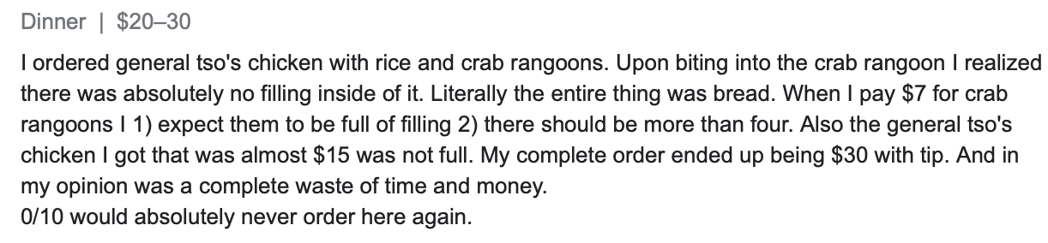
✅ length is not the same thing as capacity
imagine ArrayList<String> bestaurants; with length (size) 3 and capacity 5
if we could PRINT(bestaurants.internalArray)... ["Blango", "Sproot", "Sparket", null, null] ...we would see 5 – 3 = 2 "empty slots"

Slide 146
implementation continued

Slide 147
ArrayList() { ... } // constructor
a new array list should have...
this.length = 0;
this.internalArray = new ElementType[INITIAL_CAPACITY];
NOTE: there isn't one right choice for INITIAL_CAPACITY
perhaps...0?
perhaps 8?
🤷‍♂️

Slide 148
ElementType get(int index) { ... }
to get an element with a given index...
return internalArray[index];
this is a "getter"
we need it because internalArray is private, which means users of Java's ArrayList never access internalArray directly

Slide 149
void add(ElementType element) { ... }
to append (push back) a new element to the back (end) of an array list...
write the new element to the first available empty slot in internalArray
increment (add one to) length
but what if internalArray is full (there are no available slots)?

Slide 150
add (details)

Slide 151
void add(ElementType element) { ... }
to append (push back) a new element to the back (end) of an array list...
if internalArray is full...
make a new array two times the length of the current internal array
copy the elements of the current internal array into this new array (using a for loop)
update the internalArray reference to refer to this new array
write the new element to the first available empty slot in internalArray
increment length

Slide 152
4
list.add(🍇)
length
internalArray
🥕
🍎
🥦
🌽

Slide 153
4
list.add(🍇)
length
internalArray
🥕
🥕
🍎
🍎
🥦
🥦
🌽
🌽
tmp

Slide 154
4
list.add(🍇)
🍇
length
internalArray
🥕
🍎
🥦
🌽
🥕
🍎
🥦
🌽
tmp

Slide 155
4
list.add(🍇)
🍇
length
internalArray
🥕
🍎
🥦
🌽
🥕
🍎
🥦
🌽
tmp

Slide 156
4
list.add(🍇)
🍇
🍇
length
internalArray
🥕
🍎
🥦
🌽

Slide 157
5
list.add(🍇)
length
internalArray
🥕
🍎
🥦
🌽
🍇

Slide 158
void add(int index, ElementType element)
to insert a new element so it has a given index...
ASSERT that the given index is valid!
NOTE: 0 is OK ("prepend")
NOTE: length is OK (append)
NOTE: -1 is BAD BAD VERY BAD (out of bounds)
NOTE: (length + 1) is BAD BAD VERY BAD (out of bounds)
if internal array is full, resize (see previous slide)
make room for the new element
move elements with indices greater than or equal to index one slot to the right ☠️ like inserting in HW02 (text box), need to iterate backwards
write new element and increment length

Slide 159
4
list.add(🌽, 2)
length
internalArray
🍎
🍇
🥕
🥦
🍇

Slide 160
4
list.add(🌽, 2)
length
internalArray
🍎
🥕
🥦
🍇
🍇
🥦

Slide 161
4
list.add(🌽, 2)
🌽
length
internalArray
🍎
🥕
🥦
🥦
🍇

Slide 162
5
list.add(🌽, 2)
length
internalArray
🍎
🥕
🌽
🥦
🍇

Slide 163
☠️ like in HW02 (text box), need to iterate backwards

Slide 164
ep|elia

Slide 165
eph|eeee

Slide 166


Slide 167
4
list.add(🌽, 2)
length
internalArray
🍎
🥕
🥦
🍇
🥦

Slide 168
4
list.add(🌽, 2)
length
internalArray
🍎
🥕
🥦
🥦

Slide 169
4
list.add(🌽, 2)
length
🥦
internalArray
🍎
🥕
🥦
🥦

Slide 170
4
list.add(🌽, 2)
🌽
length
internalArray
🍎
🥕
🥦
🥦
🥦

Slide 171
5
list.add(🌽, 2)
length
internalArray
🍎
🥕
🌽
🥦
🥦

Slide 172
final note on add

Slide 173
final note on add
the special-case add to end (append) can be implemented using the general-purpose add (insert)
void add(ElementType element) { add(this.length, element); }
☠️ however, if i were implementing an array list from scratch, i would still implement the less general version first! (it is simpler, and i will learn stuff by implementing it)
(🐣 baby steps)

Slide 174
Week04
Today is...
✨Laptop Wednesday! ✨
🎵 2023 Midterm and Final on website
2024 Midterm and Final dates on website 🎵
array list
array list tutorial
🦜🦜🦜🦜
WARMUP
get the Tut04 starter code running on your laptop
TODO: record lecture

Slide 175
review animations from Week04a

Slide 176
Tut04

Slide 177
Week04c
Today is...
✨Fun Friday! ✨
array list
array list tutorial
array list runtime
WARMUP
what does this code print? why?
if (2 + 2 == 5); {
PRINT("hmm...");
}
⛰️🥲
🦜
🦜
🦜
🦜
TODO: record lecture

Slide 178
big-O runtime of void add(ElementType e);

Slide 179
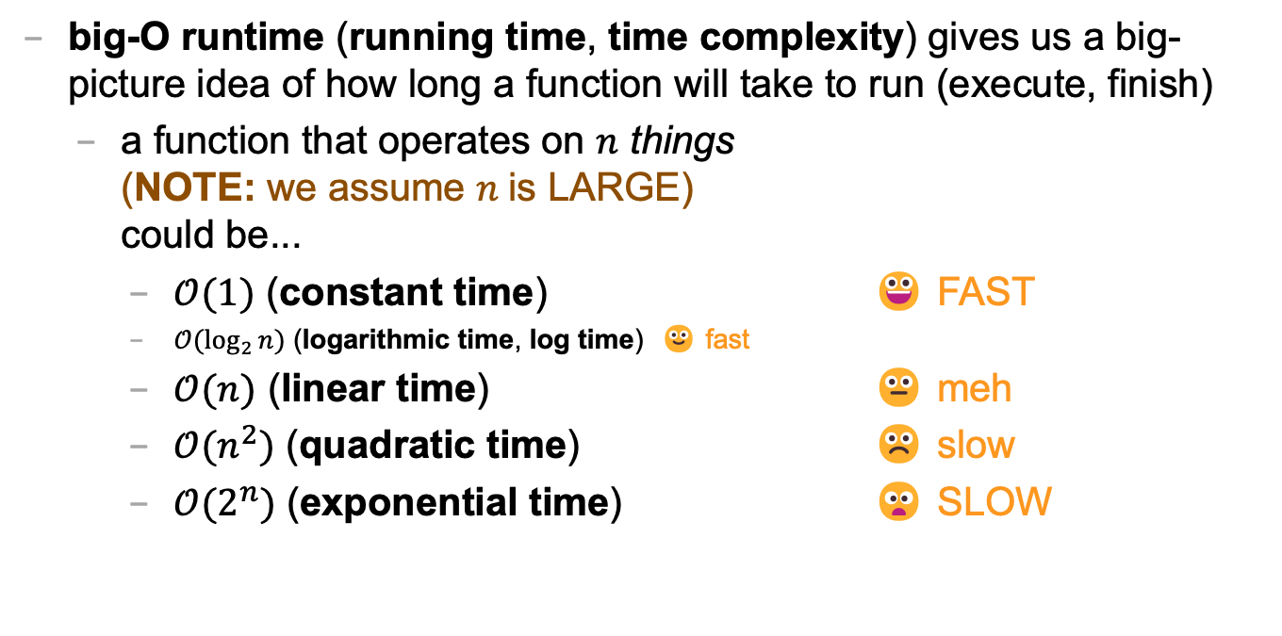
review: big-O runtime
big-O runtime (running time, time complexity) gives us a big-picture idea of how long a function will take to run (execute, finish)
a function that operates on $n$ things (NOTE: we assume $n$is LARGE) could be...
$𝒪(1)$ (constant time) 😀 FAST
$𝒪(\log_{2}{n})$ (logarithmic time, log time) 🙂 fast
$𝒪(n)$ (linear time) 😐 meh
$𝒪(n^{2})$ (quadratic time) ☹️ slow
$𝒪(2^{n})$ (exponential time) 😦 SLOW

Slide 180
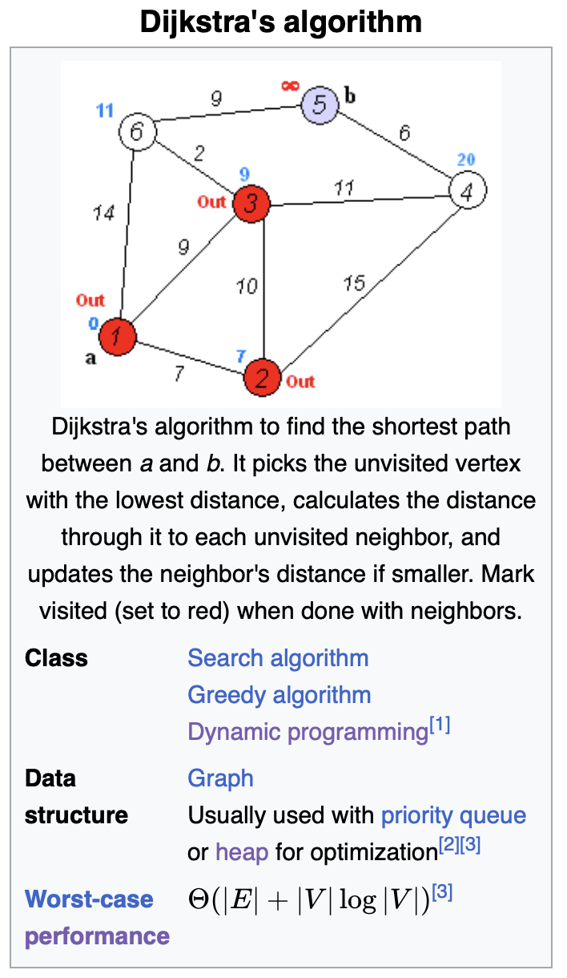
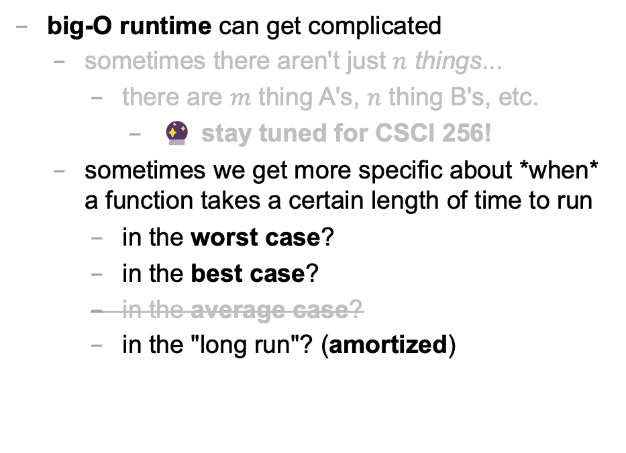
big-O runtime
big-O runtime can get complicated
sometimes there aren't just $n$ things...
there are $m$ thing A's, $n$ thing B's, etc.
🔮 stay tuned for CSCI 256!
sometimes we get more specific about *when* a function takes a certain length of time to run
in the worst case?
in the best case?
in the average case?
in the "long run"? (amortized)

Slide 181
best case and worst case runtime of adding to the back of an array list

Slide 182
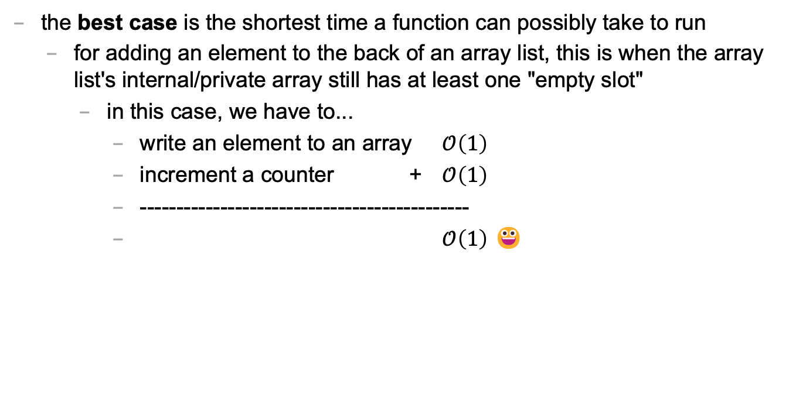
best case
the best case is the shortest time a function can possibly take to run
for adding an element to the back of an array list, this is when the array list's internal/private array still has at least one "empty slot"
in this case, we have to...
write an element to an array $𝒪\left(1\right)$
increment a counter + $𝒪\left(1\right)$
---------------------------------------------
$𝒪\left(1\right)$ 😀

Slide 183
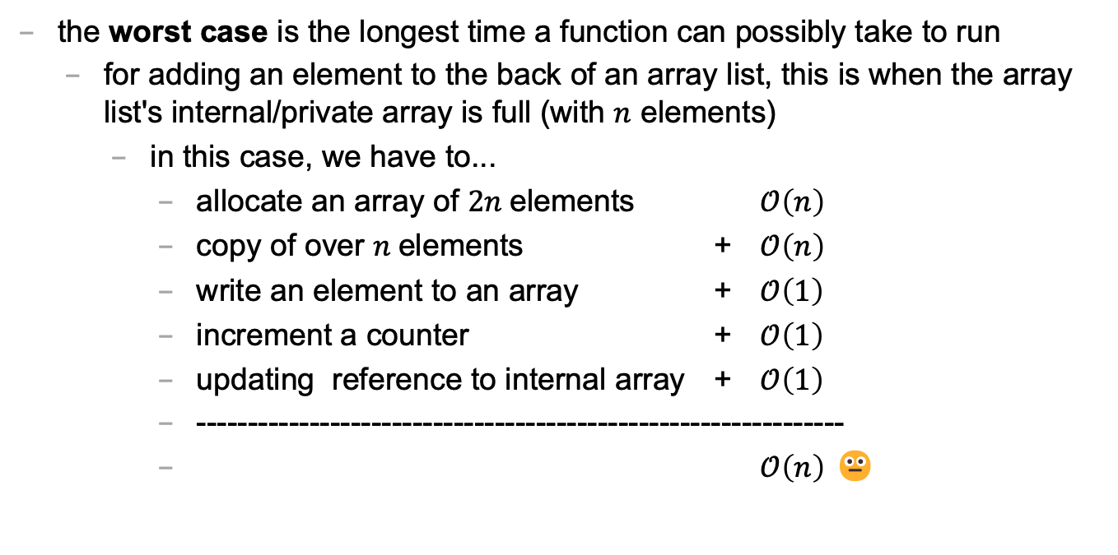
worst case
the worst case is the longest time a function can possibly take to run
for adding an element to the back of an array list, this is when the array list's internal/private array is full (with $n$ elements)
in this case, we have to...
allocate an array of $2n$elements $𝒪\left(n\right)$
copy of over $n$elements + $𝒪\left(n\right)$
write an element to an array + $𝒪\left(1\right)$
increment a counter + $𝒪\left(1\right)$
updating reference to internal array + $𝒪\left(1\right)$
---------------------------------------------------------------
$𝒪\left(n\right)$ 😐

Slide 184
sometimes the best case and worst case are very different

Slide 185
amortized runtime of adding to the back of an array list

Slide 186
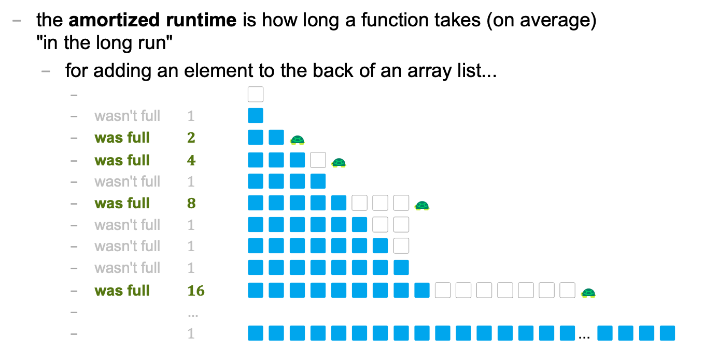
amortized
the amortized runtime is how long a function takes (on average) "in the long run"
for adding an element to the back of an array list...
⬜️
wasn't full $1$ 🟦
was full $2$ 🟦🟦🐢
was full $4$ 🟦🟦🟦⬜️🐢
wasn't full $1$ 🟦🟦🟦🟦
was full $8$ 🟦🟦🟦🟦🟦⬜️⬜️⬜️🐢
wasn't full $1$ 🟦🟦🟦🟦🟦🟦⬜️⬜️
wasn't full $1$ 🟦🟦🟦🟦🟦🟦🟦⬜️
wasn't full $1$ 🟦🟦🟦🟦🟦🟦🟦🟦
was full $16$ 🟦🟦🟦🟦🟦🟦🟦🟦🟦⬜️⬜️⬜️⬜️⬜️⬜️⬜️🐢
$…$
$1$ 🟦🟦🟦🟦🟦🟦🟦🟦🟦🟦🟦🟦🟦🟦🟦🟦... 🟦🟦🟦🟦

Slide 187
1
1
2
4
1
8
1
1
1
16
1
1
1
1
1
1
1
32
1
1
1
1
1
⬜️
🟦
🟦🟦🐢
🟦🟦🟦⬜️🐢
🟦🟦🟦🟦
🟦🟦🟦🟦🟦⬜️⬜️⬜️🐢
🟦🟦🟦🟦🟦🟦⬜️⬜️
🟦🟦🟦🟦🟦🟦🟦⬜️
🟦🟦🟦🟦🟦🟦🟦🟦
🟦🟦🟦🟦🟦🟦🟦🟦🟦⬜️⬜️⬜️⬜️⬜️⬜️⬜️🐢
🟦🟦🟦🟦🟦🟦🟦🟦🟦🟦⬜️⬜️⬜️⬜️⬜️⬜️
🟦🟦🟦🟦🟦🟦🟦🟦🟦🟦🟦⬜️⬜️⬜️⬜️⬜️
🟦🟦🟦🟦🟦🟦🟦🟦🟦🟦🟦🟦⬜️⬜️⬜️⬜️
🟦🟦🟦🟦🟦🟦🟦🟦🟦🟦🟦🟦🟦⬜️⬜️⬜️
🟦🟦🟦🟦🟦🟦🟦🟦🟦🟦🟦🟦🟦🟦⬜️⬜️
🟦🟦🟦🟦🟦🟦🟦🟦🟦🟦🟦🟦🟦🟦🟦⬜️
🟦🟦🟦🟦🟦🟦🟦🟦🟦🟦🟦🟦🟦🟦🟦🟦
🟦🟦🟦🟦🟦🟦🟦🟦🟦🟦🟦🟦🟦🟦🟦🟦🟦⬜️⬜️⬜️⬜️⬜️⬜️⬜️⬜️⬜️⬜️⬜️⬜️⬜️⬜️⬜️ 🐢
🟦🟦🟦🟦🟦🟦🟦🟦🟦🟦🟦🟦🟦🟦🟦🟦🟦🟦⬜️⬜️⬜️⬜️⬜️⬜️⬜️⬜️⬜️⬜️⬜️⬜️⬜️⬜️
🟦🟦🟦🟦🟦🟦🟦🟦🟦🟦🟦🟦🟦🟦🟦🟦🟦🟦🟦⬜️⬜️⬜️⬜️⬜️⬜️⬜️⬜️⬜️⬜️⬜️⬜️⬜️
🟦🟦🟦🟦🟦🟦🟦🟦🟦🟦🟦🟦🟦🟦🟦🟦🟦🟦🟦🟦⬜️⬜️⬜️⬜️⬜️⬜️⬜️⬜️⬜️⬜️⬜️⬜️
🟦🟦🟦🟦🟦🟦🟦🟦🟦🟦🟦🟦🟦🟦🟦🟦🟦🟦🟦🟦🟦⬜️⬜️⬜️⬜️⬜️⬜️⬜️⬜️⬜️⬜️⬜️
🟦🟦🟦🟦🟦🟦🟦🟦🟦🟦🟦🟦🟦🟦🟦🟦🟦🟦🟦🟦🟦🟦⬜️⬜️⬜️⬜️⬜️⬜️⬜️⬜️⬜️⬜️
🐢

Slide 188
1
1
2
4
1
8
1
1
1
16
1
1
1
1
1
1
1
32
1
1
1
1
1
1
1
1
1
1
1
1
1
1
1
64
1
1
1
1
1
1
1
1
1
1
1
1
1
1
1
1
1
1
1
1
1
1

Slide 189
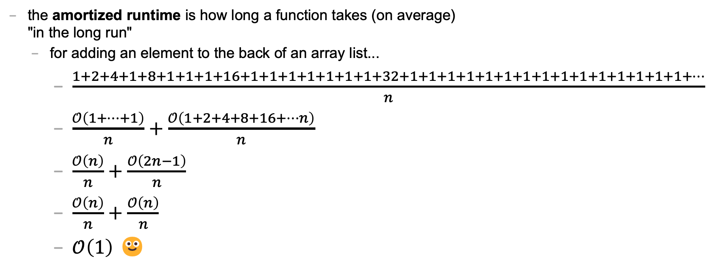
amortized
the amortized runtime is how long a function takes (on average) "in the long run"
for adding an element to the back of an array list...
$\frac{1+2+4+1+8+1+1+1+16+1+1+1+1+1+1+1+32+1+1+1+1+1+1+1+1+1+1+1+1+1+1+1+…}{n}$
$\frac{𝒪\left(1+…+1\right)}{n}+\frac{𝒪\left(1+2+4+8+16+…n\right)}{n}$
$\frac{𝒪\left(n\right)}{n}+\frac{𝒪\left(2n−1\right)}{n}$
$\frac{𝒪\left(n\right)}{n}+\frac{𝒪\left(n\right)}{n}$
$𝒪\left(1\right)$ 🙂

Slide 190
the amortized run time is less "pessimistic" than worst case

Slide 191
the most relevant runtime depends on context 💭 when might worst case be more relevant? 💭 when might amortized be more relevant?

Slide 192
best case and worst case runtime of inserting into the front of an array list

Slide 193
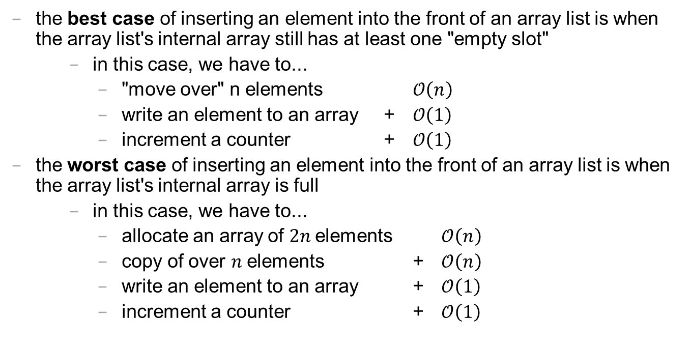
best case and worst cast
the best case of inserting an element into the front of an array list is when the array list's internal array still has at least one "empty slot"
in this case, we have to...
"move over" n elements $𝒪\left(n\right)$
write an element to an array + $𝒪\left(1\right)$
increment a counter + $𝒪\left(1\right)$
the worst case of inserting an element into the front of an array list is when the array list's internal array is full
in this case, we have to...
allocate an array of $2n$elements $𝒪\left(n\right)$
copy of over $n$elements + $𝒪\left(n\right)$
write an element to an array + $𝒪\left(1\right)$
increment a counter + $𝒪\left(1\right)$

Slide 194
lesson?: sometimes best case and worst case are the same

Slide 195
deleting while iterating backwards, grugbrain, comments (including stb), Vim, Kahoot! (including Jim's unpublished Kahoot! op-ed)
choose your own adventure!

Slide 196
https://grugbrain.dev

Slide 197
Week03
TODO: record lecture
Today is...
✨No-Laptop Monday! ✨
🦜🦜🦜
WARMUP
What is a bullet hell?
HW03 preview
functions
classes
HW03 behind the scenes
references
BONUS
Who wrote the game Everyday Shooter?
What is she working on now?
BONUS
What does Touhou 7: Perfect Cherry Blossom's Extra Stage look like? Who wrote this?

Slide 198
but first, something nice

Slide 199
🦉 secret agent owl

Slide 200
🦉 secret agent owl

Slide 201
🦉 secret agent owl

Slide 202
🦉 secret agent owl

Slide 203
HW03 preview 👻

Slide 204
functions

Slide 205
anatomy of a function

Slide 206
anatomy of a function (1/2)
a function is a lil chunk of code you can call from elsewhere
a function takes any number of arguments
... foo(int arg) { ... } // function foo takes an int
a function with a non-void return type must return a value of that type
int bar(...) { ... } // bar returns an int
void baz(...) { ... } // baz doesn't return anything
ReturnType functionName(ArgumentOneType argumentOne, ...) {
...
}

Slide 207
anatomy of a function (2/2)
void drawLine(
double a_x,
double a_y,
double b_x,
double b_y,
Color color) {
...
}

Slide 208
return

Slide 209
return (1/2)
a return statement stops execution of a function and returns the program to where the function was called
some return statements return a value
return 123;
others do not
return;
✨ this can be used to stop running a void-returning function in the middle

Slide 210
return (2/2)
a function with a non-void return type must return a value of that type, regardless of the path taken through the function
Error: missing return statement
static boolean isEven(int n) {
if (n % 2 == 0) {
return true;
}
}

Slide 211
return (2/2)
a function with a non-void return type must return a value of that type, regardless of the path taken through the function
static boolean isEven(int n) {
if (n % 2 == 0) {
return true;
} return false;
}

Slide 212
return (3/2)
a function with a non-void return type must return a value of that type, regardless of the path taken through the function
static boolean isEven(int n) {
return (n % 2 == 0);
}

Slide 213
return (3/2)
a function with a non-void return type must return a value of that type, regardless of the path taken through the function

Slide 214
return (2/2)
a function with a non-void return type must return a value of that type, regardless of the path taken through the function
Error: missing return statement
static boolean isPrime(int n) {
if (n <= 1) { return false; }
for (int i = 2; i <= SQRT(n); ++i) {
if (n % i == 0) { return false; }
}
}

Slide 215
return (2/2)
a function with a non-void return type must return a value of that type, regardless of the path taken through the function
static boolean isPrime(int n) {
if (n <= 1) { return false; }
for (int i = 2; i <= SQRT(n); ++i) {
if (n % i == 0) { return false; }
}
return true;
}

Slide 216
void

Slide 217
void
void is a special return type meaning a function does not return a value
void functions often modify (the objects referenced by) their arguments
static void inPlaceReverse(int[] array) { ... }
// no need to return a reference to array // (user of the function already has one)
in Java, the main method is a void function (it doesn't return anything)
public static void main(String[] arguments) { ... }

Slide 218
the call stack

Slide 219
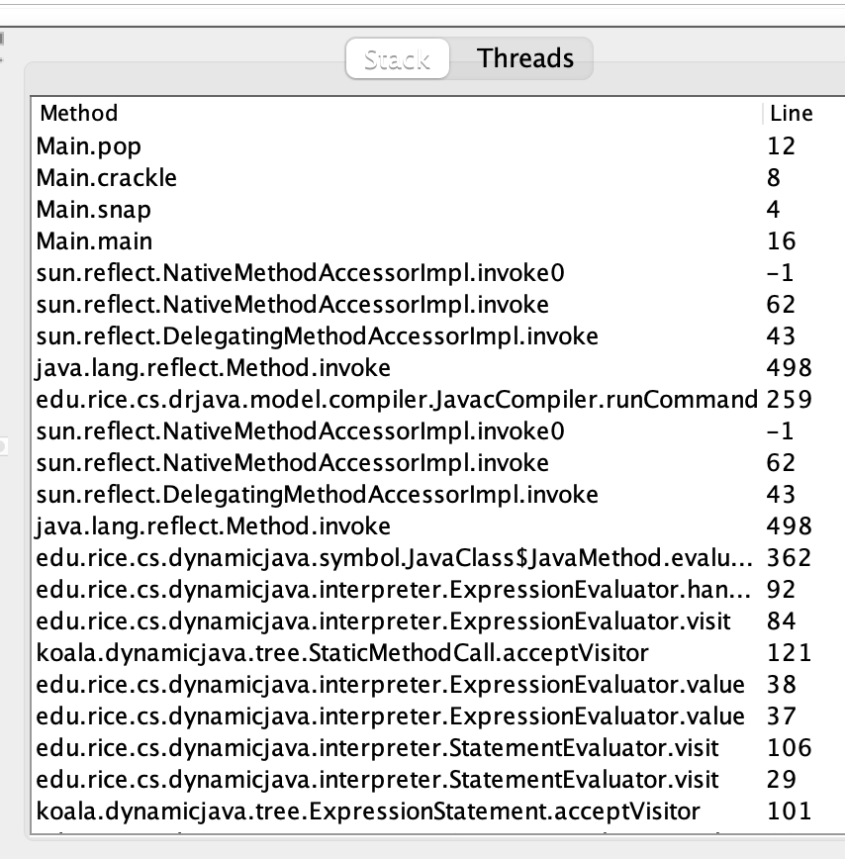
the call stack
functions can call other functions
the resulting "stack" of function calls is called the call stack
class Main {
static void snap() {
crackle();
}
static void crackle() {
pop();
}
static void pop() {
return;
}
public static void main(String[] arguments) {
snap();
}
}

Slide 220
🤔

Slide 221
[let's see what Eclipse does]

Slide 222
recursion

Slide 223
recursion (1/2)
a recursive function is a function that calls itself
each call must make progress towards a base case (when the function finally returns without calling itself)
✨ when in doubt, try something like zero for your base case
class Main extends Cow {
static int digitSum(int n) {
if (n == 0) {
return 0;
}
return digitSum(n / 10) + (n % 10);
}
public static void main(String[] arguments) {
PRINT(digitSum(256)); // 13
}
}

Slide 224
static int digitSum(int n) {
if (n == 0) {
return 0;
}
return digitSum(n / 10) + (n % 10);
}
return 0;
return digitSum(0) + 2;
return digitSum(2) + 5;
return digitSum(25) + 6;
int a = digitSum(256);

Slide 225
static int digitSum(int n) {
if (n == 0) {
return 0;
}
return digitSum(n / 10) + (n % 10);
}
return 0;
return digitSum(0) + 2;
return digitSum(2) + 5;
return digitSum(25) + 6;
int a = digitSum(256);

Slide 226
static int digitSum(int n) {
if (n == 0) {
return 0;
}
return digitSum(n / 10) + (n % 10);
}
return 0 + 2;
return digitSum(2) + 5;
return digitSum(25) + 6;
int a = digitSum(256);

Slide 227
static int digitSum(int n) {
if (n == 0) {
return 0;
}
return digitSum(n / 10) + (n % 10);
}
return 2;
return digitSum(2) + 5;
return digitSum(25) + 6;
int a = digitSum(256);

Slide 228
static int digitSum(int n) {
if (n == 0) {
return 0;
}
return digitSum(n / 10) + (n % 10);
}
return 2;
return digitSum(2) + 5;
return digitSum(25) + 6;
int a = digitSum(256);

Slide 229
static int digitSum(int n) {
if (n == 0) {
return 0;
}
return digitSum(n / 10) + (n % 10);
}
return 2 + 5;
return digitSum(25) + 6;
int a = digitSum(256);

Slide 230
static int digitSum(int n) {
if (n == 0) {
return 0;
}
return digitSum(n / 10) + (n % 10);
}
return 7;
return digitSum(25) + 6;
int a = digitSum(256);

Slide 231
static int digitSum(int n) {
if (n == 0) {
return 0;
}
return digitSum(n / 10) + (n % 10);
}
return 7;
return digitSum(25) + 6;
int a = digitSum(256);

Slide 232
static int digitSum(int n) {
if (n == 0) {
return 0;
}
return digitSum(n / 10) + (n % 10);
}
return 7 + 6;
int a = digitSum(256);

Slide 233
static int digitSum(int n) {
if (n == 0) {
return 0;
}
return digitSum(n / 10) + (n % 10);
}
return 13;
int a = digitSum(256);

Slide 234
static int digitSum(int n) {
if (n == 0) {
return 0;
}
return digitSum(n / 10) + (n % 10);
}
return 13;
int a = digitSum(256);

Slide 235
static int digitSum(int n) {
if (n == 0) {
return 0;
}
return digitSum(n / 10) + (n % 10);
}
int a = 13;

Slide 236
fin.

Slide 237
recursion (2/2)
a stack overflow error happens when functions call too many functions without returning; these errors are usually caused by broken recursive code
class Main {
static void stackOverflow() {
stackOverflow();
}
public static void main(String[] arguments) {
stackOverflow();
}
}
java.lang.StackOverflowError
at Main.stackOverflow(Tmp.java:3)
at Main.stackOverflow(Tmp.java:3)
at Main.stackOverflow(Tmp.java:3)
at Main.stackOverflow(Tmp.java:3)
at Main.stackOverflow(Tmp.java:3)
at Main.stackOverflow(Tmp.java:3)
at Main.stackOverflow(Tmp.java:3)
at Main.stackOverflow(Tmp.java:3)
at Main.stackOverflow(Tmp.java:3)
at Main.stackOverflow(Tmp.java:3)
at Main.stackOverflow(Tmp.java:3)
at Main.stackOverflow(Tmp.java:3)
at Main.stackOverflow(Tmp.java:3)
at Main.stackOverflow(Tmp.java:3)
at Main.stackOverflow(Tmp.java:3)
at Main.stackOverflow(Tmp.java:3)
at Main.stackOverflow(Tmp.java:3)
at Main.stackOverflow(Tmp.java:3)
at Main.stackOverflow(Tmp.java:3)
at Main.stackOverflow(Tmp.java:3)
at Main.stackOverflow(Tmp.java:3)
at Main.stackOverflow(Tmp.java:3)
at Main.stackOverflow(Tmp.java:3)
at Main.stackOverflow(Tmp.java:3)
at Main.stackOverflow(Tmp.java:3)
at Main.stackOverflow(Tmp.java:3)
at Main.stackOverflow(Tmp.java:3)
at Main.stackOverflow(Tmp.java:3)
at Main.stackOverflow(Tmp.java:3)
at Main.stackOverflow(Tmp.java:3)
at Main.stackOverflow(Tmp.java:3)
at Main.stackOverflow(Tmp.java:3)
at Main.stackOverflow(Tmp.java:3)
at Main.stackOverflow(Tmp.java:3)
at Main.stackOverflow(Tmp.java:3)
at Main.stackOverflow(Tmp.java:3)
at Main.stackOverflow(Tmp.java:3)
at Main.stackOverflow(Tmp.java:3)
at Main.stackOverflow(Tmp.java:3)
at Main.stackOverflow(Tmp.java:3)
at Main.stackOverflow(Tmp.java:3)
at Main.stackOverflow(Tmp.java:3)
at Main.stackOverflow(Tmp.java:3)
at Main.stackOverflow(Tmp.java:3)
at Main.stackOverflow(Tmp.java:3)
at Main.stackOverflow(Tmp.java:3)
at Main.stackOverflow(Tmp.java:3)
at Main.stackOverflow(Tmp.java:3)
at Main.stackOverflow(Tmp.java:3)
at Main.stackOverflow(Tmp.java:3)
at Main.stackOverflow(Tmp.java:3)
at Main.stackOverflow(Tmp.java:3)
at Main.stackOverflow(Tmp.java:3)
at Main.stackOverflow(Tmp.java:3)
at Main.stackOverflow(Tmp.java:3)
at Main.stackOverflow(Tmp.java:3)
at Main.stackOverflow(Tmp.java:3)
at Main.stackOverflow(Tmp.java:3)
at Main.stackOverflow(Tmp.java:3)
at Main.stackOverflow(Tmp.java:3)
at Main.stackOverflow(Tmp.java:3)
at Main.stackOverflow(Tmp.java:3)
at Main.stackOverflow(Tmp.java:3)
at Main.stackOverflow(Tmp.java:3)
at Main.stackOverflow(Tmp.java:3)
at Main.stackOverflow(Tmp.java:3)

Slide 238
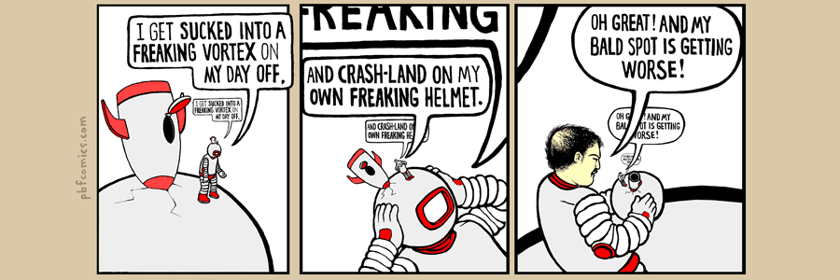

Slide 239
classes

Slide 240
anatomy of a class

Slide 241
anatomy of a class (1/2)
class ClassName {
VariableOneType variableOne;
...
FunctionOneReturnType functionOneName(...) { ... }
...
}
a class lets you bundle together data and functions
a class may have any number of variables (fields)
int foo; // objects of this class have an int called foo
a class may have any number of functions (methods)
int bar() { ... } // objects of class have function bar

Slide 242
anatomy of a class (2/2)
class Thing {
// instance variables
double x;
double y;
Color color;
double radius;
// instance methods
void draw() { ... }
...
}

Slide 243
dot

Slide 244
dot
the dot operator is used to access an object's variables and functions
Thing thing = new Thing();
thing.x = 3.0;
thing.y = 4.0;
thing.draw();

Slide 245
terminology

Slide 246
class vs. object (instance of a class)
a class is NOT the same thing as an object
a class is "a blueprint for making objects"
we can make an instance of a class (an object) using the new keyword
this is called "instantiating the class"
Thing thing = new Thing();

Slide 247
[off the record note on OOP (Object Oriented Programming) terminology]

Slide 248
new and constructors

Slide 249
new
the new keyword create a new instance of a class and calls its appropriate constructor
int[] array = new int[5]; // { 0, 0, 0, 0, 0 }
Color color = new Color(1.0, 0.0, 0.0); // (1.0, 0.0, 0.0)
☠️ you don't need new to create a new string
String string = "strings are their own thing";
☠️ you don't need new to create a new array when using {} syntax
int[] array = { 1, 2, 3 };
☠️ new doesn't actually return the object it created; it returns a reference to the object

Slide 250
constructors (1/2)
a constructor is called when an object is created
if the class does not have a constructor, then the default constructor must be called, which takes no arguments and sets all variables to zero
Color color = new Color(); // (0.0, 0.0, 0.0)

Slide 251
constructors (2/2)
a (non-default) constructor is never necessary, but is often convenient
Color color = new Color(1.0, 1.0, 1.0); // (r=1.0, g=1.0, b=1.0)
Color color = new Color(); // (0.0, 0.0, 0.0)
color.r = 1.0; // (1.0, 0.0, 0.0)
color.g = 1.0; // (1.0, 1.0, 0.0)
color.b = 1.0; // (1.0, 1.0, 1.0)

Slide 252
this 🐍 in Python, this is self

Slide 253
this
this is a reference to the instance of the class whose function we're inside of
✨ especially useful inside a constructor
class Color {
...
void shade() {
this.r /= 2;
this.g /= 2;
this.b /= 2;
}
Color(double r, double g, double b) { // constructor
this.r = r;
this.g = g;
this.b = b;
}
}

Slide 254
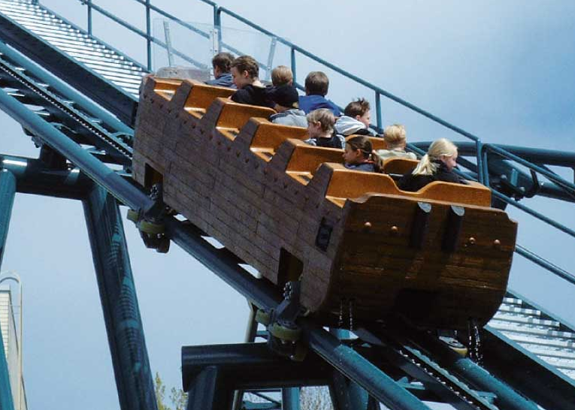
Week03b
Today is...
Wednesday!
(136 is a rollercoaster
that only goes up)
TODO: record lecture
🦜🦜🦜
HW03 preview
functions
classes (not quite done)
memory FUNdaMENTALs
the stack and the heap
passing arguments to functions
WARMUP
what is 42 in hex?

Slide 255
static (wrapping up last lecture)

Slide 256
static variables and static methods

Slide 257
instance variables vs static variables
an instance variable is part of an instance of a class
a static variable (class variable) is part of the class itself
there is only one, period. (it's a global variable that lives "on the class")
class Thing {
int type;
static int TYPE_BULLET = 1;
...
}
// Thing thing = new Thing();
// thing.type = Thing.TYPE_BULLET;

Slide 258
instance methods vs static methods
an instance method must be called on an instance (object) of a class
a static method (class method) can be called on the class itself
✅ there is no this in a static method
class Thing {
void draw() { ... }; // (non-static method)
static boolean collisionCheck(Thing a, Thing b) { ... }
...
}
// Thing a, b;
// a.draw();
// if (Thing.collisionCheck(...)) { ... }

Slide 259
and now... today's lecture!

Slide 260
☠️ this is the hardest lecture in 136

Slide 261
but learning this stuff is very worth 🙂👍 note: you will likely need to review this lecture a few times (i am sure you will all do this)

Slide 262
but learning this stuff is very worth 🙂👍 note: you will likely need to review this lecture a few times (i am sure you will all do this)

Slide 263
but learning this stuff is very worth 🙂👍 note: you will likely need to review this lecture a few times (i am sure you will all do this)

Slide 264
but learning this stuff is very worth 🙂👍 note: you will likely need to review this lecture a few times (i am sure you will all do this 🥲)

Slide 265
note: i am intentionally breaking these examples into many steps to teach you about memory don't actually code this way! int foo = 7; // <-- Good!

Slide 266
memory FUNdaMENTALs

Slide 267
the two kinds of variables in Java

Slide 268
a variable in Java is either... a primitive or a reference to an Object

Slide 269
primitives (review)

Slide 270
primitive types
in this class, "a variable being a primitive" means that the variable is a boolean, char, double, or int
primitive types are simple
primitive types are small
primitive types are NOT Objects
we will talk about Objects later
examples of Objects: String, MyCoolClass, int[] (array of ints)

Slide 271
boolean, char, double, int
a boolean stores a truth value
true, false
a char stores a character
'\0', 'a', 'Z', '!', '\n'
a double stores a real number
0.0, -0.5, 3.1415926, Double.NEGATIVE_INFINITY
an int stores an integer
0, -1, 4

Slide 272
primitives
some examples of primitives
int a; // a is an int
boolean b; // b is a boolean
char c; // c is a char

Slide 273
references to Objects

Slide 274
references (1/2)
we interact with Object's through references
String string; // string is a reference to a String object
Color color; // color is a reference to a Color object
int[] array; // array is a reference to an int array

Slide 275
references (2/2)
a reference is a memory address ("where the object lives in memory")
a memory address is an integer
a memory address is often written in hexadecimal (hex, base-16, 0...9A...F)
Thing a = new Thing();
// ^ refers to a Thing object at memory address 0x70f806418

Slide 276
null

Slide 277
null (1/2)
a null reference refers to nothing
the actual memory address referred to by null is zero (0x00... in hex)
Thing b = null;
// ^ refers to nothing (memory address 0x000000000)

Slide 278
null (2/2)
Thing[] pool = new Thing[7];
// ^ refers to a Thing[] object at memory address 0x70f805b68
//
// NOTE: the Thing array referred to by pool has 7 entries,
// all zero-initialized (null; memory address 0x000000000)
pool[0] = new Thing();
// pool[0] now refers to a Thing object at memory address // 0x70f8079c0

Slide 279
the stack and the heap (where stuff lives)

Slide 280
overview

Slide 281
let's get more specific than saying "variables live in memory" we divide memory into two parts: the stack and the heap

Slide 282
"the stack"
local variable primitives & references to Objects live here
variables undefined (?) by default (will NOT compile if used)
"the heap"
the actual Objects (including arrays and Strings) live here
Objects are cleared to 0 by default

Slide 283
primitives live on the stack

Slide 284
"the stack"
local variable primitives & references to Objects live here
variables undefined (?) by default (will NOT compile if used)
"the heap"
the actual Objects (including arrays and Strings) live here
Objects are cleared to 0 by default

Slide 285
int a;
int b;
a = 3;
b = a;
a = 7;

Slide 286
int a;
int b;
a = 3;
b = a;
a = 7;
a
?

Slide 287
int a;
int b;
a = 3;
b = a;
a = 7;
a
b
?
?

Slide 288
int a;
int b;
a = 3;
b = a;
a = 7;
a
b
3
?

Slide 289
int a;
int b;
a = 3;
b = a;
a = 7;
a
b
3
3

Slide 290
int a;
int b;
a = 3;
b = a;
a = 7;
a
b
7
3

Slide 291
int a;
int b;
a = 3;
b = a;
a = 7;
a
b
7
3

Slide 292
Objects live on the heap (but references to objects live on the stack)

Slide 293
"the stack"
local variable primitives & references to Objects live here
variables undefined (?) by default (will NOT compile if used)
"the heap"
the actual Objects (including arrays and Strings) live here
Objects are cleared to 0 by default

Slide 294
class Thing {
double x;
double y;
}
Thing a;
a = new Thing();
Thing b;
b = a;
a.x = 3.0;
b.y = 4.0;
a = null;

Slide 295
class Thing {
double x;
double y;
}
Thing a;
a = new Thing();
Thing b;
b = a;
a.x = 3.0;
b.y = 4.0;
a = null;
a
?

Slide 296
class Thing {
double x;
double y;
}
Thing a;
a = new Thing();
Thing b;
b = a;
a.x = 3.0;
b.y = 4.0;
a = null;
a
0xb7
.x
.y
0.0
0.0

Slide 297
class Thing {
double x;
double y;
}
Thing a;
a = new Thing();
Thing b;
b = a;
a.x = 3.0;
b.y = 4.0;
a = null;
a
b
0xb7
?
.x
.y
0.0
0.0

Slide 298
class Thing {
double x;
double y;
}
Thing a;
a = new Thing();
Thing b;
b = a;
a.x = 3.0;
b.y = 4.0;
a = null;
a
b
0xb7
0xb7
.x
.y
0.0
0.0

Slide 299
class Thing {
double x;
double y;
}
Thing a;
a = new Thing();
Thing b;
b = a;
a.x = 3.0;
b.y = 4.0;
a = null;
a
b
0xb7
0xb7
.x
.y
3.0
0.0

Slide 300
class Thing {
double x;
double y;
}
Thing a;
a = new Thing();
Thing b;
b = a;
a.x = 3.0;
b.y = 4.0;
a = null;
a
b
0xb7
0xb7
.x
.y
3.0
4.0

Slide 301
class Thing {
double x;
double y;
}
Thing a;
a = new Thing();
Thing b;
b = a;
a.x = 3.0;
b.y = 4.0;
a = null;
a
b
0x00
0xb7
.x
.y
3.0
4.0

Slide 302
class Thing {
double x;
double y;
}
Thing a;
a = new Thing();
Thing b;
b = a;
a.x = 3.0;
b.y = 4.0;
a = null;
a
b
0x00
0xb7
.x
.y
3.0
4.0

Slide 303
stack variables disappear when they leave scope Objects are garbage collected when nothing refers to them anymore

Slide 304
"the stack"
local variable primitives & references to Objects live here
variables undefined (?) by default (will NOT compile if used)
"the heap"
the actual Objects (including arrays and Strings) live here
Objects are cleared to 0 by default

Slide 305
{
int a;
a = 7;
}
{
int[] b;
b = new int[5];
b[4] = 8;
}

Slide 306
{
int a;
a = 7;
}
{
int[] b;
b = new int[5];
b[4] = 8;
}

Slide 307
{
int a;
a = 7;
}
{
int[] b;
b = new int[5];
b[4] = 8;
}
a
?

Slide 308
{
int a;
a = 7;
}
{
int[] b;
b = new int[5];
b[4] = 8;
}
a
7

Slide 309
{
int a;
a = 7;
}
{
int[] b;
b = new int[5];
b[4] = 8;
}
a
7

Slide 310
{
int a;
a = 7;
}
{
int[] b;
b = new int[5];
b[4] = 8;
}

Slide 311
{
int a;
a = 7;
}
{
int[] b;
b = new int[5];
b[4] = 8;
}

Slide 312
{
int a;
a = 7;
}
{
int[] b;
b = new int[5];
b[4] = 8;
}
b
?

Slide 313
{
int a;
a = 7;
}
{
int[] b;
b = new int[5];
b[4] = 8;
}
b
0xb7
[0]
[1]
[2]
[3]
[4]
0
0
0
0
0

Slide 314
{
int a;
a = 7;
}
{
int[] b;
b = new int[5];
b[4] = 8;
}
b
0xb7
[0]
[1]
[2]
[3]
[4]
0
0
0
0
8

Slide 315
{
int a;
a = 7;
}
{
int[] b;
b = new int[5];
b[4] = 8;
}
b
0xb7
[0]
[1]
[2]
[3]
[4]
0
0
0
0
8

Slide 316
{
int a;
a = 7;
}
{
int[] b;
b = new int[5];
b[4] = 8;
}
0
0
0
0
8

Slide 317
{
int a;
a = 7;
}
{
int[] b;
b = new int[5];
b[4] = 8;
}
0
0
0
0
8
🚛

Slide 318
garbage collector

Slide 319
garbage collector
the garbage collector is like a trash truck that drives around in the heap; when it notices an object that your program no longer has any references to, it frees up that memory for future use
🌊 C does NOT have a garbage collector; in C you free heap-allocated memory yourself by calling free(...)

Slide 320
[review all examples at least one more time]

Slide 321
passing arguments to functions

Slide 322
arguments to functions are passed by value (a copy of the) value of the primitive or (a copy of the) value of the reference

Slide 323
primitives are passed by value

Slide 324
void foo(int a) {
a = 8;
}
void main() {
int a = 7;
foo(a);
}

Slide 325
void foo(int a) {
a = 8;
}
void main() {
int a = 7;
foo(a);
}
main

Slide 326
void foo(int a) {
a = 8;
}
void main() {
int a = 7;
foo(a);
}
a
main
7

Slide 327
void foo(int a) {
a = 8;
}
void main() {
int a = 7;
foo(a);
}
foo
a
main
7

Slide 328
void foo(int a) {
a = 8;
}
void main() {
int a = 7;
foo(a);
}
a
foo
a
main
7
7

Slide 329
void foo(int b) {
b = 8;
}
void main() {
int a = 7;
foo(a);
}
b
foo
a
main
7
7

Slide 330
void foo(int a) {
a = 8;
}
void main() {
int a = 7;
foo(a);
}
a
foo
a
main
7
7

Slide 331
void foo(int a) {
a = 8;
}
void main() {
int a = 7;
foo(a);
}
a
foo
a
main
8
7

Slide 332
void foo(int a) {
a = 8;
}
void main() {
int a = 7;
foo(a);
}
a
foo
a
main
8
7

Slide 333
void foo(int a) {
a = 8;
}
void main() {
int a = 7;
foo(a);
}
a
main
7

Slide 334
void foo(int a) {
a = 8;
}
void main() {
int a = 7;
foo(a);
}
a
main
7

Slide 335
void foo(int a) {
a = 8;
}
void main() {
int a = 7;
foo(a);
}

Slide 336
references are also passed by value

Slide 337
void foo(Thing a) {
a.y = 4.0;
a = null;
}
void main() {
Thing a;
a = new Thing();
a.x = 3.0;
foo(a);
a.y = 5.0;
}

Slide 338
void foo(Thing a) {
a.y = 4.0;
a = null;
}
void main() {
Thing a;
a = new Thing();
a.x = 3.0;
foo(a);
a.y = 5.0;
}
main

Slide 339
void foo(Thing a) {
a.y = 4.0;
a = null;
}
void main() {
Thing a;
a = new Thing();
a.x = 3.0;
foo(a);
a.y = 5.0;
}
a
main
?

Slide 340
void foo(Thing a) {
a.y = 4.0;
a = null;
}
void main() {
Thing a;
a = new Thing();
a.x = 3.0;
foo(a);
a.y = 5.0;
}
a
main
0xb7
.x
.y
0.0
0.0

Slide 341
void foo(Thing a) {
a.y = 4.0;
a = null;
}
void main() {
Thing a;
a = new Thing();
a.x = 3.0;
foo(a);
a.y = 5.0;
}
a
main
0xb7
.x
.y
3.0
0.0

Slide 342
void foo(Thing a) {
a.y = 4.0;
a = null;
}
void main() {
Thing a;
a = new Thing();
a.x = 3.0;
foo(a);
a.y = 5.0;
}
foo
a
main
0xb7
.x
.y
3.0
0.0

Slide 343
void foo(Thing a) {
a.y = 4.0;
a = null;
}
void main() {
Thing a;
a = new Thing();
a.x = 3.0;
foo(a);
a.y = 5.0;
}
foo
a
a
main
0xb7
0xb7
.x
.y
3.0
0.0

Slide 344
void foo(Thing a) {
a.y = 4.0;
a = null;
}
void main() {
Thing a;
a = new Thing();
a.x = 3.0;
foo(a);
a.y = 5.0;
}
foo
a
a
main
0xb7
0xb7
.x
.y
3.0
4.0

Slide 345
void foo(Thing a) {
a.y = 4.0;
a = null;
}
void main() {
Thing a;
a = new Thing();
a.x = 3.0;
foo(a);
a.y = 5.0;
}
foo
a
a
main
0x00
0xb7
.x
.y
3.0
4.0

Slide 346
void foo(Thing a) {
a.y = 4.0;
a = null;
}
void main() {
Thing a;
a = new Thing();
a.x = 3.0;
foo(a);
a.y = 5.0;
}
foo
a
a
main
0x00
0xb7
.x
.y
3.0
4.0

Slide 347
void foo(Thing a) {
a.y = 4.0;
a = null;
}
void main() {
Thing a;
a = new Thing();
a.x = 3.0;
foo(a);
a.y = 5.0;
}
a
main
0xb7
.x
.y
3.0
4.0

Slide 348
void foo(Thing a) {
a.y = 4.0;
a = null;
}
void main() {
Thing a;
a = new Thing();
a.x = 3.0;
foo(a);
a.y = 5.0;
}
a
main
0xb7
.x
.y
3.0
5.0

Slide 349
void foo(Thing a) {
a.y = 4.0;
a = null;
}
void main() {
Thing a;
a = new Thing();
a.x = 3.0;
foo(a);
a.y = 5.0;
}
a
main
0xb7
.x
.y
3.0
5.0

Slide 350
void foo(Thing a) {
a.y = 4.0;
a = null;
}
void main() {
Thing a;
a = new Thing();
a.x = 3.0;
foo(a);
a.y = 5.0;
}
3.0
5.0

Slide 351
void foo(Thing a) {
a.y = 4.0;
a = null;
}
void main() {
Thing a;
a = new Thing();
a.x = 3.0;
foo(a);
a.y = 5.0;
}
3.0
5.0
🚛

Slide 352
Week03c
no Jim office hours today
(i have to catch a train)
🦜
Today is Fun Friday!
🦜
String
HW03 questions
review
WARMUP
what is a string?
🦜
TODO: record lecture

Slide 354
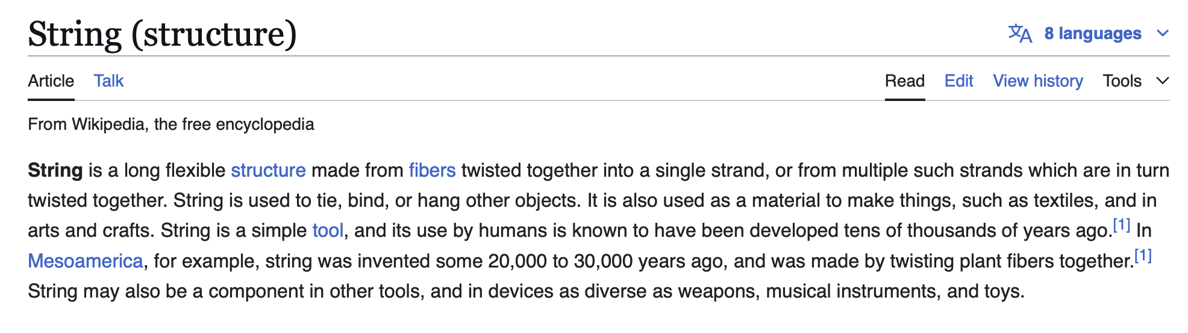

Slide 355
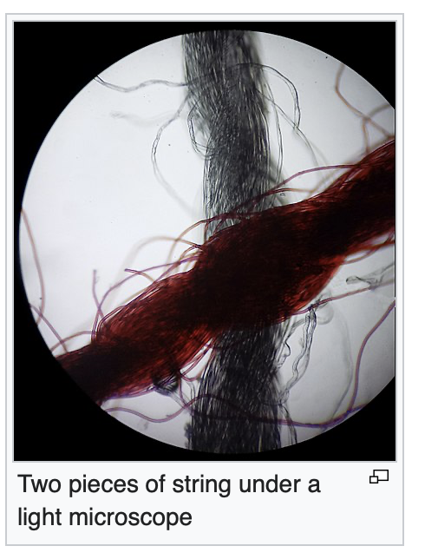

Slide 356


Slide 357
built-in classes (classes that are "built in" to Java)

Slide 358
built-in classes are "special" (they break the rules of other classes in Java)

Slide 359
review: instantiating a class (creating an object)

Slide 360
constructors
// Option A: Use default constructor and initialize using dot
Color color = new Color(); // (r=0.0, g=0.0, b=0.0)
color.r = 1.0; // (r=1.0, g=0.0, b=0.0)
color.g = 1.0; // (r=1.0, g=1.0, b=0.0)
color.b = 1.0; // (r=1.0, g=1.0, b=1.0)
// Option B: Use a custom constructor
Color color = new Color(1.0, 1.0, 1.0); // (r=1.0, g=1.0, b=1.0)

Slide 361
review: array

Slide 362
creating an array (1/2)
you can create a new array by specifying its length inside of square brackets; if you do, the array is zero-initialized (all elements are initially set to zero)
int[] A = new int[8]; // { 0, 0, 0, 0, 0, 0, 0, 0 }
double[] B = new double[1]; // { 0.0 }
boolean[] C = new boolean[2]; // { false, false }
char[] D = new char[4]; // { '\0', '\0', '\0', '\0' }
String[] E = new String[3]; // { null, null, null }

Slide 363
creating an array (2/2)
you can also create a new array by specifying its elements inside of curly braces; if you do, the array's length is the number of elements you specified
int[] array = { 7, 7, 9 }; // new int[3] is implied
NOTE: this syntax can only be used for creation
🙅 NOT okay to do later: array = { 4, 5, 6 };
🙆 OKAY to do later:
array[0] = 4;
array[1] = 5;
array[2] = 6;
boolean[] array = { true };
String[] array = { "hello", "world" };

Slide 364
String

Slide 365
String (1/2)
a String is a sequence of characters
"Hello World", "Foo123"

Slide 366
String (2/2)
you can create a new String by specifying its elements inside of double quotation marks
String string = "Hello";
String has some useful instance methods (see Docs)
PRINT(string.length()); // 5
PRINT(string.charAt(1)); // 'e'
PRINT(string.substring(1, 3)); // "el"

Slide 367
String concatenation (1/2)
+ concatenates two String's
// String foo = "Hello".concat("World"); String foo = "Hello" + "World"; // "HelloWorld"
it also does some conversions for you (very convenient; kind of confusing)
// String foo = "Hello".concat(Integer.toString(2)); String foo = "Hello" + 2; // "Hello2"

Slide 368
String concatenation (2/2)
stringA + foo is the ONLY example of operator overloading in Java
(the * operator just does multiplication)
(the / operator just does division)
...but the + operator does both addition and string concatenation
🐍 Python and 👹C++ let you implement your own operator overloading
(very fun; very confusing)

Slide 369
inside of a String (1/4)
inside of String, there must be a char[]
motivation: as you experienced in HW02, working directly with character arrays is hard / painful
idea: String "wraps up" a char[] into an easy-to-use package

Slide 370
inside of a String (2/4)
if a String is really just a char[]...
...then what does this code actually do? 🧠
String a = "Hello";
String b = "World";
String c = a + b;
PRINT(c);

Slide 371
XStringExample
class XStringExample extends SuperCow {
static class XString {
char[] array;
static XString plus(XString a, XString b) {
XString result = new XString();
// allocates new array that's the sum of both lengths
// O(n) runtime
result.array = new char[a.array.length + b.array.length];
// copies over a
// O(n)
for (int i = 0; i < a.array.length; ++i) { // O(n)
result.array[i] = a.array[i]; // O(1)
}
// copies over b
// O(n)
for (int i = 0; i < b.array.length; ++i) {
result.array[a.array.length + i] = b.array[i];
}
// returning result
// O(1)
return result;
}
}
public static void main(String[] arguments) {
XString a = new XString();
a.array = new char[6];
a.array[0] = 'H';
a.array[1] = 'e';
a.array[2] = 'l';
a.array[3] = 'l';
a.array[4] = 'l';
a.array[5] = 'o';
XString b = new XString();
b.array = new char[5];
b.array[0] = 'W';
b.array[1] = 'o';
b.array[2] = 'r';
b.array[3] = 'l';
b.array[4] = 'd';
XString c = XString.plus(a, b);
PRINT(a.array);
PRINT(b.array);
PRINT(c.array);
}
}

Slide 372
inside of a String (3/4)
if a String is really just a char[]...
...then what does this code actually do? 🧠
.. how many char[]'s are created?
String a = "Hello";
String b = " ";
String c = "World";
String d = "!";
String e = a + b + c + d;
PRINT(e);

Slide 373
interlude
if a String is really just a char[]...
...then what does this code do?
...what is this code's big O runtime? 🧠
int foo = 0;
for (int i = 0; i < n; ++i) { // O(n)
foo += 1; // * O(1)
}
PRINT(foo);

Slide 374
inside a String (4/4)
if a String is really just a char[]...
...then what does this code do?
...what is its big O runtime? 🧠
String scream = "";
for (int i = 0; i < n; ++i) {
scream += "A";
}
PRINT(scream);

Slide 375
questions on HW03?

Slide 376
pool[i] inside of specific updates (don't define enemy1 and enemy2)

Slide 377
why i gave you a player reference

Slide 378
this inside of fireBullet

Slide 379
☕️ the art of coding things in the right order compile and run early, compile and run often

Slide 380
well, let us imagine...

Slide 381
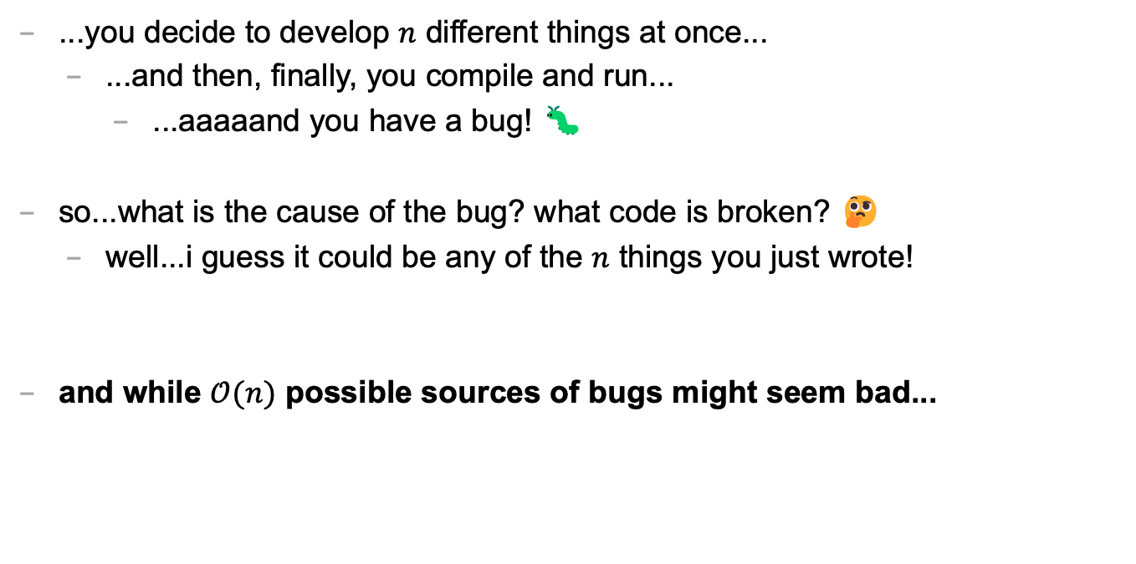
let's imagine...
...you decide to develop $n$ different things at once...
...and then, finally, you compile and run...
...aaaaand you have a bug! 🐛
so...what is the cause of the bug? what code is broken? 🤔
well...i guess it could be any of the $n$ things you just wrote!
and while $𝒪(n)$ possible sources of bugs might seem bad...

Slide 382
...the reality is ✨so much worse✨!

Slide 383

because broken code likes to interact with other broken code, to make✨super bugs✨!

Slide 385
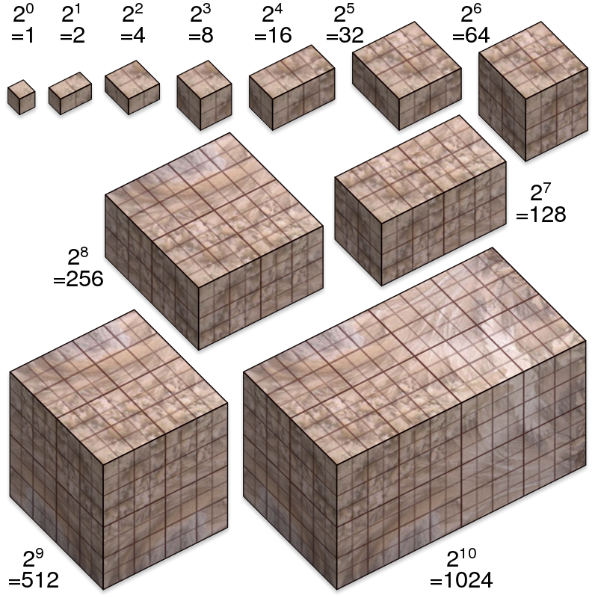
not broken
broken
developing one thing at a time

Slide 386
not broken
A is broken
B is broken
A and B are both broken
developing two things at a time

Slide 387
not broken
A broken
C broken
A and C broken
A and B broken
B broken
B and C broken
A, B, and C broken
developing three things at a time

Slide 388

asymptotic bug-finding time

Slide 389
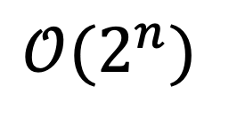
$$𝒪(2^{n})$$
gl;hf 🙂👍

Slide 390
big lesson
implement code one thing at a time
compile and run and test after implementing every single thing
figuring out the order to do things in is a learned skill!
sometimes i choose the wrong order...
...and then i usually have to start over 🙂👍

Slide 391
this is a learned skill!

Slide 392

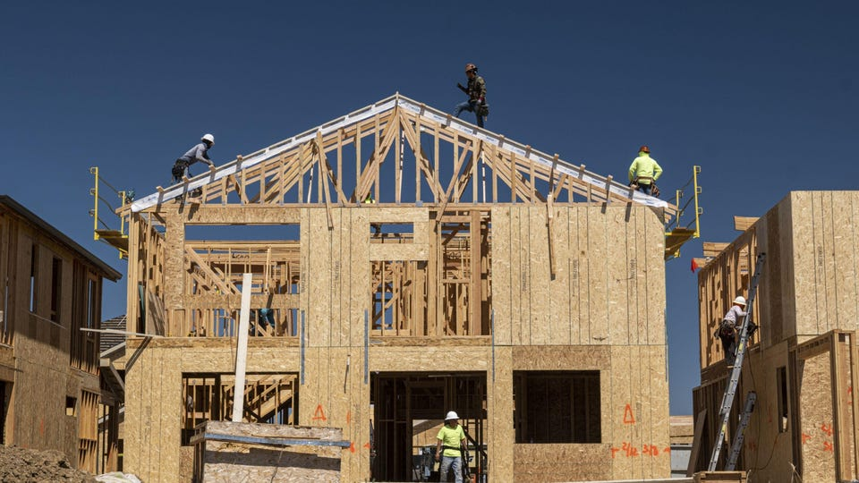
in summary

Slide 393
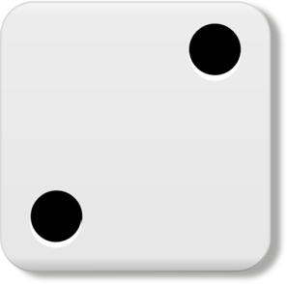
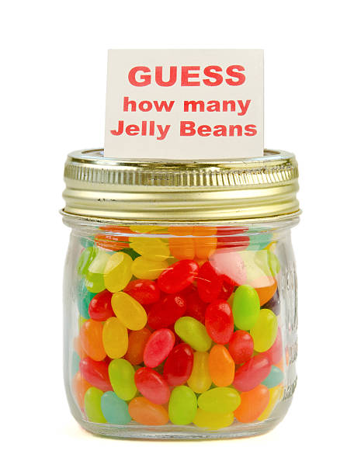
Week02
TODO: record lecture
🦜
NOTE: Jim has jury duty on thu 🎉
🦜
arrays
array examples
swap
array examples that use swaps
WARMUP
Guess how many arrays we used to make this:
https://youtu.be/dadIdXQMBi4
NOTE: an array is a fixed-length sequence of elements, all the same type

Slide 394
how many arrays?
ARRAYS (not counting tiny arrays of 3 double's, which i use to represent points)
NOTE: Counts are very approximate
==========
strings for loading files >5
huge arrays for drawing random stuff (the floor, etc) 2
random stuff in my cow.cpp library (keyboard state, OpenGL objects, etc.) >20
random global variables 1
building the simulation >6
simulation state 3
simulation itself >20
dragon head mesh 7
dragon body mesh 7
dragon mesh 7
sphere mesh 3
cylinder mesh 3
motor configuration 3
arrays that just move data back and forth between C++ <-> unity 8
inverse kinematics >15
physics >10
----------
definitely at least 100; probably less than 1000

Slide 395
arrays

Slide 396
metaphor

Slide 397
an array is like a very organized person's flower planter - one flower per square - the planter can't change size (it is made of artisinal woods or something)

Slide 398
🌻
🌺
🥀
🌹

Slide 399
mental model of an array

Slide 400
mental model of an array
a fixed number of equally-sized boxes, all right next to each other
the array itself lives "in memory"
1 | 5 | 3 | 2 | 7
int[] foo = new int[5];
foo[0] = 1;
foo[1] = 5;
foo[2] = 3;
foo[3] = 2;
foo[4] = 7;

Slide 401
the array itself lives "in memory"
1 | 5 | 3 | 2 | 7

Slide 402

1 | 5 | 3 | 2 | 7

Slide 403
learn about memory and become a real CS pro a couple important questions to ask yourself: https://www.youtube.com/watch?v=BNtcWpY4YLY

Slide 404
arrays

Slide 405
arrays (1/2)
an array is a fixed-length sequence of elements, all of the same type
"an array of 4372 double's"
"an array of 1 int's"
"an array of 64 Student's"

Slide 406
arrays (2/2)
we will often write an array using curly braces
{ 7, 7, 9 } is an array containing 7, 7, and 9
optionally, you can include a comma after the last element
{ 7, 7, 9, }
☠ even though sets from math also use curly braces, Java arrays have nothing to do with sets; in a set, all elements must be unique; in an array, elements do NOT have to be unique

Slide 407
array operations

Slide 408
array operations

Slide 409
creating an array (1/2)
you can create an array by specifying its length (the number of elements); if you do, the array is zero-initialized (all elements are initially set to zero)
int[] A = new int[8]; // { 0, 0, 0, 0, 0, 0, 0, 0 }
double[] B = new double[1]; // { 0.0 }
boolean[] C = new boolean[2]; // { false, false }
char[] D = new char[4]; // { '\0', '\0', '\0', '\0' }
String[] E = new String[3]; // { null, null, null }
[visualize in Eclipse]

Slide 410
creating an array (2/2)
you can also create an array by specifying its elements; if you do, the array's length is the number of elements you specified
int[] array = { 7, 7, 9 }; // new int[3] is implied
NOTE: this syntax can only be used for creation
🙅 NOT okay to do later: array = { 4, 5, 6 };
🙆 OKAY to do later:
array[0] = 4;
array[1] = 5;
array[2] = 6;
boolean[] array = { true };
String[] array = { "hello", "world" };

Slide 411
getting an array's length
after creating an array, you can get (but not set) its length
int[] array = { 7, 7, 9 };
PRINT(array.length); // 3
int[] array = new int[8];
PRINT(array.length); // 8
Error: cannot assign a value to final variable length
array.length = 42;

Slide 412
getting the value of an element of an array
you can get the value of an element of an array using the square brackets and the index of the element
this is also called "accessing the array"
int[] array = { 3, 4, 5 };
int foo = array[0]; // 3
int[] array = { 3, 4, 5 };
int foo = array[42];
java.lang.ArrayIndexOutOfBoundsException: 42

Slide 413
setting the value of an element of an array
you can set the value of an element of an array using the square brackets and the index of the element
int[] array = { 7, 7, 9 };
array[1] = 8;
// { 7, 8, 9 }
int[] array = { 7, 7, 9 };
array[-1] = 1000;
java.lang.ArrayIndexOutOfBoundsException: -1

Slide 414
☠ printing the elements of an array
☠ in Java, you don't simply call System.out.println(array)
instead, you call System.out.println(Arrays.toString(array));
note: this prints with square brackets instead of curly brackets
🤷‍♂️
or just call PRINT(array);
🐄💖✨
(note: also uses square brackets)

Slide 415
iterating over an array

Slide 416
iterating over an array
a for loop can be used to iterate over an array
for (int i = 0; i < array.length; ++i) {
array[i] = ...;
}

Slide 417
[example in Eclipse]

Slide 418
Week02b
🛌
zzz...
arrays
array examples
swap
array examples that use swaps
WARMUP:
On your computer, write an array deep copy from scratch, including test code.
TODO: record lecture

Slide 419
array examples

Slide 420
example: creating an array of the first 100 non-negative integers

Slide 421
example: creating an array of the first 100 non-negative integers [ 0, 1, ..., 99 ]
class Main extends Cow {
public static void main(String[] arguments) {
int[] array = new int[100];
for (int i = 0; i < array.length; ++i) {
array[i] = i;
}
PRINT(array);
}
}

Slide 422
example: (deep) array copy

Slide 423
example: array copy
class Main extends Cow {
public static void main(String[] arguments) {
int[] source = { 3, 4, 5 };
int[] destination = new int[source.length];
for (int i = 0; i < source.length; ++i) {
destination[i] = source[i];
}
PRINT(source);
PRINT(destination);
}
}

Slide 424
☠ example: bad very bad broken array copy

Slide 425
☠ example: bad very bad broken array copy
class Main extends Cow {
public static void main(String[] arguments) {
int[] source = { 3, 4, 5 };
int[] destination = source;
source[0] = 7;
PRINT(source);
PRINT(destination);
}
}

Slide 426
example: circular array
3, 4, 5, 6, 7, 8, 9, 10, 11,

Slide 427
class Main extends Cow {
public static void main(String[] arguments) {
int nextIndex = 0;
int[] circularArray = new int[5];
for (int dataPoint = 1; dataPoint < 100; ++dataPoint) {
// push dataPoint into the circularArray
circularArray[nextIndex] = dataPoint;
// update nextIndex
nextIndex = (nextIndex + 1) % circularArray.length;
}
}
}

Slide 428
example: finding the index (and value) of an array's maximum element

Slide 429
example: finding the index (and value) of an array's maximum element
import java.util.*;
class Main {
public static void main(String[] arguments) {
double[] array = { 1.0, 3.0, -42.0, 1000.0, 99.0 };
int indexOfMaximumElement = -1;
double valueOfMaximumElement = Double.NEGATIVE_INFINITY;
for (int i = 0; i < array.length; ++i) {
if (array[i] > valueOfMaximumElement) {
indexOfMaximumElement = i;
valueOfMaximumElement = array[i];
}
}
System.out.println("array[" + indexOfMaximumElement + "] = " + valueOfMaximumElement);
}
}

Slide 430
multi-dimensional arrays

Slide 431
multi-dimensional arrays

Slide 432
multi-dimensional arrays (arrays of arrays of ...)
multi-dimensional arrays are sometimes really handy
int[][] array = { { 3, 4 }, { 5, 6 }, { 7, 8 } };
PRINT(array);
// [[3, 4], [5, 6], [7, 8]]
PRINT(array[0][1]); // 4
int[][][] array = new int[2][3][4];
array[0][0][0] = 42;
System.out.println(Arrays.toString(array));
// [[[42, 0, 0, 0], [0, 0, 0, 0], [0, 0, 0, 0]], [[0, 0, 0, 0], [0, 0, 0, 0], [0, 0, 0, 0]]]

Slide 433
Week02c
!
juggling club after colloquium today 🤹
🛌
HW01 is being graded
so far only 1 person followed the TODO's... 🥲
(fix for full points back)
Pre-Lab
Post-Lab
arrays
array examples
swap
array examples that use swaps
big O
WARMUP:
How do we swap two numbers...
...in Java?
...in Python?
...in C using XOR and no temporary?
BONUS:
What is the big O runtime of pressing backspace in your text box (n is buffer.length)
TODO: record lecture

Slide 434
swap

Slide 435
🐍 Python swap

Slide 436
🐍 Python swap
a = 0
b = 1
a, b = b, a # Python swap
# a is now 1
# b is now 0

Slide 437
☠️ BAD VERY BAD BROKEN swap

Slide 438
☠️ BAD VERY BAD BROKEN swap
int a = 0;
int b = 1;
{ // BAD VERY BAD BROKEN swap
a = b; // a <- 1
b = a; // b <- 1
}

Slide 439
swap

Slide 440
swap
int a = 0;
int b = 1;
{ // swap
int tmp = a; // tmp <- 0
a = b; // a <- 1
b = tmp; // b <- 0
}

Slide 441
array algorithms that use swaps

Slide 442
reversing an array

Slide 443
out-of-place reverse
we can reverse an array out-of-place using an additional array
static int[] outOfPlaceReverse(int[] array) {
int[] result = new int[array.length];
for (int i = 0; i < array.length; ++i) {
int j = (array.length - 1) - i;
result[i] = array[j];
}
return result;
}

Slide 444
in-place reverse
we can reverse an array in-place using "swaps" (no additional array)
static void inPlaceReverse(int[] array) {
for (int i = 0; i < array.length / 2; ++i) {
int j = (array.length - 1) - i; // "mirror index"
// swap array[i] <-> array[j]
int tmp = array[i];
array[i] = array[j];
array[j] = tmp;
}
}

Slide 445
bubble sort

Slide 446
bubble sort
bubble sort is a simple in-place sorting algorithm that uses swaps
class Main {
public static void main(String[] arguments) {
int[] array = { 2, 4, 1, 6, 0, 3, 5 };
boolean arrayIsSorted;
do {
arrayIsSorted = true;
for (int i = 0; i < array.length - 1; ++i) {
if (array[i] > array[i + 1]) {
arrayIsSorted = false;
// swap
int tmp = array[i];
array[i] = array[i + 1];
array[i + 1] = tmp;
}
}
} while (!arrayIsSorted);
PRINT(array);
}
}

Slide 447
bubble sort
bubble sort is a simple in-place sorting algorithm that uses swaps
boolean arrayIsSorted;
do {
arrayIsSorted = true;
for (int i = 0; i < array.length - 1; ++i) {
if (array[i] > array[i + 1]) {
arrayIsSorted = false;
// swap
int tmp = array[i];
array[i] = array[i + 1];
array[i + 1] = tmp;
}
}
} while (!arrayIsSorted);

Slide 448
big O

Slide 449
big O (math)

Slide 450
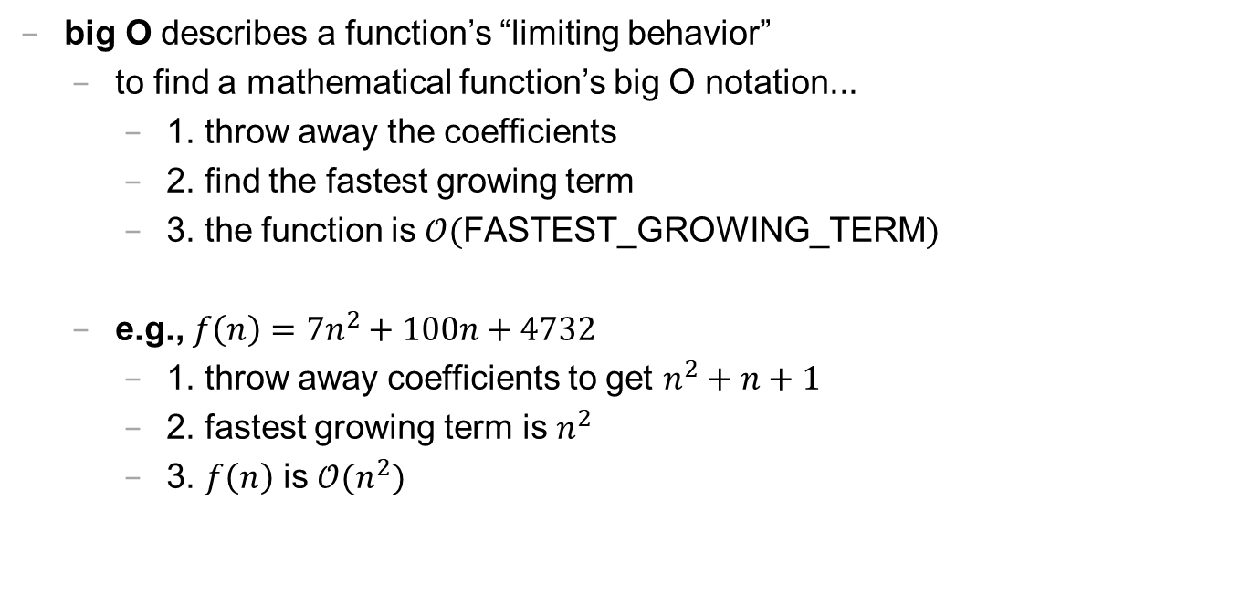
big O (1/2)
big O describes a function’s “limiting behavior”
to find a mathematical function’s big O notation...
1. throw away the coefficients
2. find the fastest growing term
3. the function is $𝒪($FASTEST_GROWING_TERM$)$
e.g., $f\left(n\right)=7n^{2}+100n+4732$
1. throw away coefficients to get $n^{2}+n+1$
2. fastest growing term is $n^{2}$
3. $f\left(n\right)$ is $𝒪(n^{2})$

Slide 451
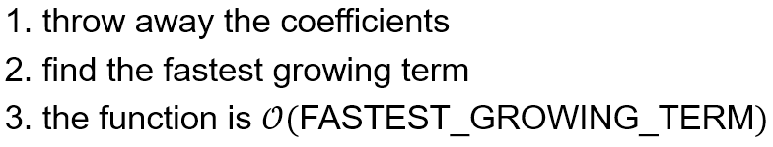

big O (2/2)
what is $f\left(n\right)=77n^{7}+2^{n}$ in big O notation?
$n^{7}+2^{n}$
$2^{n}$ 🧪 is this true?
$𝒪(2^{n})$
what is $f\left(n\right)=100$ in big O notation?
$1$
$1$ 🧠 what does this mean?
$𝒪(1)$
what is $f\left(n\right)=n+log⁡(n)$ in big O notation?
$n+log⁡(n)$
$n$ 🧪 is this true?
$𝒪(n)$

Slide 452
logarithmic growth is the inverse of exponential growth

Slide 453
y = 2^{x}
🧠 solve for x.

Slide 454
y = 2^{x} x = log₂ y

Slide 455

y = 2^{x} x = log₂ y
y
x

Slide 456
y = 2^{x} x = log₂ y
y
x

Slide 457
big O runtime (arrays)

Slide 458

runtime of array operations
arrays are fast!
⏱️ creating an array takes $𝒪(n)$ time, where $n$ is the length of the array
⏱️ getting the value of the i-th element of an array takes $𝒪(1)$ time
⏱️ setting the value of the i-th element of an array takes $𝒪(1)$ time

Slide 459

accessing an array "under the hood"
how Java does array[4], step-by-step:
start at the head (0-th element) of the array 🟦⬛⬛⬛⬛⬛⬛⬛
move over 4 slots (using an $𝒪(1)$ "add") ⬛⬛⬛⬛🟦⬛⬛⬛
return the value of the element in that slot ⬛⬛⬛⬛🟨⬛⬛⬛
we can't actually see Java do this (it's too "low level")
but we *can* see C do it! (stay tuned 🙂)

Slide 460
big O runtime (code)

Slide 461

big-O runtime (1/3)
big-O runtime (running time, time complexity) gives us a big-picture idea of how long a function will take to run (execute, finish)
a function that operates on $n$ things, could be...
$𝒪(1)$ (constant time) 😀 FAST
$𝒪(\log_{2}{n})$ (logarithmic time, log time) 🙂 fast
$𝒪(n)$ (linear time) 😐 meh
$𝒪(n^{2})$ (quadratic time) ☹️ slow
$𝒪(2^{n})$ (exponential time) 😦 SLOW

Slide 462

big O runtime (2/3)
big O runtime is how much time it takes code to run (in the worst case)
time is measured in the number of $𝒪\left(1\right)$(constant time) operations
examples of $𝒪\left(1\right)$ operations:
a + b
c && d
!e
f = g
a += b // NOTE: O(1) + O(1) = O(1)
array[i]

Slide 463

big O runtime (3/3)
example of $𝒪\left(n\right)$ algorithms:
create new array of length n (NOTE: this is a definition)
print array of length n
deep copy array of length n
in-place reverse array of length n
examples of $𝒪\left(n^{2}\right)$ algorithms:
bubble sort array of length n

Slide 464
fun examples

Slide 465


Caaaaaaaaaaaarl
e.g., Imagine a classroom with $n$ students. I want to figure out if any students are named Carl.
I need an ✨Algorithm✨ -- boolean isAnyoneNamedCarl(Student[] students);
What is the big O of the following algorithms?
Algorithm 1: Ask each student, one at a time, “Are you named Carl?”
Algorithm 2: Pass a paper around the room, and have each student write their name on it. Then take the paper, and read through it.
Algorithm 3: The students draw straws one at a time. The student who draws the short straw must leave. On their way out of the room, ask them whether their name is Carl. Repeat this procedure until the room is empty.
Algorithm 4: Play Kahoot. The winner legally changes their name to Carl.

Slide 466
textbox examples

Slide 467
let's say n equals buffer.length

Slide 468
what's the big O of pressing →?

Slide 469
what's the big O of pressing A?

Slide 470
💻 array tutorial

Slide 471
💻 array tutorial

Slide 472
💻 array tutorial
// 🟢 ([5, 4, 7, 0, 7], 7) -> 2
// 🟢 ([5, 4, 7, 0, 7], 3) -> -1
static int findFirstIndexOf(int[] array, int value);
// 🟦 ([1, 3, 3, 2, 3, 4], 3) -> [1, 2, 4]
static int[] removeAllOccurences(int[] array, int value);
// ♦️ [[1, 3], [2, 4, 5], [0, 5]] -> [0, 1, 2, 3, 4, 5, 5]
static int[] mergeArrayOfSortedArrays(int[][] arrays);

Slide 473
Week01
🦜
tips and tricks
operators
control flow
Cow.Java
WARMUP
foo = (2 * 5.0) - 1.0;
what type is foo?
what value is foo?
bar = (3 > foo);
what type is bar?
what value is bar?
char baz = 'A' + ('7' - '5');
what value is baz?

Slide 474
tips and tricks

Slide 475
"hot code replace failed" Eclipse message

Slide 476

if you've been getting this error a bunch...

Slide 477

make sure you are pressing this button after every crash / failed assert (otherwise Eclipse keeps your program running, and will try to "hot swap" your changes into it)

Slide 478
you can also press this button (which, for us, does basically the same thing)

Slide 479
you can also just close Eclipse and reopen it if anything really weird happens 🤷

Slide 480
how to email jim

Slide 481
first, how to email not-jim
Subject Line: Question Regarding The Reading
Email Body:
Dear Prof. Dr. Professorson Ph.D Exquire,
I hope you are having a wonderful afternoon; that the morning sun is shining upon you this fine evening, and that you do not feel the quiet whisper of the all-consuming Void chilling you to your very core.
I am writing because I am unclear on the assigned reading for tomorrow. Your very, very helpful syllabus says to read pages 300 – 500 of Beowulf, however the book is, it seems, much fewer than 500 pages long.
Thank you so much for your help with this matter. I appreciate the time you take in supporting me in my studies—I could not do this without you.
Sincerely,
James Bern
Caltech '15

Slide 482

how to email jim
Subject Line: brew won't install 😡

Slide 483

how to email jim
Subject Line: can't run tic tac toe 😢

Slide 484
this is the fastest way to get your question answered i will not be offended i promise

Slide 485
how to do HW

Slide 486
implement one thing at a time get it working perfectly then, try the next thing

Slide 487

code up the entire homework without ever trying to run it
compile early; compile often

Slide 488

compilers

Slide 489
operators (except for bitwise operators, which we'll do later maybe)

Slide 490
assignment operator

Slide 491
assignment operator
= assigns the value on the right-hand side to the variable on the left-hand side
int i = 0; // 0 ("int i now has the value 0")
double foo = coolFunction();
☠ the assignment operator returns the value it assigned this is usually pretty confusing
boolean b = false;
boolean c = (b = foo());

Slide 492
arithmetic operators

Slide 493
basic arithmetic (number) operators
+ adds two numbers
- subtracts two numbers
* multiplies two numbers
/ divides two numbers
☠ an int divided by an int is an int
int foo = 8 / 2; // 4
int bar = 7 / 2; // 3
Java "throws away the remainder"
- returns the negative of a number
int bar = -7; // -7 ("negative 7" or "minus 7")
int baz = -bar; // 7

Slide 494
modulo
x % y returns the remainder of (x / y) and is read "x modulo y"
int foo = 17 % 5; // 2 ("17 divided by 5 is 3 remainder 2")
☠ % probably doesn't do what you expect for negative numbers; if x can be negative, use MODULO(x, y) instead
5 % 3 // 2
4 % 3 // 1
3 % 3 // 0
2 % 3 // 2
1 % 3 // 1
0 % 3 // 0
-1 % 3 // -1 🤔
MODULO(-1, 3) // 2 🙂👍

Slide 495
modulo

Slide 496
7 % 3
2
R1
3
7
-
6
1

Slide 497
🐍 -7 % 3
☕️ MODULO(-7, 3)
☕️ -7 % 3
-2
R-1
3
-7
-7 - (-6)
= -7 + 6
= -1
+ 3 = 2
-
-6
-1
-1

Slide 498
%
x % y returns the remainder of (x / y) and is read "x modulo y"
int foo = 17 % 5; // 2 ("17 divided by 5 is 3 remainder 2")
☠ % probably doesn't do what you expect for negative numbers; if x can be negative, use Math.floorMod(x, y) instead
5 % 3 // 2
4 % 3 // 1
3 % 3 // 0
2 % 3 // 2
1 % 3 // 1
0 % 3 // 0
-1 % 3 // -1 WAIT WHAT 🤔
MODULO(-1, 3) // 2 🙂👍

Slide 499
MODULO(x, y)
MODULO( 5, 3) // 2
MODULO( 4, 3) // 1
MODULO( 3, 3) // 0
MODULO( 2, 3) // 2
MODULO( 1, 3) // 1
MODULO( 0, 3) // 0
MODULO(-1, 3) // 2
MODULO(-2, 3) // 1
MODULO(-3, 3) // 0
MODULO(-4, 3) // 2
MODULO(-5, 3) // 1
MODULO(-6, 3) // 0
MODULO(-7, 3) // 2

Slide 500
logical operators

Slide 501
logical operators (1/2)
|| returns whether the left-hand side or the right-hand side is true
(true || true) // true
(true || false) // true
(false || true) // true
(false || false) // false
&& returns whether the left-hand side and the right-hand side are true
(true && true) // true
(true && false) // false
(false && true) // false
(false && false) // false
! returns the opposite of a boolean, and is read as "not"
(!true) // false ("not true")
(!false) // true

Slide 502
logical operators (2/2)
// example, step by step
boolean a = (2 + 2 == 5); // false
boolean b = true; // true
boolean c = (a || b); // true
boolean d = !c; // false
// same thing all on one line
boolean d = !((2 + 2 == 5) || true); // false
// equivalent code
boolean d = false;

Slide 503
☠ logical operator short-circuiting
(false && foo()) "lazily" evaluates to false without evaluating foo()
(true || foo()) "lazily" evaluates to true without evaluating foo()

Slide 504
comparison operators

Slide 505
☠ equality (is equal to)
== returns whether the left-hand side is equal to the right-hand side
boolean b = (foo == bar);
if (foo == bar) { ... }
☠ this does NOT work for String's
instead, use (stringA.equals(stringB))
☠ this (usually) does NOT work for double's
instead, use ARE_EQUAL(double1, double2)

Slide 506
is greater than, is less than
> returns whether the left-hand side is greater than the right-hand side
< returns whether the left-hand side is less than the right-hand side

Slide 507
convenient operators (feel free to ignore these for now)

Slide 508
inequality
!= returns whether the left-hand side is not equal to the right-hand side
(left != right) is exactly the same as (!(left == right))

Slide 509
greater than or equal to, less than or equal to
>= returns whether the left-hand side is greater than or equal to the right-hand side
(left >= right) is basically the same as ((left > right) || (left == right)) greater-than or equal
<= returns whether the left-hand side is less than or equal to the right-hand side

Slide 510
arithmetic assignment operators
a += b; // a = a + b;
a -= b; // a = a - b;
a *= b; // a = a * b;
a /= b; // a = a / b;

Slide 511
String concatenation
+ concatenates two String's
// String foo = "Hello".concat("World"); String foo = "Hello" + "World"; // "HelloWorld"
it also does some conversions for you (very convenient, kind of confusing)
// String foo = "Hello".concat(Integer.toString(2)); String foo = "Hello" + 2; // "Hello2"

Slide 512
increment operator
to "increment" means to increase the value of a number by one
i = i + 1;
i += 1;
the pre-increment ++i increments i and returns the new value of i
j = ++i; // i = i + 1;
// j = i;
the post-increment i++ increments i and returns the old value of i
j = i++; // j = i;
// i = i + 1;

Slide 513
decrement operator
to "decrement" means to decrease the value of a number by one
i = i - 1;
i -= 1;
the pre-decrement --i decrements i and returns the new value of i
j = --i; // i = i - 1;
// j = i;
the post-decrement i-- decrements i and returns the old value of i
j = i--; // j = i;
// i = i - 1;

Slide 514
Week01b
🦜
🐝
record lecture
tips and tricks
operators
control flow
Cow.Java
REVIEW
foo = true;
bar = false;
baz = (!(!foo || !bar) && !!foo);
what value is baz?
WARMUP
A) imagine if code didn't have for, while, or functions...
B) imagine if it didn't have if...
could it get the job done?
could it ✨spark joy✨?

Slide 515
control flow

Slide 516
the execution of a Java program starts at the top of main(...) and flows down down down

Slide 517
let's step through this program in our minds, and then in a debugger
class Main extends Cow {
public static void main(String[] arguments) {
double a = 3.0;
double b = 4.0;
double result = SQRT(a * a + b * b);
PRINT(result);
}
}

Slide 518
[visualizing the flow of HW00A in a debugger] 💻👥

Slide 519
functions (preview)

Slide 520
functions (preview)
when a function is called, control flow jumps to the top of the function, flows down through it, and then jumps back to right after the function call
class Main {
static double pythagoreanTheorem(double a, double b) {
return Math.sqrt(a * a + b * b);
}
public static void main(String[] arguments) {
double hypotenuse = pythagoreanTheorem(3.0, 4.0);
System.out.println(hypotenuse);
}
}

Slide 521
ASSERT

Slide 522
ASSERT(condition);
an assert statement crashes the program if its condition is false
ASSERT(false); crashes the program no matter what
class Main {
static double pythagoreanTheorem(double a, double b) {
ASSERT(a > 0.0);
ASSERT(b > 0.0);
return Math.sqrt(a * a + b * b);
}
public static void main(String[] arguments) {
double hypotenuse = pythagoreanTheorem(3.0, 4.0);
PRINT(hypotenuse);
}
}

Slide 523
assert condition; (Java Java)
☠ Java's asserts are actually disabled by default (wat)
you can enable them in Eclipse, but it's easy to forget to do

Slide 524
if and else

Slide 525
if (condition) { body }
an if statement lets a program make a decision (instead of just stepping down down down forever down)
int choice = getIntFromUser();
if (choice == 0) {
System.out.println("The user chose 0. What a fine choice");
}

Slide 526
if (...) { if-body } else { else-body }
the body of an else statement is executed if its corresponding if statement's condition is false
int choice = getIntFromUser();
if (choice == 0) {
System.out.println("The user chose 0. What a fine choice");
} else {
System.out.println("The user did not choose 0.");
System.out.println("How avant-garde!");
}

Slide 527
if (...) { ... } else if (...) { ... } ... else { ... }
if and else statements can be chained together
this is great for decisions with many options
int choice = getIntFromUser();
if (choice == 0) {
...
} else if (choice == 1) {
...
} else if (choice == 2) {
...
} else {
ASSERT(false);
}

Slide 528
while and do...while

Slide 529
while (condition) { body }
a while loop repeats a block of code as long as the condition holds (if the condition is false the first time we see it, we never execute the body)
while (true) { ... } is an infinite loop
while (!gameOver) {
...
if (player.health <= 0) {
gameOver = true;
}
}

Slide 530
do { ... } while (...);
a do...while loop is (sometimes) useful when you know you need to do something at least once (and then potentially a bunch more times)
int choice;
do {
choice = getIntFromUser();
} while (!(0 <= choice && choice <= 2));
int choice = getIntFromUser();
while (!(0 <= choice && choice <= 2)) {
choice = getIntFromUser();
}

Slide 531
for

Slide 532
for (...; condition; ...) { ... } (1/2)
a for loop can be a convenient alternative to a while loop
for (int i = 0; i < n; ++i) {
...
}
{
int i = 0;
while (i < n) {
...
++i;
}
}

Slide 533
for (...; condition; ...) { ... } (2/2)
for loops can be kind of wild (probably stick with simple ones for now)
for (double a = 10.0; (a > 1.01); a = SQRT(a)) {
...
}
for (int j = n - 1, i = 0; (i < n); j = i++) {
...
}
for (;;) {
...
}

Slide 534
break and continue

Slide 535
break
break breaks out of a loop
while (true) {
...
if (player.health <= 0) {
break;
}
}

Slide 536
continue
continue continues to the next iteration of a loop
for (int i = 0; i < chairs.length; ++i) {
if (chairs[i].hasStudentSittingInIt) {
continue;
}
...PRINT student's name...
}

Slide 537
exceptions to the rule that "scope is the same as curly braces"

Slide 538
for (...; ...; ...) { ... }
variables declared inside the parentheses of a for loop are not available outside of the for loop (this is probably the behavior you already expected)
Compile Error: cannot find symbol i
class Main {
public static void main(String[] arguments) {
for (int i = 0; i < 10; ++i) {
...
}
PRINT(i);
}
}

Slide 539
☠ if, else, for, while without braces (1/2)
☠ if you (intentionally or unintentionally) forget your curly braces, then Java will assume you wanted them go around the first statement after the if (...), else, for (...), or while (...)
in this class, i highly recommend always using curly braces
if (choice == 0)
System.out.println("The user chose 0. What a fine choice");
if (choice == 0) {
System.out.println("The user chose 0. What a fine choice");
}

Slide 540
☠ if, for, while without braces (2/2)
if (choice == 0)
PRINT("The user chose 0. What a fine choice");
else
PRINT("The user did not choose 0.");
PRINT("How avant-garde!");
if (choice == 0) {
PRINT("The user chose 0. What a fine choice");
} else {
PRINT("The user did not choose 0.");
} // whoops!
PRINT("How avant-garde!");

Slide 541
Week01c
🦜
🐝
record lecture
tips and tricks
operators
control flow
Cow.Java
story tiiiime ☕️
NOTE: if lab too loud can use other room
REVIEW / WARMUP
1) what is 1234 % 10?
2) what is 1234 / 10?
3) what is 1 / 10?
4) implement int digitSum(int n) { ... }
using a while loop
BONUS: what does this print?
double a = -42.0;
double b = 0 * a;
PRINT(b);
PRINT(b == 0.0);

Slide 542
Java doesn't have a goto
NOTE: gray sections are just for fun; not on the HW; not on the tests

Slide 543
goto

Slide 544
goto label;
a goto "goes to" some label
it turns out loops are just convenient alternatives to goto's
goto's are considered *spooky*👻
while (condition) {
...
}
label BEGINNING_OF_WHILE:
if (!condition) {
goto END_OF_WHILE;
}
...
goto BEGINNING_OF_WHILE;
label END_OF_WHILE:

Slide 545


Slide 546


Slide 547


Slide 548




Slide 549
story time ☕️

Slide 550


Slide 551


Slide 552


Slide 553
{
}
goto fail;

Slide 554
did the bug really happen because they left out the curly braces?

Slide 555


Slide 557
press CTRL+A and then press CTRL+I

Slide 558
🙂👍

Slide 559
Cow.Java

Slide 560
overview during a frame (like a frame of a movie) we update and draw the world

Slide 561

beginFrame()
beginFrame()
beginFrame()
beginFrame()
beginFrame()
beginFrame()

Slide 562
[discussion of update-draw loop]

Slide 563
your best friend

Slide 564

DOCUMENTATION

Slide 565
[examples]

Slide 566
Cow.java examples
rainbow circle example
grid
checkerboard
paint

Slide 567
Week00
Hans the Announcement Parrot
🦜
introduce class
introduce self
take roll
syllabus
type
whitespace
scope
success tips
fix Eclipse installs
NOTE: lecture is recorded and posted ~noon same day
NOTE: Homework00 is due on Monday
NOTE: Help Hours start on Monday

Slide 568
record lecture!

Slide 569
introduce class

Slide 570
what is CS 136?
a computer science major requirement 🎉
a bridge between coding and theory
about how you store data (HINT: in an array)
harder problems
bigger problems
good prep for coding interviews 💸
going beyond "it works" to different measures of "good"
speed 🦔
space 🐘
elegance? ✨

Slide 571
introduce self

Slide 572
[other slide deck]

Slide 573
take roll

Slide 574
take roll
this is the only time i will ever take roll
this is also the only time i will wear a coat 😢
please correct me if i mispronounce your name
if you are not yet enrolled, please fill out the other sheet now

Slide 575
syllabus

Slide 576
syllabus

Slide 577
syllabus
🚌

Slide 578
syllabus
🚌
🪟

Slide 579
the syllabus is online https://github.com/james-bern/CS136/wiki

Slide 580
grading

Slide 581
final grade
final grade is 1/3 homework, 1/3 midterm exam, 1/3 final exam
homework is on an A- (90), A (95), A+ (100) scale
A- is meant to be doable
A is meant to be challenging
A+ is meant to be a growth opportunity 🪴
i will go over some of your homework with you during lab and ask you questions about it 🙂👍
exams are in-person, on-paper, no-notes
questions are either similar to homework, or similar to PracticeExam
"if you understand the (A- and A) homework, the exam should be unsurprising and approachable"

Slide 582
😈 ChatGPT

Slide 583
ChatGPT can do every homework in this class up to an A level 😈 it is impossible for me to prove whether or not you used ChatGPT (people who say otherwise are wronggg)

Slide 584
so, ChatGPT, etc. are "allowed," but...
you are not allowed copy and paste code from anywhere
bad bad very bad don't do it
(unless i gave you the code then it's fine 🙂👍)
you can't use ChatGPT, etc. on exams
😈 "if your coding job can be done by an AI, then it will be done by an AI"

Slide 585
collaboration

Slide 586

😈

Slide 588
Java

Slide 589
Java

Slide 590
☕️

Slide 591
this class is in Java

Slide 592
this class is in Cow.Java

Slide 593
which is basically C

Slide 594
by which I mean Java

Slide 595
type

Slide 596
type

Slide 597
a variable in Java has a type
# okay in Python
foo = 7 # foo is an int
foo = False # now, foo is a boolean
// NOT okay in Java
int foo = 7; // foo is an int
foo = false; // Error: incompatible types:
// boolean cannot be converted to int

Slide 598
declaring and initializing are separate things
// Option A: one line int foo = 7; // declare int foo and initialize it to 7
// Option B: two lines int foo; // declare a variable foo of type int foo = 7; // initialize foo to 7

Slide 599
primitive types

Slide 600
primitive types
in this class, "a variable being a primitive" means that the variable is a boolean, char, double, or int
primitive types are simple
primitive types are small
primitive types are NOT Objects
we will talk about Objects later
examples of Objects: String, MyCoolClass, int[] (array of ints)

Slide 601
boolean, char, double, int
a boolean stores a truth value
true, false
a char stores a character
'\0', 'a', 'Z', '!', '\n'
a double stores a real number
0.0, -0.5, 3.1415926, Double.NEGATIVE_INFINITY
an int stores an integer
0, -1, 4

Slide 602
primitive type Venn diagram
integers
numbers
char
double
boolean
int

Slide 603
char is an integer type
a char is an integer type
each char has a corresponding integer, for example ('a' == 97)
the letters are in order ('a' == 97), ('b' == 98), ('c' == 99)...
the numbers are also in order ('0' == 48), ('1' == 49)...
you can do math with char's
char foo = 'a' + 2; // foo is 'c'
char bar = '0' + 7; // bar is '7'
int baz = '6' - '0'; // baz is 6

Slide 604
zero
each primitive data type has its own notion of what it means to "be zero"
int zero = 0;
double zero = 0.0;
boolean zero = false;
char zero = '\0'; // the "null character"

Slide 605
whitespace

Slide 606
whitespace

Slide 607
whitespace
whitespace includes spaces, tabs, and newlines
🐍 Python does care about whitespace (indentation changes what code does)
☕️ Java does NOT care about whitespace (it cares about curly braces)
🗣️ do you care about whitespace?
some guidelines:
be consistent
make sure your curly braces line up
✨ use Eclipse's auto-indentation feature (see Tut00)! no excuses!
sparks joy | NOT equivalent -- doesn’t spark joy
for (int i = 0; i < 10; ++i) { if (i % 3 == 0) { System.out.println("fizz"); } } | for (int i = 0; i < 10; ++i) { if (i % 3 == 0) { } System.out.println("fizz"); }

Slide 608
scope

Slide 609
scope

Slide 610
scope
a scope is a region of code in which variables live
in Java, a scope is (usually) defined by a pair of curly braces
OUTER_SCOPE { INNER_SCOPE } OUTER_SCOPE
{
int i;
{
int j;
// you CAN use i here 🙆‍♂️
// you CAN use j here 🙆‍♂️
}
// you CAN use i here 🙆‍♂️
// you CANNOT use j here 🙅
}

Slide 611
common scope-related errors

Slide 612
cannot be resolved to a variable
Compile Error: foo cannot be resolved to a variable
class Main extends Cow {
public static void main(String[] arguments) {
if (...) {
int foo = 0;
} else {
int foo = 1;
}
PRINT(foo);
}
}

Slide 613
cannot be resolved to a variable
class Main extends Cow {
public static void main(String[] arguments) {
int foo;
if (...) {
foo = 0;
} else {
foo = 1;
}
PRINT(foo);
}
}

Slide 614
duplicate local variable
Compile Error: duplicate local variable foo
class Main extends Cow {
public static void main(String[] arguments) {
int foo;
if (...) {
int foo = 0;
} else {
foo = 1;
}
PRINT(foo);
}
}

Slide 615
duplicate local variable
class Main extends Cow {
public static void main(String[] arguments) {
int foo;
if (...) {
foo = 0;
} else {
foo = 1;
}
PRINT(foo);
}
}

Slide 617
success tips

Slide 618
success tips (1/3)
establish basic study habits (this might not have been necessary in highschool; it most likely is now)
start homework early! (very hard to code well while stressed)
don't work in a vaccuum
collaborate with your friends / acquaintences / enemies
come to help hours (they are there for you!)
code a lot (ideally, 5+ days per week)
if the homeworks are feeling too hard, talk to me; we have resources!
if the homeworks are too easy, do the A+ / A++; do side projects; just keep coding; code code code code code; COOOOOOOOODE

Slide 619
success tips (2/3)
try to find your own bugs
this is a huge skill; it takes time (and pain) to build
try to answer your own questions (using Google!) ("what does IDE stand for?"; "what does this error message mean?")
this is also a huge skill; it also takes time (and pain) to build
however, if you are stuck (>= 10+ minutes of pain), ASK FOR HELP
there is literally no judgement here; we all have different starting points; my only goal is for all students to get stronger and have fun 🙂👍
and, for what it's worth, i was a mechanical engineering undergrad and my first comp sci course was *terrifying* (though, eventually, fun)

Slide 620
most importantly though

Slide 621

you gotta push the button

Slide 624
come see me if you had trouble with Tut00 otherwise, see you in class on Monday 🌞

Slide 626
☕️ the art of coding things in the right order compile and run early compile and run often

Slide 627
why implement Rule 22 first? why not just skip straight to the general case?

Slide 628
well, let us imagine...

Slide 629
let's imagine...
...you decide to develop $n$ different things at once...
...and then, finally, you compile and run...
...aaaaand you have a bug! 🐛
so...what is the cause of the bug? what code is broken? 🤔
well...i guess it could be any of the $n$ things you just wrote!
and while $𝒪(n)$ possible sources of bugs might seem bad...

Slide 630
...the reality is ✨so much worse✨!

Slide 631
because broken code likes to interact with other broken code, to make✨super bugs✨!

Slide 633
not broken
broken
developing one thing at a time

Slide 634
not broken
A is broken
B is broken
A and B are both broken
developing two things at a time

Slide 635
asymptotic bug-finding time

Slide 636
$$𝒪(2^{n})$$
gl;hf 🙂👍

Slide 637
big lesson
implement code one thing at a time
compile and run and test after implementing every single thing
this is a learned skill!
how i would actually implement the automata homework
make the array
print the array as an array
print the array as a string
update the array once using Rule 22 and print the result
wrap the printing and update in a for loop
implement code to handle all rules and test it on Rule 22
test it on the other rules

Slide 638
this is a learned skill!

Slide 639
in summary

Slide 640
colloquium

Slide 641
where is everyone?

Slide 642


San Diego 🌞🏝️🏄‍♀️🌮

Slide 643
we have snacks!

Slide 644
wait till the end 🍪

Slide 645
wait till the end 🥲

Slide 646
🥲

Slide 647
🍪

Slide 648
odd.

Slide 649
announcements

Slide 650
juggling club is after colloquium 🤹‍♀️

Slide 651
juggging club after colloquium 🤹‍♀️
juggling
is
colloquium
club
after

Slide 652
note: alumnus Rich Ward '89 sent us juggling clubs! they are fun and purple and gold

Slide 653


Slide 654


Slide 655
note: alumnus Rich Ward '89 sent us juggling clubs! they are fun and purple and gold

Slide 656
note: in unrelated news, the Registered Student Organization known as the Williams Juggling Club is now the Ward Juggling Club ✨

Slide 657
:D

Slide 658
any other announcements?

Slide 659
speaker

Slide 660
Hannah Gommerstadt
🥾
🥾
Position: Assistant Professor of Computer Science at Vassar
Research: Programming Languages; Concurrent Data Structures
Teaching: Compilers, Functional Programming, Discrete Math
Hobbies: Hiking

Slide 661
int a = 5; int b=8;

Slide 662
ANNOUNCEMENTS welcome back i hope you had a nice mountain day :)
WARMUP what is this robot for? →
TODAY stacks and queues

Slide 663
record LEC-02

Slide 664
where are we?

Slide 665
recap of first half

Slide 666
we built a foundation
Java!
types, operators, & compiler errors
when should we compile?
early and often!
avoid repetition!
functions!
for when we have the same chunk of logic repeated in multiple places
classes!
for when we repeatedly pass around the same chunk of data

Slide 667
we started thinking about code more deeply
the array!
how *fast* is an array?
what are pros and cons of the array?
how might we address the cons of an array?
the array list!
how *fast* is an array list? best case? worst case? ...
what are pros and cons of the array list?
how might we address the cons of an array list?
...

Slide 668


Slide 669
preview of second half

Slide 670
we will look at how to structure data
we will meet a whole menagerie of data structures
stacks
queues
hash tables
linked lists
trees
graphs
heaps
we will analyze speed and space

Slide 671
we will learn to choose the right data structure for the job
fun homeworks (at least in my opinion) 🙂👍
Flip Book
array list of array lists of array lists of Vector2's
PostScript Interpreter
stack and hash table
Text Generator
hash table of hash tables
...

Slide 672
data structures

Slide 673
what is a data structure? why is a data structure?

Slide 674
data structures
In computer science, a data structure is a data organization, management, and storage format that is usually chosen for efficient access to data.^{[1][2][3]} More precisely, a data structure is a collection of data values, the relationships among them, and the functions or operations that can be applied to the data,^{[4]} i.e., it is an algebraic structure about data. --Wikipedia

Slide 675
data structures
In computer science, a data structure is the organization and implementation of values and information. In simple words, it is the way of organizing information in a computer so that it can be more easily understood and worked with. --Simple Wikipedia

Slide 676
data structures
A data structure is...a system for organizing and using information... It...make[s] information easier to understand and work with.. --Simple Wikipedia, further simplified by ChatGPT

Slide 677
data structures
data means numbers (and letters)
a data structure organizes your data
for a particular task...
...a good data structure is...
easy to work with (programmer time)
runs fast (runtime / user's time)

Slide 678
were array lists a good choice for implementing a Flip Book? 💭 (how) could you have done it with just arrays?

Slide 679
we didn't know how many...
frames in each animation
strokes in each frame
points (Vector2's) in each stroke

Slide 680
"Alternative" 1: just use arrays, but resize them yourself when needed (essentially, implement the functionality of an array list without actually having a class)

Slide 681
"Alternative" 2: // ~30,000,000 elements Vector2[][][] animation = new Vector2[64][512][1024]; // need all these counter variables // can't just call .size() like before! int numFrames = 0; int[] numStrokes = ...; int[][] numPoints = ...;

Slide 682
interface

Slide 683
interface
add, get, set, remove, ...
ArrayList<ElementType>'s
state
your state

Slide 684


Slide 686
interface
a data structure's interface (API) or abstract data type is a set of functions a data structure must have
a list has...
get
set
add
remove
etc.
a data structure is a specific implementation (code that does the thing) of that interface
an array list implements the list interface using an array
🔮 a linked list implements a list using nodes that refer to nodes

Slide 687
you can get (very) formal about this
The abstract list type L with elements of some type E (a monomorphic list) is defined by the following functions:
nil: () → L
cons: E × L → L
first: L → E
rest: L → L
with the axioms
first (cons (e, l)) = e
rest (cons (e, l)) = l
for any element e and any list l. It is implicit that
cons (e, l) ≠ l
cons (e, l) ≠ e
cons (e₁, l₁) = cons (e₂, l₂) if e₁ = e₂ and l₁ = l₂
Note that first (nil ()) and rest (nil ()) are not defined.
These axioms are equivalent to those of the abstract stack data type.

Slide 688
i typically won't. just know there is a difference between interface ("list") and implementation (ArrayList<Element>)

Slide 689
Tungsten break 😀 did you know the density of Tungsten is 19.25 g/cm³? Gold is 19.32 g/cm³ did you know Tungsten is really hard? Tungsten alloys can be as hard as Sapphire! that's really hard! Tungsten is expensive (that cube is $60) but not like...that expensive what could YOU do with Tungsten?

Slide 690
stacks

Slide 691
stack

Slide 694
pushing
popping

Slide 696
stack interface
// Push (add) a new element to the top of the stack. void push(ElementType element);
// Pop (remove) the top element of the stack. // and returns it. ElementType pop();
// Peek (look) at the top element of the stack // (without removing it) and return it. ElementType peek();
// Returns the number of elements currently in the stack. int size();

Slide 697
queues

Slide 698
queue

Slide 700
Back

Slide 701

Back
add
remove

Slide 702
queue interface
// Add (enqueue) a new element to the back of the queue. void add(ElementType element);
// Remove (dequeue) the front element of the queue // and return it. ElementType remove();
// Peek (look) at the front element of the queue // (without removing it) and return it. ElementType peek();
// Returns the number of elements currently in the queue. int size();

Slide 703
why stacks and queues in the same lecture?

Slide 704
stack interface
// Push (add) a new element to the top of the stack. void push(ElementType element);
// Remove (pop) the top element of the stack. // and returns it. ElementType pop();
// Peek (look) at the top element of the stack // (without removing it) and return it. ElementType peek();
// Returns the number of elements currently in the stack. int size();

Slide 705
queue interface
// Add (enqueue) a new element to the back of the queue. void add(ElementType element);
// Remove (dequeue) the front element of the queue // and return it. ElementType remove();
// Peek (look) at the front element of the queue // (without removing it) and return it. ElementType peek();
// Returns the number of elements currently in the queue. int size();

Slide 706
💭 what are some example uses of stacks and queues in computer science?

Slide 708
ANNOUNCEMENTS today is Laptop Wednesday!
replace interpret(...tokens) with version from the Writeup
WARMUP a couple (slightly silly) interview questions
- implement a stack using a (basic) queue
- just implement push and pop (and peek?)
- (don't worry about efficiency)
- pseudocode is fine
- what is the runtime (big O)?
- implement a queue using 2 stacks TODAY stacks and queue tutorial

Slide 709
record LEC-02

Slide 710
Stack and Queue tutorial 💻

Slide 711
the midterm 😱

Slide 712
i graded the midterm over the weekend

Slide 713
i had so much fun

Slide 714
not really

Slide 715


Slide 717
the midterm
overall, i think it went well!
MEAN ~ 87
STANDARD DEVIATION ~ 11
if you have any questions (how to prep for final, why did you lose points), let's chat in Lab (we can also schedule a chat)
notes on grading
some feedback just for your benefit (no lost points) – variable names, etc.
feedback is very sparse! (please ask questions if unsure what i mean)

Slide 718


some common pain points
i have removed them from the HW-03;
let's take a look
let's also redo this problem together on the board
"convenience variables" created lots of problems
this is an example of modifying an array while you're iterating over it (see HW-02 README)
let's redo it together on the board

Slide 719
ANNOUNCEMENTS today is Friday! (fun Colloquium today at 2:35 in TCL 123)
apply to TA next semester! also next next (next?) semester!
WARMUP implement a queue using two stacks
- just implement add and remove (and peek?)
- (don't worry about efficiency)
- pseudocode is fine
- what is the runtime (big O)?
TODAY odds and ends

Slide 720
record LEC-02

Slide 721
tricky midterm questions

Slide 722
Player -> Player[]

Slide 723
question
class HW03 extends App { // BEFORE
Player player;
void setup() {
player = new Player();
player.color = Vector3.cyan;
player.radius = 4.0;
player.position = new Vector2(0.0, 0.0)
}
}

Slide 724
answer
class HW03 extends App { // AFTER
Player[] players;
void setup() {
players = new Player[4];
for (int i = 0; i < players.length; i++) {
players[i] = new Player();
players[i].radius = 4.0;
players[i].position = new Vector2(0.0, 0.0);
}
players[0].color = Vector3.red;
players[1].color = Vector3.orange;
players[2].color = Vector3.yellow;
players[3].color = Vector3.green;
}
}

Slide 725
alternate answer
class HW03 extends App { // AFTER
Player[] players;
Vector3[] colors =
{ Vector3.red, Vector3.orange, Vector3.yellow, Vector3.green };
void setup() {
players = new Player[4];
for (int i = 0; i < players.length; i++) {
players[i] = new Player();
players[i].radius = 4.0;
players[i].position = new Vector2(0.0, 0.0);
players[i].color = colors[i];
}
}
}

Slide 726
what will this code print? (arrays and array lists)

Slide 727
question
int[] array = { 2, 3, 4 };
ArrayList<Integer> list = new ArrayList<>();
for (int i = 0; i < array.length; ++i) {
for(int rep = 0; rep < 3; ++rep) {list.add(array[i]);}
}

Slide 728
question
int[] array = { 2, 3, 4 };
ArrayList<Integer> list = new ArrayList<>();
int i = 0;
for (int rep = 0; rep < 3; ++rep) { list.add(array[i]); }
i = 1;
for (int rep = 0; rep < 3; ++rep) { list.add(array[i]); }
i = 2;
for (int rep = 0; rep < 3; ++rep) { list.add(array[i]); }

Slide 729
question
int[] array = { 2, 3, 4 };
ArrayList<Integer> list = new ArrayList<>();
for (int rep = 0; rep < 3; ++rep) { list.add(array[0]); }
for (int rep = 0; rep < 3; ++rep) { list.add(array[1]); }
for (int rep = 0; rep < 3; ++rep) { list.add(array[2]); }

Slide 730
question
int[] array = { 2, 3, 4 };
ArrayList<Integer> list = new ArrayList<>();
list.add(array[0]);
list.add(array[0]);
list.add(array[0]);
list.add(array[1]);
list.add(array[1]);
list.add(array[1]);
list.add(array[2]);
list.add(array[2]);
list.add(array[2]);

Slide 731
question
int[] array = { 2, 3, 4 };
ArrayList<Integer> list = new ArrayList<>();
list.add(2);
list.add(2);
list.add(2);
list.add(3);
list.add(3);
list.add(3);
list.add(4);
list.add(4);
list.add(4);

Slide 732
question
int[] array = { 2, 3, 4 };
ArrayList<Integer> list = new ArrayList<>();
list.add(2);
list.add(2);
list.add(2);
list.add(3);
list.add(3);
list.add(3);
list.add(4);
list.add(4);
list.add(4);
// { 2, 2, 2, 3, 3, 3, 4, 4, 4 }

Slide 733
question
// { 2, 2, 2, 3, 3, 3, 4, 4, 4 }
for (int i = 0; i < list.size() / 2; ++i) {
int j = (list.size() - 1) - i;
int tmp = list.get(i);
list.set(i, list.get(j));
list.set(j, tmp);
}

Slide 734
question
// { 2, 2, 2, 3, 3, 3, 4, 4, 4 }
for (int i = 0; i < list.size() / 2; ++i) {
int j = (list.size() - 1) - i;
int tmp = list.get(i);
list.set(i, list.get(j));
list.set(j, tmp);
} // { 4, 4, 4, 3, 3, 3, 2, 2, 2 }

Slide 735
question
// { 4, 4, 4, 3, 3, 3, 2, 2, 2 }
for (int i = 0; i < list.size(); ++i) {
list.set(i, list.get(list.get(i)));
}

Slide 736
question
// { 4, 4, 4, 3, 3, 3, 2, 2, 2 }
for (int i = 0; i < list.size(); ++i) {
int j = list.get(i);
list.set(i, list.get(j));
}

Slide 737
question
// { 4, 4, 4, 3, 3, 3, 2, 2, 2 }
for (int i = 0; i < list.size(); ++i) {
int j = list.get(i);
list.set(i, list.get(j));
}
// 0 1 2 3 4 5 6 7 8
// { 4, 4, 4, 3, 3, 3, 2, 2, 2 }
// ^ ^
// | |
// | j
// |
// i

Slide 738
question
// { 4, 4, 4, 3, 3, 3, 2, 2, 2 }
for (int i = 0; i < list.size(); ++i) {
int j = list.get(i);
list.set(i, list.get(j));
}
// 0 1 2 3 4 5 6 7 8
// { 3, 4, 4, 3, 3, 3, 2, 2, 2 }
// ^ ^
// | |
// | j
// |
// i

Slide 739
question
// { 4, 4, 4, 3, 3, 3, 2, 2, 2 }
for (int i = 0; i < list.size(); ++i) {
int j = list.get(i);
list.set(i, list.get(j));
}
// 0 1 2 3 4 5 6 7 8
// { 3, 4, 4, 3, 3, 3, 2, 2, 2 }
// ^ ^
// | |
// | j
// |
// i

Slide 740
question
// { 4, 4, 4, 3, 3, 3, 2, 2, 2 }
for (int i = 0; i < list.size(); ++i) {
int j = list.get(i);
list.set(i, list.get(j));
}
// 0 1 2 3 4 5 6 7 8
// { 3, 3, 4, 3, 3, 3, 2, 2, 2 }
// ^ ^
// | |
// | j
// |
// i

Slide 741
question
// { 4, 4, 4, 3, 3, 3, 2, 2, 2 }
for (int i = 0; i < list.size(); ++i) {
int j = list.get(i);
list.set(i, list.get(j));
}
// 0 1 2 3 4 5 6 7 8
// { 3, 3, 4, 3, 3, 3, 2, 2, 2 }
// ^ ^
// | |
// | j
// |
// i

Slide 742
question
// { 4, 4, 4, 3, 3, 3, 2, 2, 2 }
for (int i = 0; i < list.size(); ++i) {
int j = list.get(i);
list.set(i, list.get(j));
}
// 0 1 2 3 4 5 6 7 8
// { 3, 3, 3, 3, 3, 3, 2, 2, 2 }
// ^ ^
// | |
// | j
// |
// i

Slide 743
question
// { 4, 4, 4, 3, 3, 3, 2, 2, 2 }
for (int i = 0; i < list.size(); ++i) {
int j = list.get(i);
list.set(i, list.get(j));
}
// 0 1 2 3 4 5 6 7 8
// { 3, 3, 3, 3, 3, 3, 2, 2, 2 }
// ^
// |
// j
// |
// i

Slide 744
question
// { 4, 4, 4, 3, 3, 3, 2, 2, 2 }
for (int i = 0; i < list.size(); ++i) {
int j = list.get(i);
list.set(i, list.get(j));
}
// 0 1 2 3 4 5 6 7 8
// { 3, 3, 3, 3, 3, 3, 2, 2, 2 }
// ^
// |
// j
// |
// i

Slide 745
question
// { 4, 4, 4, 3, 3, 3, 2, 2, 2 }
for (int i = 0; i < list.size(); ++i) {
int j = list.get(i);
list.set(i, list.get(j));
}
// 0 1 2 3 4 5 6 7 8
// { 3, 3, 3, 3, 3, 3, 2, 2, 2 }
// ^ ^
// | |
// j |
// |
// i

Slide 746
question
// { 4, 4, 4, 3, 3, 3, 2, 2, 2 }
for (int i = 0; i < list.size(); ++i) {
int j = list.get(i);
list.set(i, list.get(j));
}
// 0 1 2 3 4 5 6 7 8
// { 3, 3, 3, 3, 3, 3, 2, 2, 2 }
// ^ ^
// | |
// j |
// |
// i

Slide 747
question
// { 4, 4, 4, 3, 3, 3, 2, 2, 2 }
for (int i = 0; i < list.size(); ++i) {
int j = list.get(i);
list.set(i, list.get(j));
}
// 0 1 2 3 4 5 6 7 8
// { 3, 3, 3, 3, 3, 3, 2, 2, 2 }
// ^ ^
// | |
// j |
// |
// i

Slide 748
question
// { 4, 4, 4, 3, 3, 3, 2, 2, 2 }
for (int i = 0; i < list.size(); ++i) {
int j = list.get(i);
list.set(i, list.get(j));
}
// 0 1 2 3 4 5 6 7 8
// { 3, 3, 3, 3, 3, 3, 2, 2, 2 }
// ^ ^
// | |
// j |
// |
// i

Slide 749
question
// { 4, 4, 4, 3, 3, 3, 2, 2, 2 }
for (int i = 0; i < list.size(); ++i) {
int j = list.get(i);
list.set(i, list.get(j));
}
// 0 1 2 3 4 5 6 7 8
// { 3, 3, 3, 3, 3, 3, 2, 2, 2 }
// ^ ^
// | |
// j |
// |
// i

Slide 750
question
// { 4, 4, 4, 3, 3, 3, 2, 2, 2 }
for (int i = 0; i < list.size(); ++i) {
int j = list.get(i);
list.set(i, list.get(j));
}
// 0 1 2 3 4 5 6 7 8
// { 3, 3, 3, 3, 3, 3, 3, 2, 2 }
// ^ ^
// | |
// j |
// |
// i

Slide 751
question
// { 4, 4, 4, 3, 3, 3, 2, 2, 2 }
for (int i = 0; i < list.size(); ++i) {
int j = list.get(i);
list.set(i, list.get(j));
}
// 0 1 2 3 4 5 6 7 8
// { 3, 3, 3, 3, 3, 3, 3, 2, 2 }
// ^ ^
// | |
// j |
// |
// i

Slide 752
question
// { 4, 4, 4, 3, 3, 3, 2, 2, 2 }
for (int i = 0; i < list.size(); ++i) {
int j = list.get(i);
list.set(i, list.get(j));
}
// 0 1 2 3 4 5 6 7 8
// { 3, 3, 3, 3, 3, 3, 3, 3, 2 }
// ^ ^
// | |
// j |
// |
// i

Slide 753
question
// { 4, 4, 4, 3, 3, 3, 2, 2, 2 }
for (int i = 0; i < list.size(); ++i) {
int j = list.get(i);
list.set(i, list.get(j));
}
// 0 1 2 3 4 5 6 7 8
// { 3, 3, 3, 3, 3, 3, 3, 3, 2 }
// ^ ^
// | |
// j |
// |
// i

Slide 754
question
// { 4, 4, 4, 3, 3, 3, 2, 2, 2 }
for (int i = 0; i < list.size(); ++i) {
int j = list.get(i);
list.set(i, list.get(j));
}
// 0 1 2 3 4 5 6 7 8
// { 3, 3, 3, 3, 3, 3, 3, 3, 3 }
// ^ ^
// | |
// j |
// |
// i

Slide 755
HW06.java HW06.class ~HW06.java

Slide 756

filetypes
HW06.java is source code (input to the compiler)
HW06.class is bytecode (output from the compiler)
~HW06.java is a backup file created by DrJava 🤨

Slide 757
_thisUnderscoreMeansDoNotUse (unless you really know what you're doing)

Slide 758
constants and readability & searchability

Slide 759
if (token.type == 2) {
...
}
if (token.type == Token.TYPE_STRING) {
...
}

Slide 760
where did the Starter Code come from? (forgive me, I know this should have been on Wednesday)

Slide 761
the big decision in the Starter Code is that we're going to chop the program into a list of "tokens" and each token could be a boolean, double, String, or list

Slide 762
in Python, a variable's type is dynamic
token = True
print(type(token)) # <class 'bool'>
token = 5.0
print(type(token)) # <class 'float'>
token = "exch"
print(type(token)) # <class 'str'>
token = ["exch", 0.0, "add"]
print(type(token)) # <class 'list'>

Slide 763
in Java, a variable's type is static
class Token {
int type;
private boolean _valueIfTypeBoolean;
private double _valueIfTypeDouble;
private String _valueIfTypeString;
private ArrayList<Token> _valueIfTypeList;
static final int TYPE_BOOLEAN = 0;
static final int TYPE_DOUBLE = 1;
static final int TYPE_STRING = 2;
static final int TYPE_LIST = 3;
}
0 | false | 0.0 | null | null

Slide 764
examples
new Token(true)
new Token(5.0)
new Token("exch")
0 | true | 0.0 | null | null
1 | false | 5.0 | null | null
2 | false | 0.0 | 0x02343af34... | null
"exch"

Slide 765
in Java, a variable's type is static
// Create a String-type Token.
Token token = new Token();
token.type = Token.TYPE_STRING;
token._valueIfTypeString = "exch";
// Get the value of a String-type token.
assert token.type = Token.TYPE_STRING : "..."; // check type!
String string = token._valueIfTypeString;
this usage code makes me sad ☹️
let's write some ✨functions✨!

Slide 766
in Java, a variable's type is static
// Create a String-type Token.
Token token = new Token("exch");
// Get the value of a String-type token.
String string = token.getString();
all better 🙂

Slide 767
tl;dr

Slide 768
use these functions 🙂👍

Slide 769
and these functions!! 🙂👍

Slide 770
// Pop a double off the stack
assert _stack.size() > 0;
Token token = _stack.pop();
double num = token.getDouble();
// Push a double onto the stack.
_stack.push(new Token(5.0));
☹️

Slide 771
// Pop a double off the stack
double num = stackPopDouble();
// Push a double onto the stack.
stackPush(5.0);
🙂

Slide 772
midsemester feedback

Slide 773
do you want to give midsemester feedback?

Slide 774

help improve cs136
even though
you're never going to
take it again

Slide 775

tinyurl.com/yf725rdk

Slide 776
ANNOUNCEMENTS today is No Laptop For the First Half of Lecture Monday!
today is Prof. Bill Jannen Is Visiting LEC-02 Monday!
WARMUP long, long, ago, many people owned a large, physical book called a ✨Dictionary✨
- what was it used for?
- did you know there were different kinds of dictionaries?
TODAY maps (dictionaries, tables)

Slide 777
record LEC-01

Slide 778



HashMap<String, String> dictionary;
// {Dog=A cute, four-legged mammal, ...}
HashMap<String, String> englishToSpanishDictionary;
// {Gato=Cat, Perro=Dog, ...}
HashMap<String, ArrayList<String>> rhymingDictionary;
// {Dog=[Bog, Cog, Frog], ...}

Slide 779


Slide 780


Slide 781
maps

Slide 782
map interface

Slide 783
map
a pair is two things
a map (dictionary, table) stores key-value pairs
a map is used to lookup a key's value
a map in Java's standard library is HashMap<KeyType, ValueType>
HashMap<String, ArrayList<String>> rhymingDictionary;

Slide 784
let us imagine...

Slide 785
you have a three week long road trip planned to Bennington, but your prized parrot Hans is deathly afraid of driving it's time to put Hans in the bird kennel

Slide 786
🤵
🦜
map.put("Hans", 🦜)

Slide 787
you return invigorated from a lovely trek to Bennington it's time to get Hans from the bird kennel

Slide 788

here is Hans
🤵
Hans
squack
🦜
map.get("Hans")

Slide 789
HashMap<String, Bird>
🤵

Slide 790
map interface
// Put (add, insert) a new key-value pair into the map. // NOTE: Can also be used to update a key's value. void put(KeyType key, ValueType value);
// Get (lookup) a key's value in the map. ValueType get(KeyType key);
// Get the (unordered) set of all keys. // NOTE: Use this to iterate through all keys. // for (KeyType key : map.keySet()) { ... } Set<KeyType> keySet();

Slide 791
motivating example

Slide 792

Pokémon
there are 151 Pokémon
each has its own number
Bulbasaur
Ivysaur
Venusaur
Charmander
...

Slide 793
number → name
1 → "Bulbasaur"
2 → "Ivysaur"
3 → "Venusaur"
4 → "Charmander"
...

Slide 794
number → name (Option I)
String[] names = { "Bulbasaur", "Ivysaur", ... };
int number = ...;
String name = names[number – 1]; // NOTE: Bulbasaur is #1

Slide 795
number → name (Option II)
String[] _names = { "Bulbasaur", "Ivysaur", ... };
String getName(int number) {
return _names[number – 1];
}
int number = ...;
String name = getName(number);

Slide 796
number → name (Option I)
String[] names = { "Bulbasaur", "Ivysaur", ... };
int number = ...;
String name = names[number – 1]; // NOTE: Bulbasaur is #1

Slide 797
number → name (Option III)
String[] names = { "", "Bulbasaur", "Ivysaur", ... };
int number = ...;
String name = names[number];

Slide 798
lesson: if you're mapping from A → B, and A is something like 0, 1, 2, 3, ... ...then you can just use an array 🙂👍

Slide 799
buuut, if you're mapping from A → B, and A is nothing like 0, 1, 2, 3, ... ...then you're going to want a map 🗺️

Slide 800
name → number
🗺️ solve this problem using a
HashMap<KeyType, ValueType>
"Bulbasaur" → 1
"Ivysaur" → 2
"Venusaur" → 3
"Charmander" → 4
...
// Put (add, insert) a new key-value pair into the map. // NOTE: Can also be used to update a given key's value. void put(KeyType key, ValueType value);
// Get (look up) a key's value in the map. ValueType get(KeyType key);
what data structures will you need?
how will you set them up?
how will you use them?

Slide 801
name → number
// data structures
HashMap<String, Integer> numberFromName;
// setup
String[] names = { "Bulbasaur", "Ivysaur", ... };
numberFromName = new HashMap<>();
for (int i = 0; i < names.length; ++i) {
// Bulbasaur = 1
numberFromName.put(names[i], i + 1);
}
// usage
String name = ...;
int number = numberFromName.get(name);

Slide 802
let's implement numberFromName TODO (Jim): use keySet() method in test code

Slide 803
PokemonExample
import java.util.*;
class PokemonExample {
public static void main(String[] arguments) {
// setup
HashMap<String, Integer> numberFromName = new HashMap<>();
String[] names = { "Bulbasaur", "Ivysaur", "Venusaur", ... };
for (int number = 0; number < names.length; number++) {
numberFromName.put(names[number], number + 1);
}
// usage
for (String name : numberFromName.keySet()) {
System.out.println(name + " -> " + numberFromName.get(name));
}
}
}
Mewtwo -> 150
Raichu -> 26
Arbok -> 24
Kabuto -> 140
Charmander -> 4
Charmeleon -> 5
Shellder -> 90
Fearow -> 22
Kangaskhan -> 115
Mankey -> 56
Dodrio -> 85
Vaporeon -> 134
Golem -> 76
Marowak -> 105
Pikachu -> 25
Raticate -> 20
Kadabra -> 64
Primeape -> 57
Venomoth -> 49
Magikarp -> 129
Pidgeotto -> 17
Slowbro -> 80
Gastly -> 92
Magneton -> 82
Jolteon -> 135
Metapod -> 11
Diglett -> 50
Eevee -> 133
Caterpie -> 10
Goldeen -> 118
Abra -> 63
Blastoise -> 9
Magnemite -> 81
Pinsir -> 127
Machoke -> 67
Graveler -> 75
Meowth -> 52
Staryu -> 120
Gengar -> 94
Moltres -> 146
Dragonite -> 149
Golbat -> 42
Persian -> 53
Dugtrio -> 51
Onix -> 95
Hypno -> 97
Machop -> 66
Victreebel -> 71
Krabby -> 98
Jynx -> 124
Seadra -> 117
Rhydon -> 112
Jigglypuff -> 39
Machamp -> 68
Psyduck -> 54
Rapidash -> 78
Pidgey -> 16
Horsea -> 116
Poliwrath -> 62
Omastar -> 139
Clefairy -> 35
Exeggutor -> 103
Farfetch'd -> 83
Clefable -> 36
Oddish -> 43
Weedle -> 13
Gloom -> 44
Vileplume -> 45
Vulpix -> 37
Slowpoke -> 79
Lickitung -> 108
Golduck -> 55
Tentacruel -> 73
Weezing -> 110
Zapdos -> 145
Doduo -> 84
Haunter -> 93
Poliwhirl -> 61
Squirtle -> 7
Omanyte -> 138
Wigglytuff -> 40
Arcanine -> 59
Hitmonlee -> 106
Kabutops -> 141
Sandshrew -> 27
Venusaur -> 3
Kakuna -> 14
Tangela -> 114
Ekans -> 23
Wartortle -> 8
Venonat -> 48
Muk -> 89
Articuno -> 144
Electrode -> 101
Electabuzz -> 125
Cubone -> 104
Nidoran♀ -> 29
Magmar -> 126
Nidoran♂ -> 32
Dewgong -> 87
Tauros -> 128
Mr. Mime -> 122
Koffing -> 109
Starmie -> 121
Bulbasaur -> 1
Gyarados -> 130
Nidoqueen -> 31
Seel -> 86
Mew -> 151
Alakazam -> 65
Nidoking -> 34
Drowzee -> 96
Seaking -> 119
Rattata -> 19
Sandslash -> 28
Tentacool -> 72
Grimer -> 88
Ponyta -> 77
Exeggcute -> 102
Ditto -> 132
Flareon -> 136
Growlithe -> 58
Beedrill -> 15
Nidorina -> 30
Ivysaur -> 2
Cloyster -> 91
Kingler -> 99
Nidorino -> 33
Scyther -> 123
Dratini -> 147
Spearow -> 21
Charizard -> 6
Hitmonchan -> 107
Paras -> 46
Aerodactyl -> 142
Parasect -> 47
Butterfree -> 12
Snorlax -> 143
Weepinbell -> 70
Zubat -> 41
Chansey -> 113
Lapras -> 131
Voltorb -> 100
Dragonair -> 148
Ninetales -> 38
Bellsprout -> 69
Rhyhorn -> 111
Porygon -> 137
Geodude -> 74
Pidgeot -> 18
Poliwag -> 60

Slide 804
maps in other languages

Slide 805
🐍 Python has a built-in map (dictionary)
numbers = {}
numbers['Bulbasaur'] = 1
numbers['Ivysaur'] = 2
print(numbers['Bulbasaur']) # 1
print(numbers) # {'Bulbasaur': 1, 'Ivysaur': 2}
# Map + Dynamic type = hmm...
map = {}
map[True] = False
map['Jim'] = 3
map[-1] = map
print(map) # {True: False, 'Jim': 3, -1: {...}}

Slide 806
🥰 Lua's only data structure is a map (table)
why?
how?
what about like...arrays?
names = {}
names[1] = "Bulbasaur" -- okay fine, Lua has strings too
names[2] = "Ivysaur"
print(names[1]) -- Bulbasaur

Slide 807


Slide 808
ANNOUNCEMENTS
today is Prof. Bill Is Visiting LEC-02 Laptop Wednesday! WARMUP what is 7 % 3 ?
- ✏️do it on paper
- ☕️do it in Java (java means coffee)
- 🐍 do it in Python (a python is a kind of snake)
what is (-7) % 3 ?
- ✏️do it on paper
- ☕️do it in Java
- 🐍 do it in Python TODAY hash maps

Slide 809
record LEC-01

Slide 810
let's learn someting upsetting 🙂👍

Slide 811
7 % 3
2
R1
3
7
-
6
1

Slide 812
🐍 -7 % 3
☕️ Math.floorMod(-7, 3)
☕️ -7 % 3
-2
R-1
3
-7
-7 - (-6)
= -7 + 6
= -1
+ 3 = 2
-
-6
-1
-1

Slide 813
%
x % y returns the remainder of (x / y) and is read "x modulo y"
int foo = 17 % 5; // 2 ("17 divided by 5 is 3 remainder 2")
☠ % probably doesn't do what you expect for negative numbers; if x can be negative, use Math.floorMod(x, y) instead
5 % 3 // 2
4 % 3 // 1
3 % 3 // 0
2 % 3 // 2
1 % 3 // 1
0 % 3 // 0
-1 % 3 // -1 WAIT WHAT 🤔
Math.floorMod(-1, 3) // 2 🙂👍

Slide 814
Math.floorMod(x, y)
Math.floorMod( 5, 3) // 2
Math.floorMod( 4, 3) // 1
Math.floorMod( 3, 3) // 0
Math.floorMod( 2, 3) // 2
Math.floorMod( 1, 3) // 1
Math.floorMod( 0, 3) // 0
Math.floorMod(-1, 3) // 2
Math.floorMod(-2, 3) // 1
Math.floorMod(-3, 3) // 0
Math.floorMod(-4, 3) // 2
Math.floorMod(-5, 3) // 1
Math.floorMod(-6, 3) // 0
Math.floorMod(-7, 3) // 2

Slide 815
hash maps

Slide 816

hash map
a hash map (hash table) is a great way to implement a map
hash map are implemented using an array and a hash function
hash maps are FAST
put(key, value) is $𝒪\left(1\right)$ 😀 FAST
get(key) is $𝒪(1)$ 😀 FAST
there are many different "flavors" of hash maps
separate chaining (today)
linear probing (friday)
and so much more!

Slide 817
hash function

Slide 818
hash function
a hash function takes some data and returns an int called the data's hash code (hash, hash value)
this is called "hashing" the data
🚨 a hash function MUST be deterministic
given the same data, a hash function MUST return the same value
a hash collision (hash clash) happens when two different pieces of data have the hash code
a good hash function has very few collisions

Slide 819


Slide 820
hash function
all Java objects have a (fine) built-in hash function called hashCode()
hashCode() can be negative!
System.out.println( "Hans".hashCode()); // 2241694
System.out.println( "Gary".hashCode()); // 2212033
System.out.println("Kahoot".hashCode()); // -2054990942
System.out.println("Kahoot".hashCode()); // -2054990942

Slide 821
hash function
often, you want to turn a hash code into an index
✨ Math.floorMod(object.hashCode(), array.length)
System.out.println(Math.floorMod( "Hans".hashCode(), 10)); // 4
System.out.println(Math.floorMod( "Gary".hashCode(), 10)); // 3
System.out.println(Math.floorMod("Kahoot".hashCode(), 10)); // 8
System.out.println(Math.floorMod("Kahoot".hashCode(), 10)); // 8

Slide 822
separate chaining

Slide 823
separate chaining
separate chaining is one way of implementing a hash map
key-value pairs are stored in an array of buckets
one good choice of bucket is an array list
ArrayList<KeyValuePair> bucket;
in practice, you don't have to use an array list; you can use linked lists, binary search trees, or some mixture of the two (this is actually what Java does)

Slide 824

previously, on Hans the Parrot

Slide 825
you have a three week long road trip planned to Bennington, but your prized parrot Hans is deathly afraid of driving it's time to put Hans in the bird kennel

Slide 826
🤵
🦜
map.put("Hans", 🦜)

Slide 827
you return invigorated from a lovely trek to Bennington it's time to get Hans from the bird kennel

Slide 828
here is Hans
🤵
Hans
squack
🦜
map.get("Hans")

Slide 829
HashMap<String, Bird>
🤵

Slide 830
now, let us imagine again...

Slide 831
in a thrilling twist, it turns out that the Bennington trip was secretly cover for Agent Hans's corporate espionage of the bird kennel (rumor had it they were keeping the birds in buckets 🤨) it's time to get Hans back to the hideout

Slide 832
🐧🦉
🦜
🐤
🪣
🪣
🐦
🦆🐓🦃
🪣
🪣
🪣
Joe Kahoot Cheep Hans Doug Io Gary Max
0
1
2
3
4
👮

Slide 833
is this Hans?
buckets[bucketIndex].get(i).key.equals("Hans")?
🐧🦉
🦜
🐤
🪣
🪣
🐦
🦆🐓🦃
🪣
🪣
🪣
Joe Kahoot Cheep Hans Doug Io Gary Max
0
1
2
2
3
4
👮
which bucket is Hans in?
Math.floorMod("Hans".hashCode(), buckets.length)
map.get("Hans")

Slide 834
// Bucket[] buckets ArrayList<KeyValuePair>[] buckets;

Slide 835
ArrayList<KeyValuePair>[] buckets;
to construct the hash map
create a new buckets array
iterate through the array and create a new (empty) bucket in each slot

Slide 836
ArrayList<KeyValuePair>[] buckets;
to put a key-value pair into the hash map
// NOTE: hashCode() can be negative bucketIndex = Math.floorMod(key.hashCode(), buckets.length)
// update value if key in the map iterate through that bucket
if you find a key-value pair with matching key...
update its value
return;
if you did NOT find any key-value pair with matching key
add the key-value pair to the bucket

Slide 837
ArrayList<KeyValuePair>[] buckets;
to get a key's value from the hash map
// NOTE: hashCode() can be negative bucketIndex = Math.floorMod(key.hashCode(), buckets.length)
// return value if key in the map iterate through that bucket
if you find a key-value pair with matching key...
return its value
if you did NOT find any key-value pair with matching key
return null;

Slide 838
ANNOUNCEMENTS
today is an important Colloquium! 2:35 in Wege (TCL 123)
also juggling club after colloquium :)
🦉 today is Kahoot Friday! today is also No Blazer Friday :(
WARMUP last class, i said that hash maps have O(1) put and O(1) get
why is this sus? 🤨 list as many reasons as you can
TODAY more hash maps

Slide 839
record LEC-01

Slide 840
what happens when we call get(key)?

Slide 841
is this Hans?
buckets[bucketIndex].get(i).key.equals("Hans")?
🐧🦉
🦜
🐤
🪣
🪣
🐦
🦆🐓🦃
🪣
🪣
🪣
Joe Kahoot Cheep Hans Doug Io Gary Max
0
1
2
2
3
4
👮
which bucket is Hans in?
Math.floorMod("Hans".hashCode(), buckets.length)
map.get("Hans")

Slide 842
step 1: hashing the key (in our specific case, where key is a String and we use key.hashCode())

Slide 843
hashing the key (our specific case, where key is a String and we use key.hashCode())
// hash the key (not including the Math.floorMod) hash = 0 foreach character in string hash *= 31 hash += character return hash
🤨 this is O(numberOfCharactersInString)
but, if we assume all strings are less than, say, 64 characters... (assume a constant time hash function)
O(1) 😀

Slide 844
getting (a reference to) the correct bucket (our specific case, where bucket is an unsorted ArrayList<KeyValuePair>)
// get the bucket int bucketIndex = Math.floorMod(hash, buckets.length); ArrayList<KeyValuePair> bucket = buckets[bucketIndex];
O(1) 😀

Slide 845
searching the bucket for the key (our specific case, where bucket is an unsorted ArrayList<KeyValuePair>)
// find a key-value pair in the bucket with matching key // (or conclude no such pair exists)
foreach pair in bucket if (key matches pair.key): return pair.value return null
🤨 this is actually O(numberOfPairsInBucket)
assume a lot of buckets...
assume a good hash function...
do a lot of math...
O(1) 😀

Slide 846
🤨 also what about resizing the hash map?! that has to be O(n) !

Slide 847
resizing is O(1) amortized runtime 🙂🤨

Slide 848

REVIEW: amortized
the amortized runtime is how long a function takes (on average) "in the long run"
for adding an element to the back of an array list...
$\frac{1+2+4+1+8+1+1+1+16+1+1+1+1+1+1+1+32+1+1+1+1+1+1+1+1+1+1+1+1+1+1+1+…}{n}$
$\frac{𝒪\left(1+…+1\right)}{n}+\frac{𝒪\left(1+2+4+8+16+…n\right)}{n}$
$…$
$\frac{𝒪\left(n\right)}{n}+\frac{𝒪\left(n\right)}{n}$
$𝒪\left(1\right)$ 🙂
we can make a similar argument for a hash map

Slide 849
lesson: there is a lot of subltety hiding in the seemingly simple statement "hash maps are O(1)" buuut, in an interview, still probably just say O(1) 🙂👍

Slide 850
Tutorial: hash map with separate chaining (using array list buckets)

Slide 851


Slide 852
open addressing

Slide 853
a hash map with separate chaining used an array of buckets of key-value pairs put(key,value) hash key to find bucketIndex add (key, value) to buckets[bucketIndex]

Slide 854
a hash map with open addressing just uses an array of key-value pairs (slots) put(key, value) hash key to find slotIndex if slots[slotIndex] is full, try slots[slotIndex + 1] if slots[slotIndex + 1] is full, try slots[slotIndex + 2] if slots[slotIndex + 2] is full, try slots[slotIndex + 3] ... put (key,value) in first empty slot

Slide 855
get(key) is interesting hash key to find slotIndex is key in slots[slotIndex]? if yes, return slot.value; is key in slots[slotIndex + 1]? if yes, return slot.value; is key in slots[slotIndex + 2]? ... give up if you hit a null (empty) slot map does NOT contain key → return null;

Slide 856
open addressing -- deleting an entry
deletion must be handled (very) carefully!
BAD broken approach: delete an entry by making it null
array: [ ..., ???, notNull, notNull, deleteMe, notNull, notNull, ???, ... ]
array: [ ..., ???, notNull, notNull, null, notNull, notNull, ???, ... ]
but later...what if we call get and null is in the middle?
array: [ ..., ???, initialCollision, notNull, null, notNull, notNullKeyValuePairWeAreActuallyLookingFor, ???, ... ]
then we return null instead of notNullKeyValuePairWeAreActuallyLookingFor.value!
lazy solution: mark newly empty slot; slot.usedToBeFull = true;
good solution: swap the rightmost contiguous notNull entry into newly empty slot
array: [ ..., ???, notNull, notNull, deleteMe, notNull, notNull, ???, ... ]
array: [ ..., ???, notNull, notNull, notNull, notNull, null, ???, ... ]

Slide 857
note: these slides described a specific kind of open addressing called linear probing open addressing is a strategy for resolving collisions linear probing is just one way of doing open addressing

Slide 858
🦉 would you fancy a Kahoot?

